Slide 1
SDT ULTRASOUND SOLUTIONS
Case study CONMONSense – Planetary gearbox

Slide 2
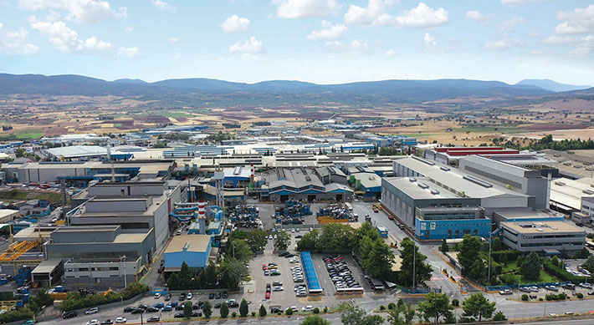
Notes:
SDT Int est une société belge familiale à taille humaine spécialisée depuis 45 ans dans la fabrication d’appareils de mesures ultrasonores

Slide 3
SDT International – REA HELLAS
Case study CONMONSense

Slide 4
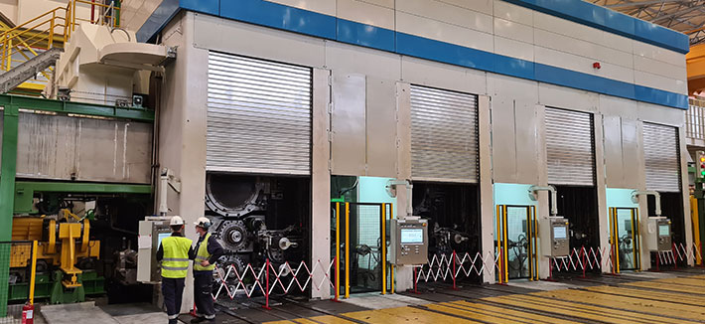
Notes:
SDT Int est une société belge familiale à taille humaine spécialisée depuis 45 ans dans la fabrication d’appareils de mesures ultrasonores

Slide 5
CASE STUDY - CONMONSense OBJECTIVES
The measurements were performed on the casting line.
Distributor: REA HELLAS
Installation of 2 CONMONSense on the output shaft of 1 planetary gearbox. Connected of existing online monitoring system with software.
Rotation speed of the output shaft around 2 RPM.
Target: coupling our sensors with existing online-monitoring systems
Target: demonstration of the effectiveness of the ultrasound measurement concerning the low rotation speed.
Target: collecting data – Static and dynamic measurements

Slide 6
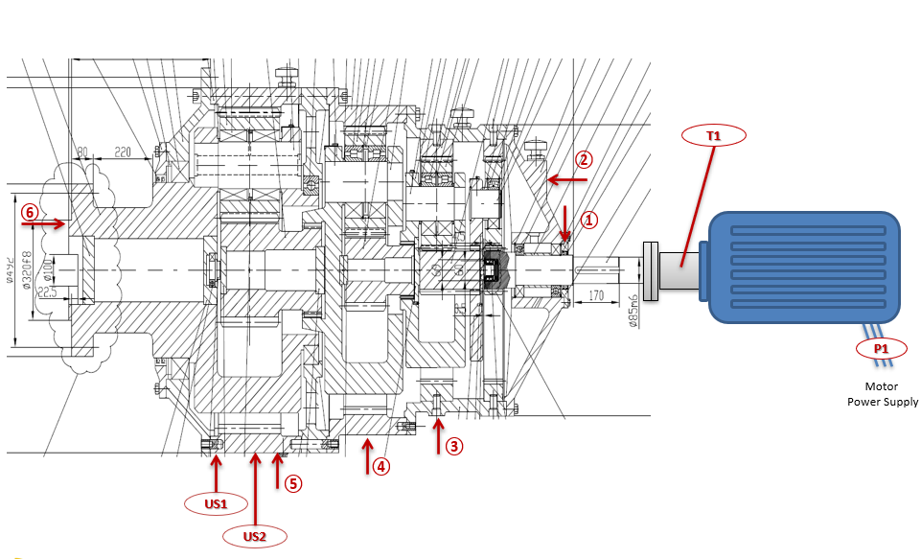
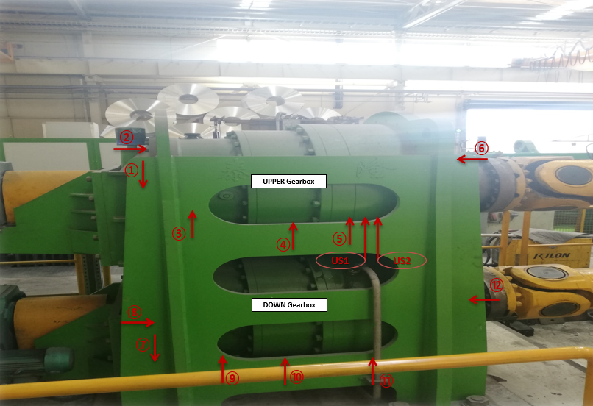
CASE STUDY - CONMONSense ONLINE MONITORING
August 2020: Already installed 2 CONMONSense on 1 planetary gearbox (output shaft). Connected of existing online monitoring system with software.

Slide 7
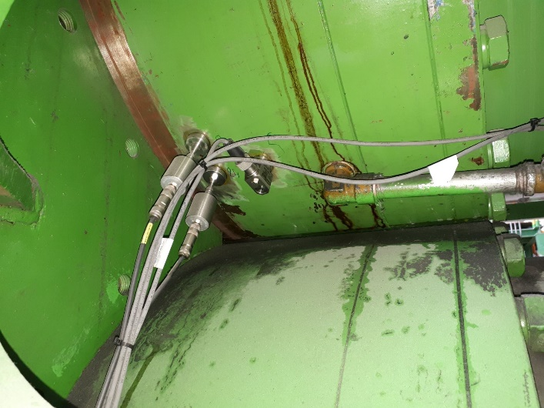
CASE STUDY - CONMONSense ONLINE MONITORING
August 2020: Already installed 2 CONMONSense on 1 planetary gearbox (output shaft). Connected of existing online monitoring system of with software.

Slide 8
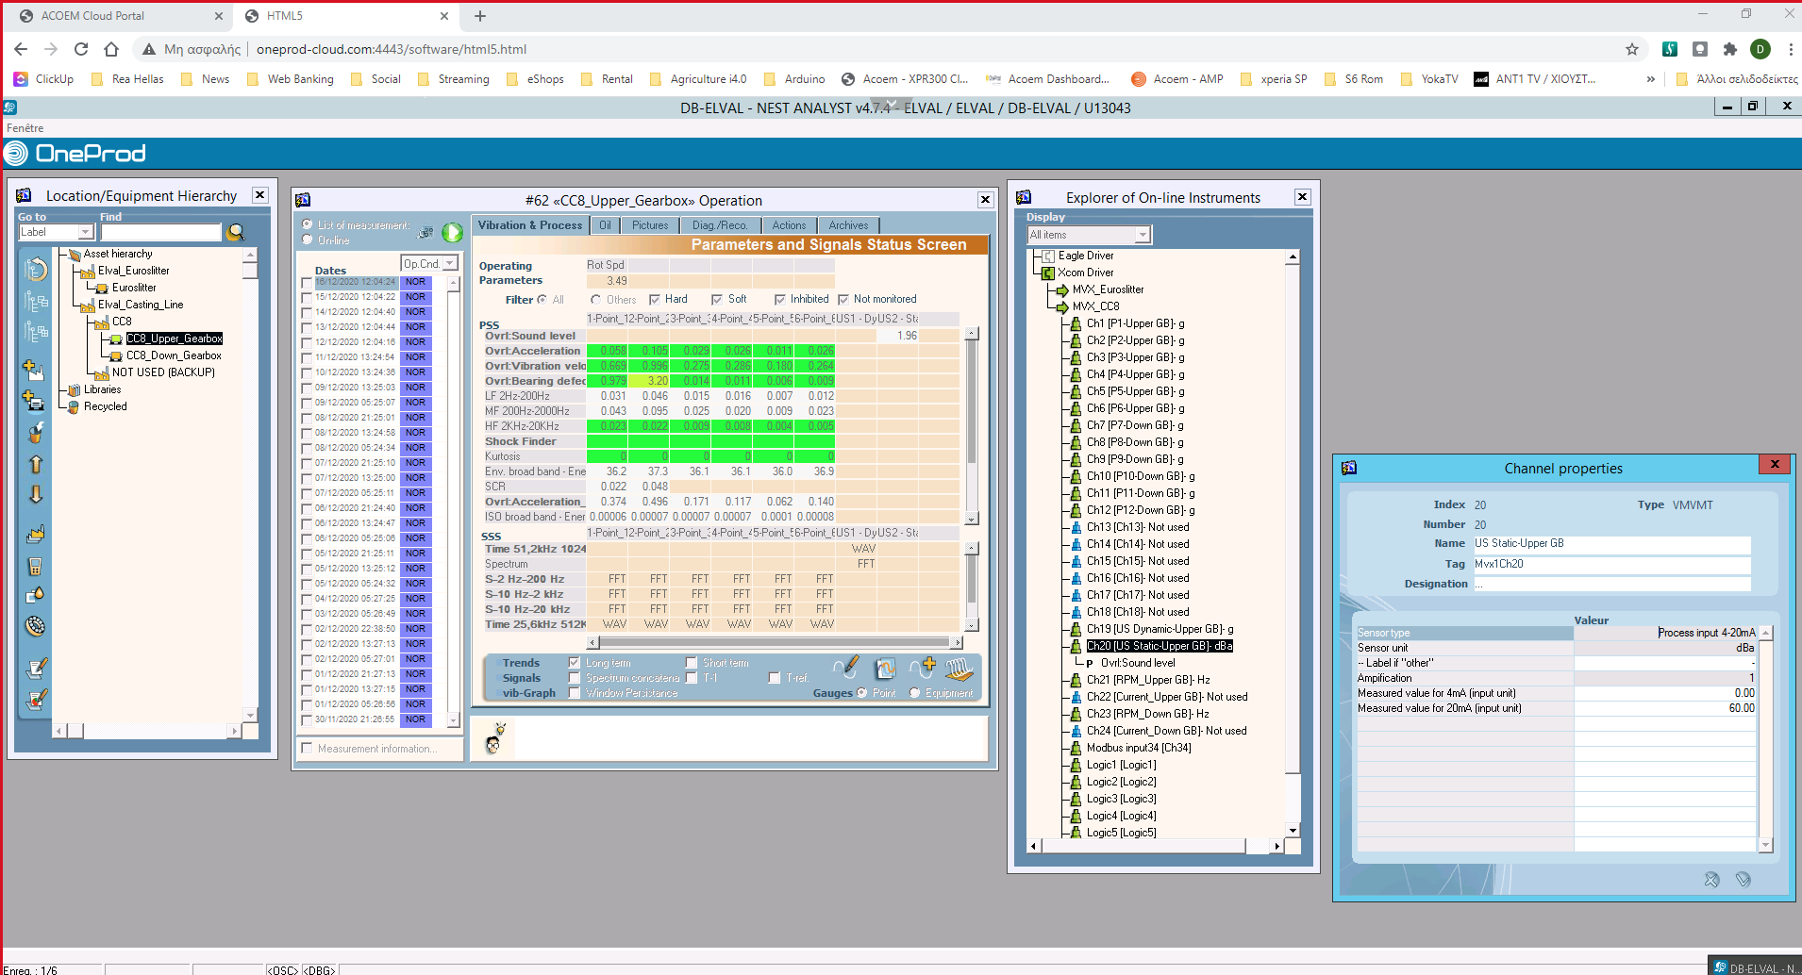
CASE STUDY - CONMONSense SOFTWARE OVERVIEW
4-20 mA
Static measurement on the MATRIX
Channel properties
Setting up
Channel assignation

Slide 9
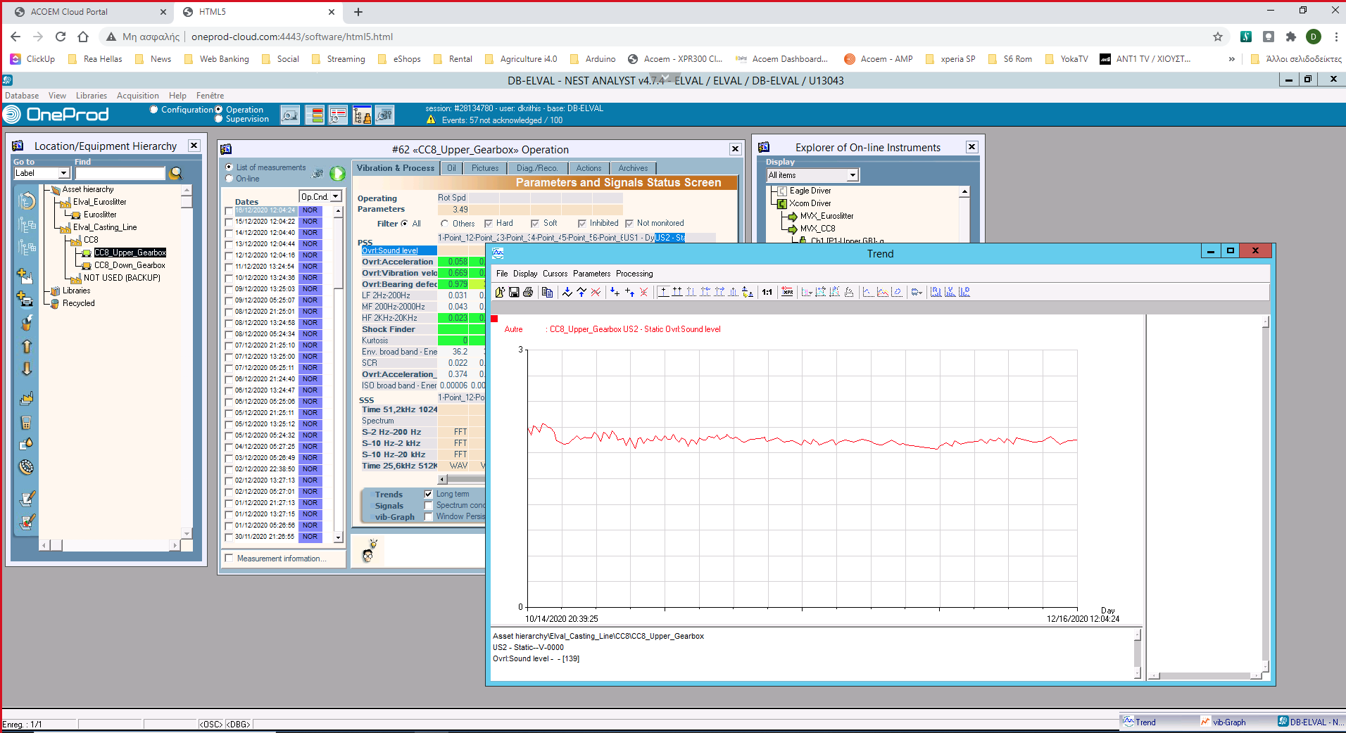
CASE STUDY - CONMONSense SOFTWARE OVERVIEW
Trend curve representation

Slide 10
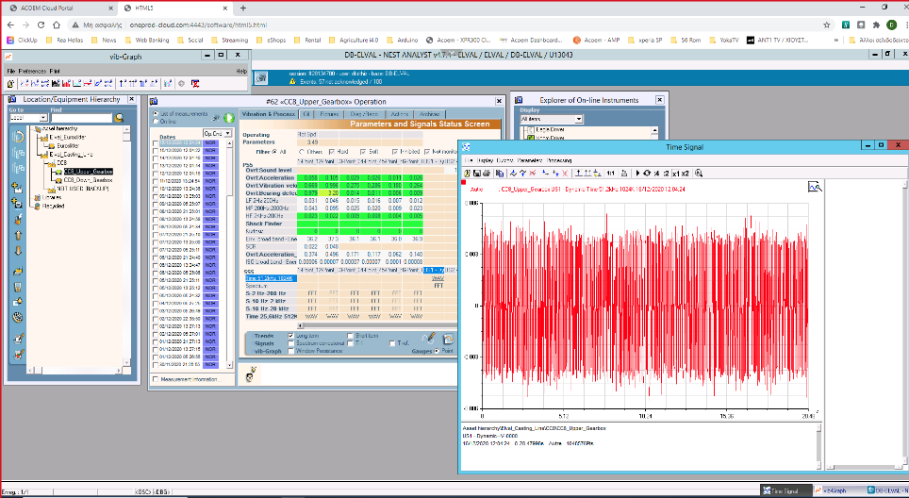
CASE STUDY - CONMONSense SOFTWARE OVERVIEW
Time waveform representation

