Slide 1
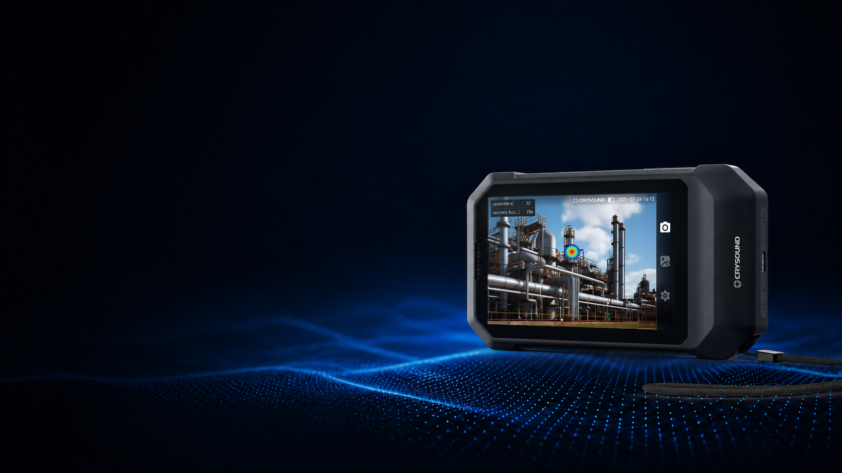


CRY8025
THE POCKET
Acoustic Camera
Measure Sound Better.
Bart De Moor
Growth Director EMEA
Bart.demoor@sdtultrasound.com

Slide 2
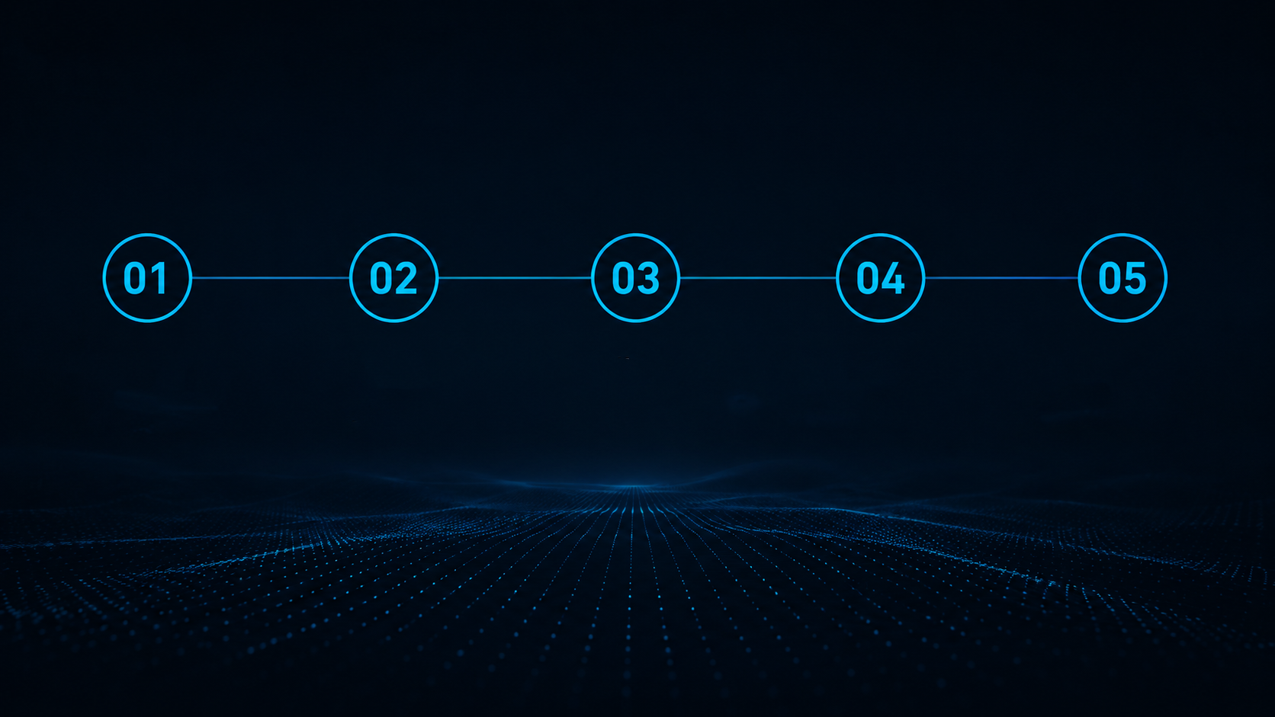
｜Table of Contents
Overview
Benefit
Application
Advantage
Thank you!

Slide 3

01
Overview

Slide 4
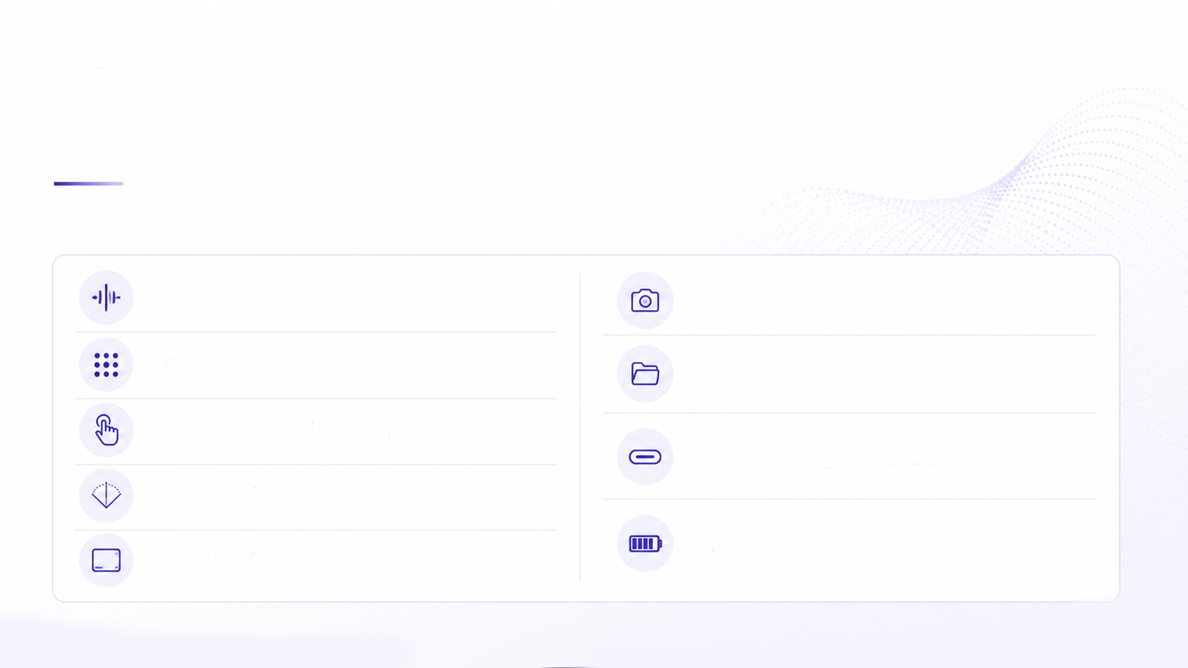
｜Overview of CRY8025
Pocket-Portable, Field-Ready
Ultra-portable acoustic imaging for daily inspection
2k to 65k Hz bandwidth
Camera : 5M pixels
64 MEMS microphone array
Storage : 32 GB
4.3 inches touch screen
Data Exchange: USB-C and Wi-Fi
Field of view : 66° (H) × 52° (V)
Battery Operating Time : up to 3 hours
Display : 4.3 inches touch screen

Slide 5


｜Overview of CRY8025
270g for
Daily Field Inspection
150 × 83 × 27.5 mm
Pocket Size
270g
Lightweight

Slide 6
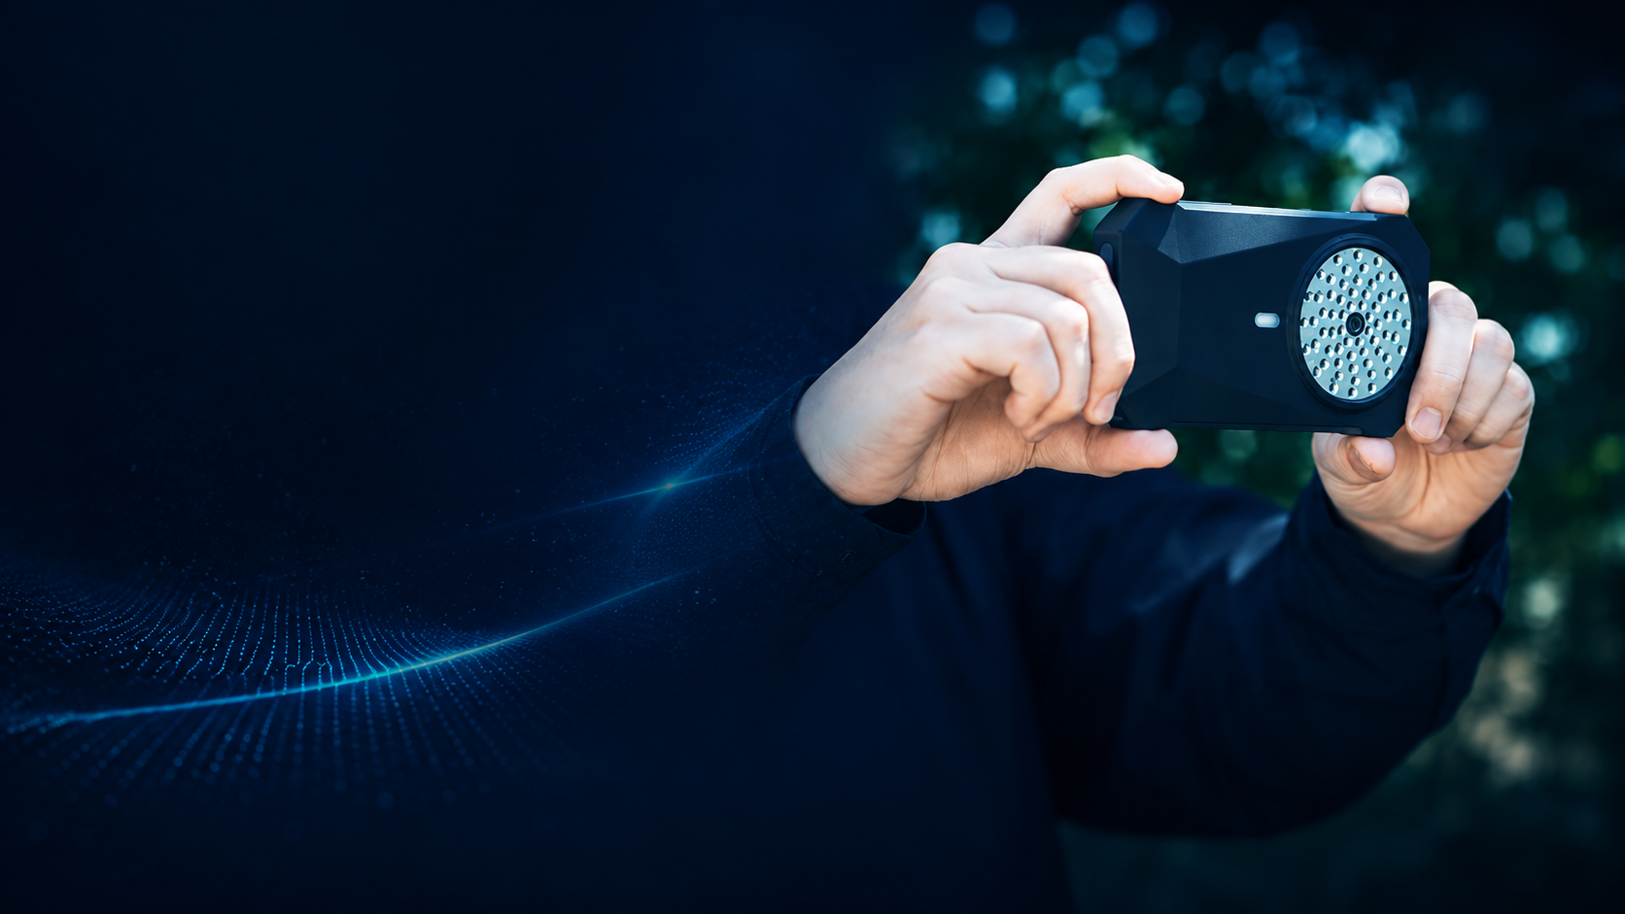
｜Overview of CRY8025
Point.
Scan.
Locate.
Find hidden problems in seconds
Compressed
air leaks
Mechanical
anomalies
Vacuum
leaks
Electrical
discharge

Slide 7
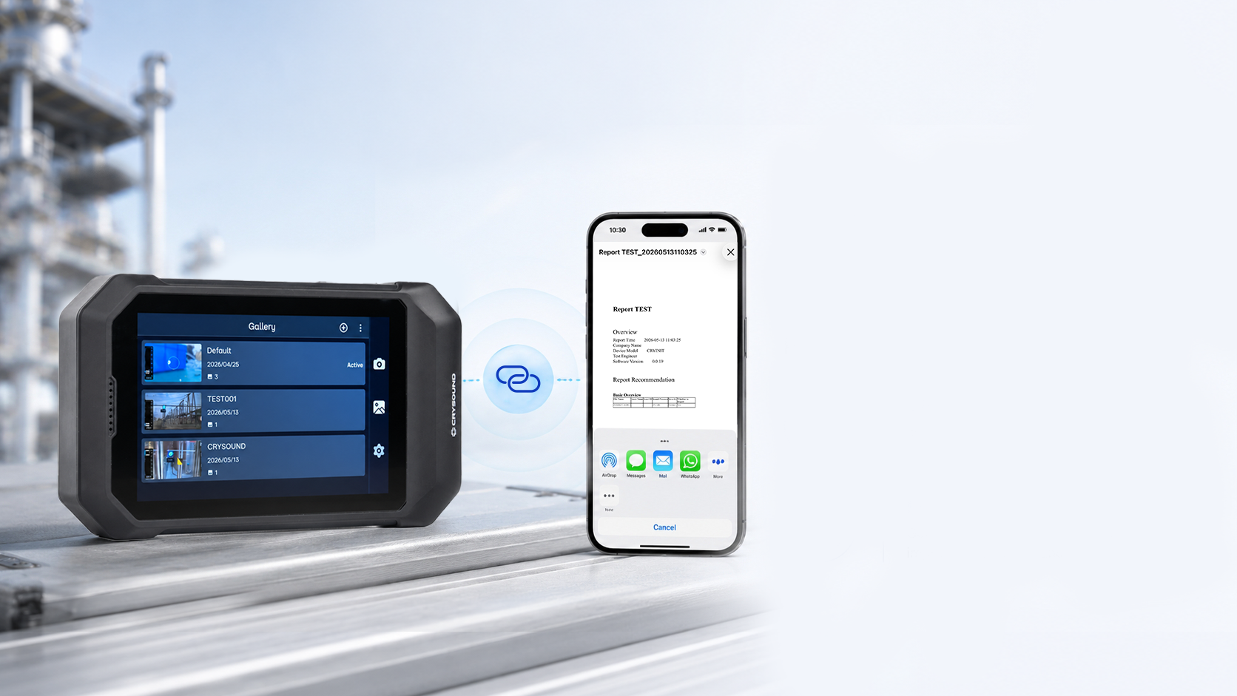
｜Overview of CRY8025
Share Detection
Data Instantly
Cable-Free Reporting in Seconds,
Perfect for Work Collaboration
Direct to Smartphone
Send data wirelessly to your phone in a tap via Wi-Fi.
Share Before You Leave the Site
Share reports to your team instantly, improving efficiency and decision-making.

Slide 8
02
Benefits

Slide 9
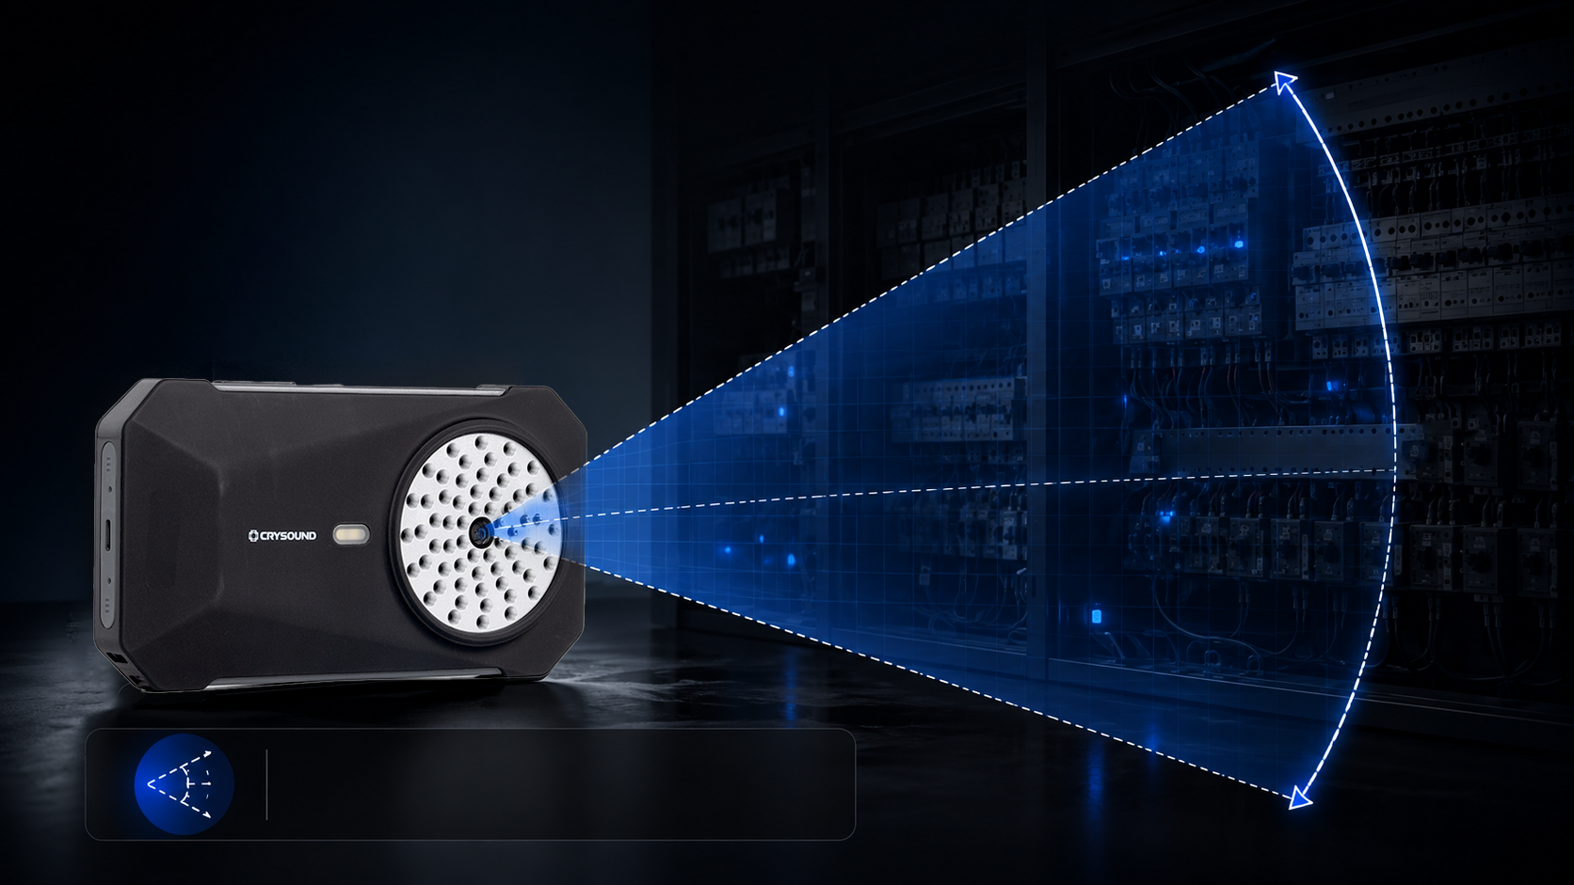
｜Advantage & Benefit
See More，Move Less
Wide Field of View Captures
Larger Areas in a Single Scan
66° × 52°
66° × 52°
Wide Field of View

Slide 10
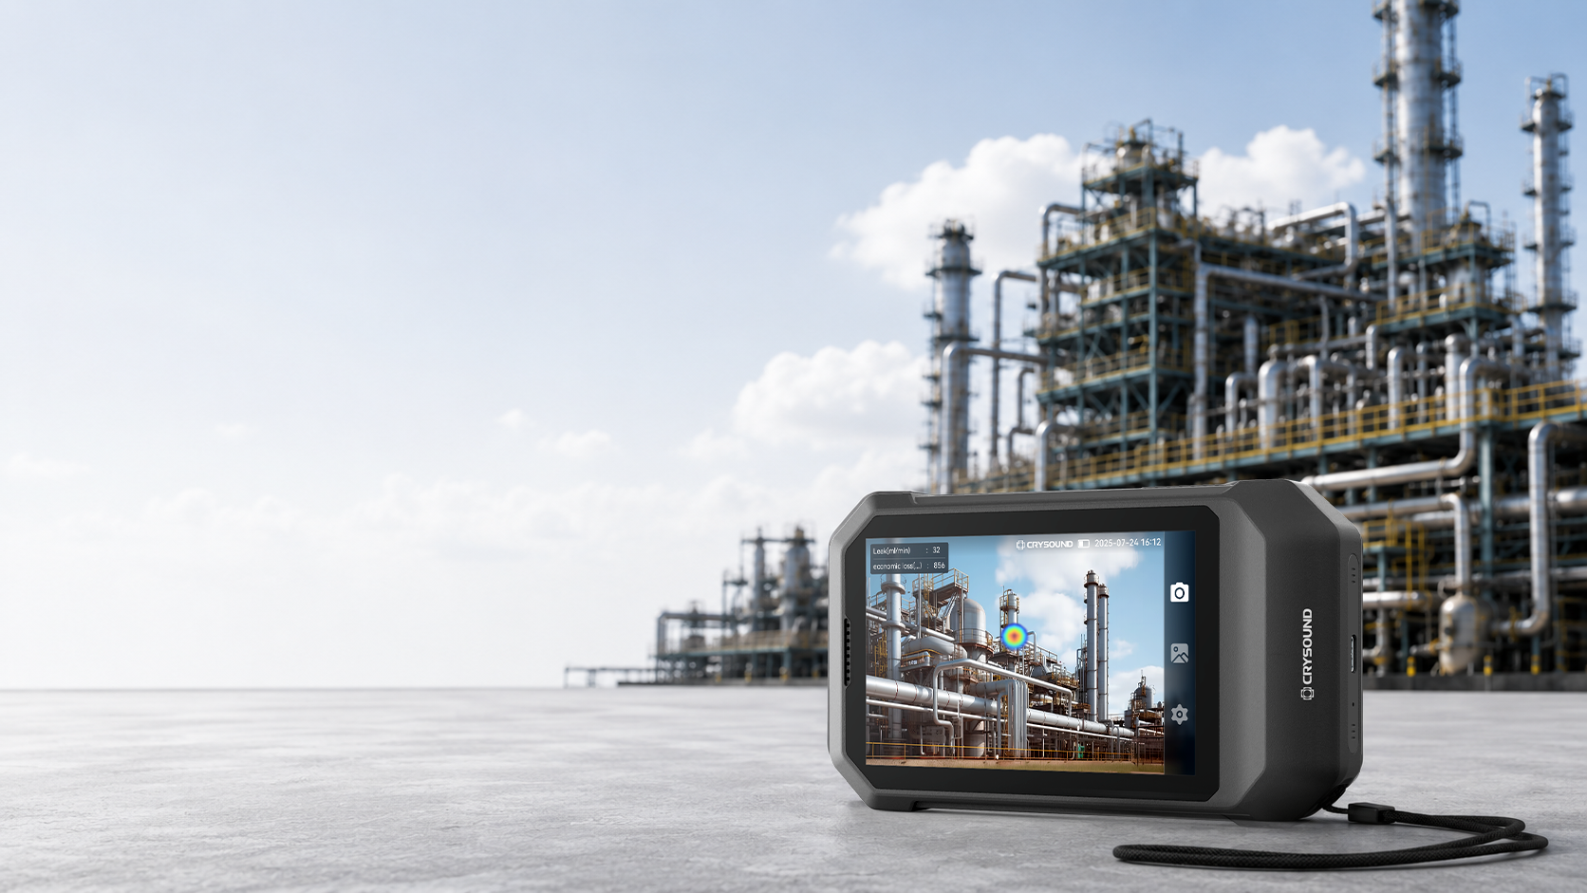
｜Advantage & Benefit
Non-Contact,
Faster and Safer.
Pinpoint leak source and partial discharge without
contact from close range to long distance.
Real-time
acoustic imaging
Faster than soap tests
and manual ultrasonic probes
Safer inspections in
complex and hard-to-reach areas

Slide 11
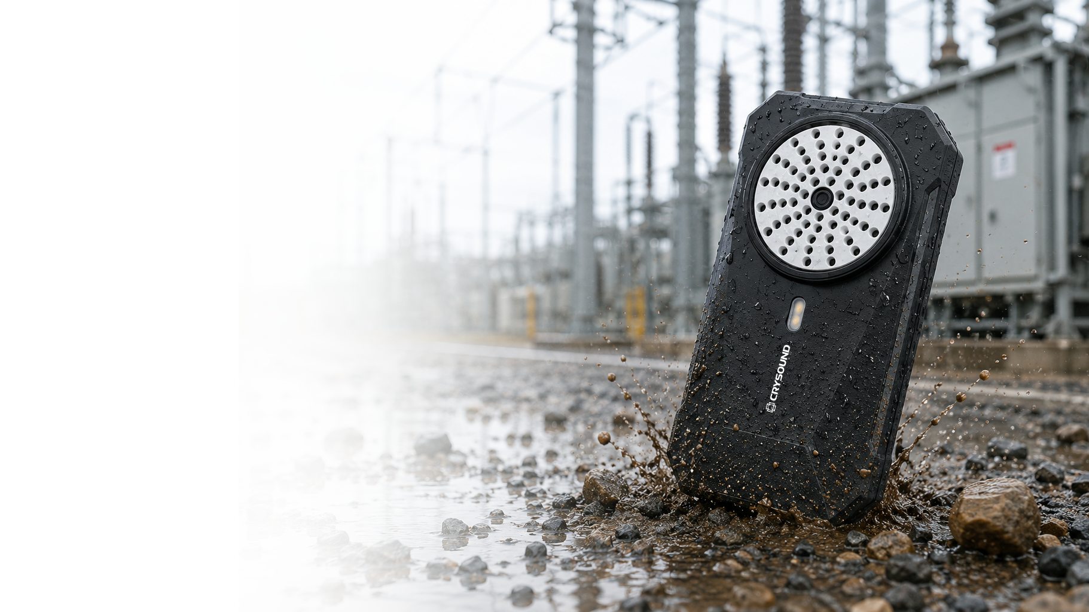


｜Advantage & Benefit
Compact and Durable
IP54
1.5 m
Protection
Drop-Tested
Built to withstand demanding industrial
environments and everyday handling.

Slide 12

03
Applications

Slide 13

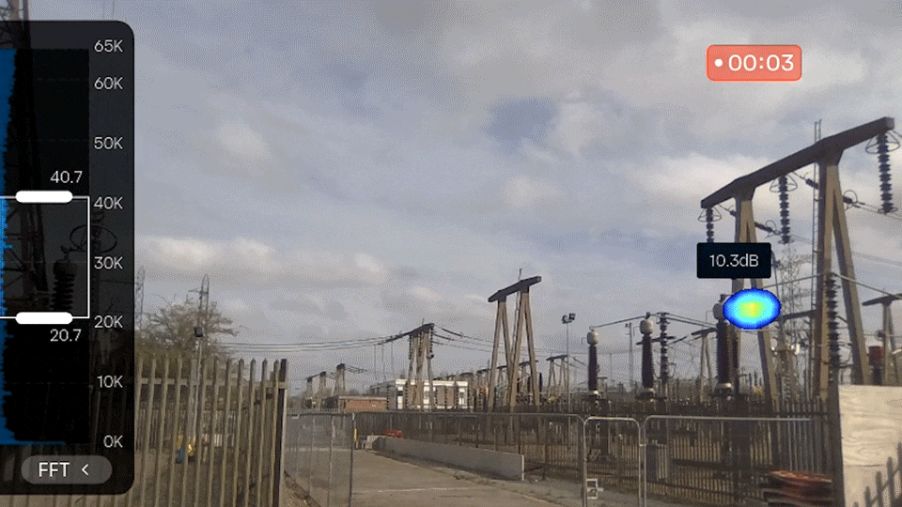
｜Application
Partial Discharge Screening
Point. Scan. See.
Non-contact PD Inspection
Real-time Visualization
Easy Problem Localization

Slide 14
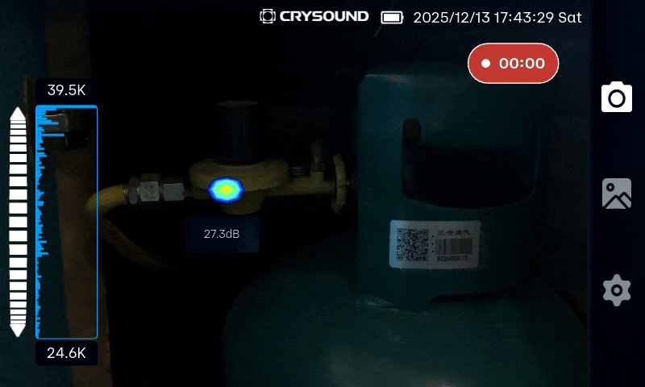
｜Application
Gas / Compressed Air / Vacuum Leak Detection
Detect leaks earlier. Repair faster. Save energy.
Portable inspection
Fast leak detection
Lower energy loss

Slide 15
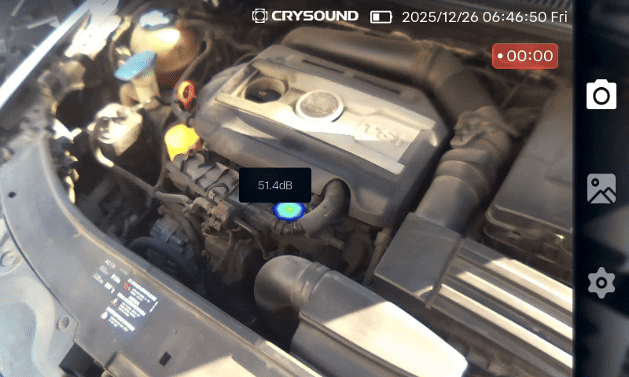
｜Application
Abnormal Noise Location
Hear the issue. Pinpoint the source.
Fast Source Localization
Real Time Acoustic Imaging, Less Guesswork
More Efficient Repairs

Slide 16
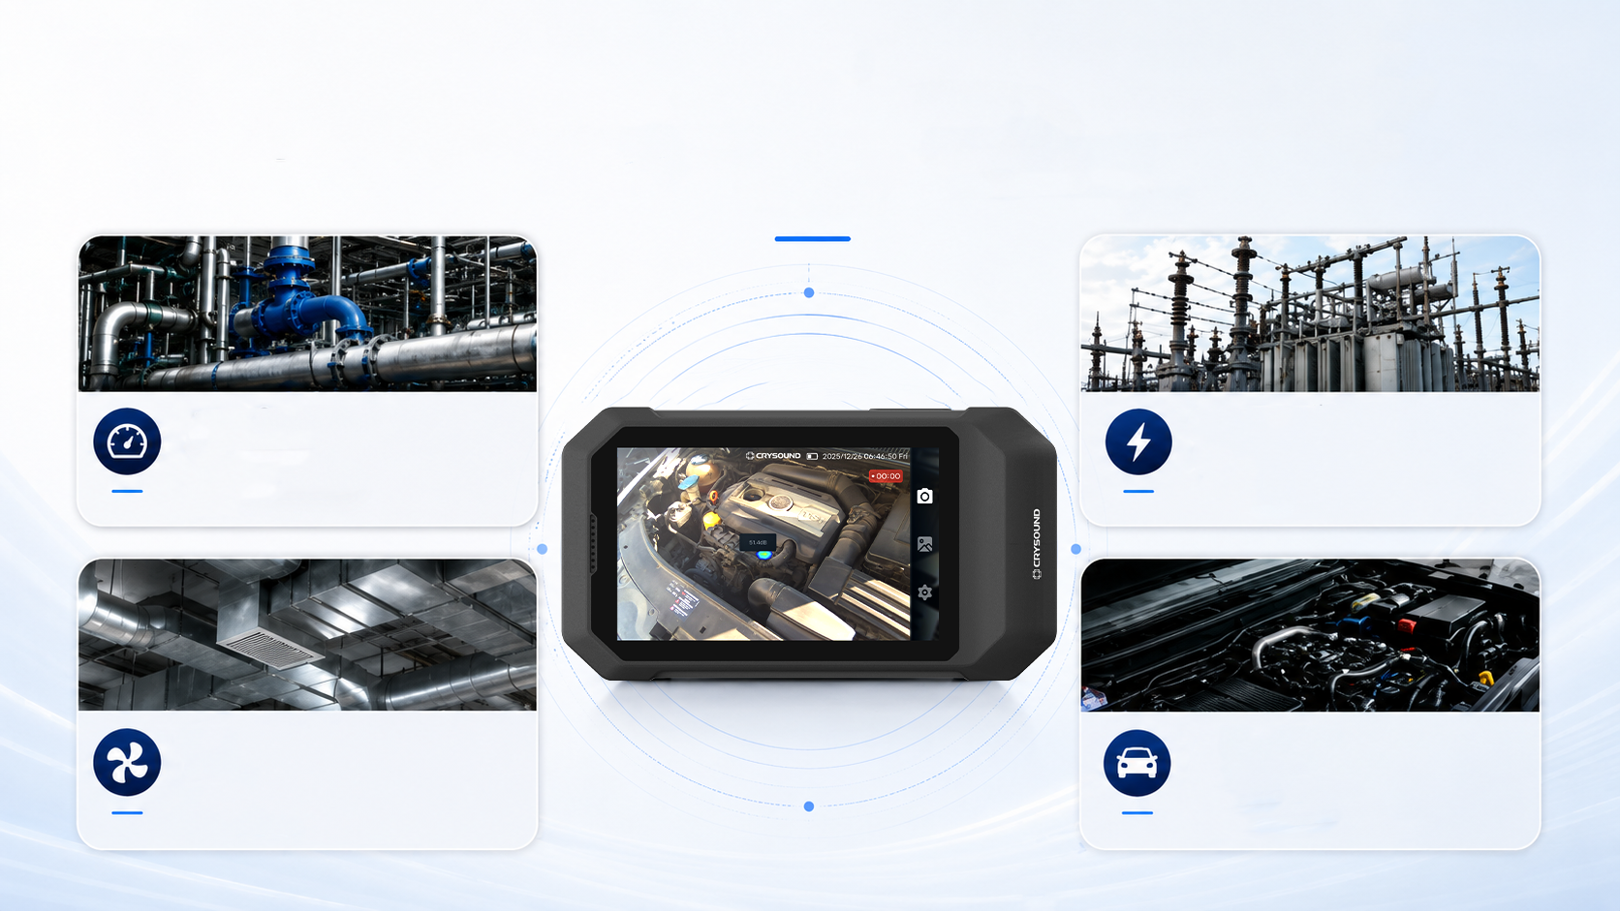
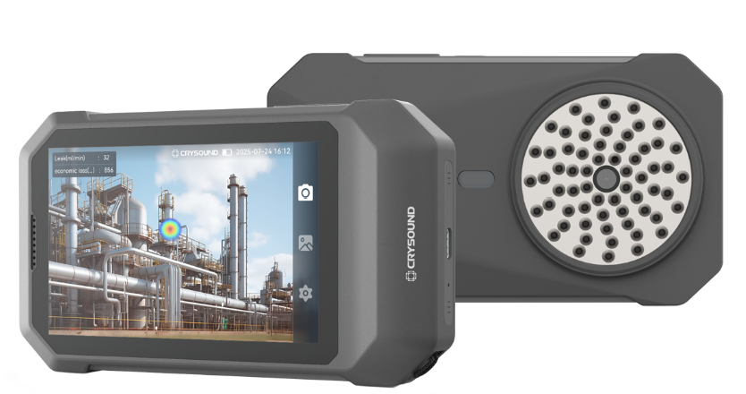
｜Application
Non-Contact Acoustic Imaging Inspection
Safer distance, faster decisions, accurate localization
Compressed Air and Vacuum Leaks
Partial Discharge
Screening
HVAC
Troubleshooting
Automotive
Noise Diagnosis

Slide 17
04
CRY8024 vs CRY8025

Slide 18

｜CRY8024 vs CRY8025
Choose the Right Model
Fast field inspection or professional analysis — select the workflow that fits your team.
Item | CRY8024 | CRY8025
Positioning | Quick locate + quick mobile reporting | Analysis, assessment + formal delivery
Recommended users | Frontline inspectors, self-purchased users, lightly skilled teams | Distributors, OEMs, industrial customers, technical service teams
Basic leak detection | √ | √
Basic PD detection / localization | √ | √
Quick mobile reporting | √ | √
Leakage assessment | — | √
PC software | — | √
Professional report output | — | √
CRY8024 for fast field work. CRY8025 for complete analysis and reporting.

Slide 19
04
Advantages

Slide 20
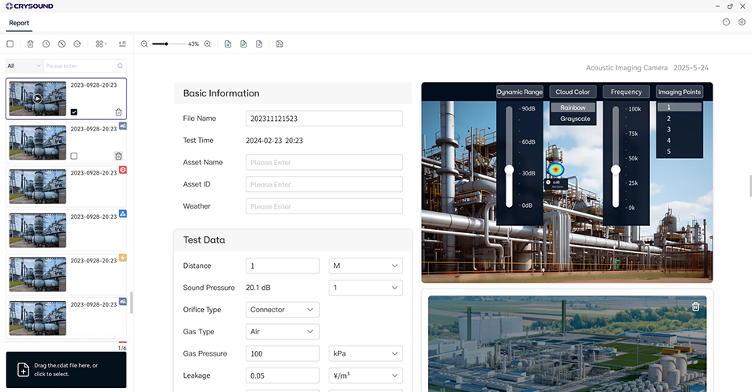

｜CRY8025 Advantage
Real-time Leak Rate Quantification
PC Software
Post-process data and deliver professional reports.
Evaluate leaks. Prioritize repairs.
Evaluate leaks. Prioritize repairs.
Get precise leak rate data for every detected gas leak.
Estimate economic loss automatically
Calculate annual energy cost based on real operating data.
Support repair prioritization
Focus on high-impact leaks and maximize returns.
Example Annual Impact*
Import via Wi-Fi or USB-C
Estimated Annual Loss
Estimated Repair Cost
Transfer acoustic imaging data seamlessly.
Estimated Annual Savings
Edit reports in real time
€ 40,000
€ 6,800
€ 33,200
Review and adjust results directly in the software.
Generate professional report output
*Actual results vary based on system conditions and local energy costs.
Export leak images, data, annotations, and loss estimates—ready to share and act on.

Slide 21
THANK YOU
Measure Sound Better
Bart.demoor@sdtultrasound.com

