Slide 1
Preventive maintenance with ultrasound

Slide 2
Theory of ultrasound

Slide 3
Frequency range of sound
Infrasound < 20 Hz.
Sound : between 20 Hz up to 20 kHz.
Ultrasound = > 20 kHz.
Infrasound
sound
Ultrasound
Sound frequencies
20 Hz
16 KHz/20 KHz

Slide 4
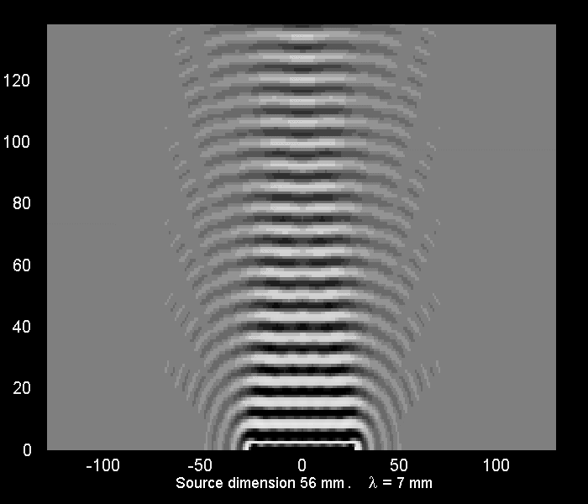
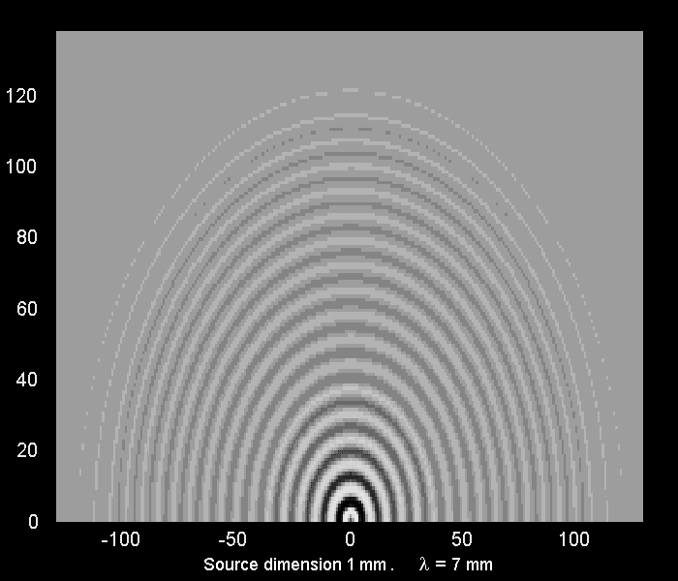
Caracteristic of ultrasound
Ultrasound : concentrated energy
around the propagation of the axis
=> Directionals.
Sound : energy dispersed
around the propagation of the axis
=> Multidirectionals.

Slide 5
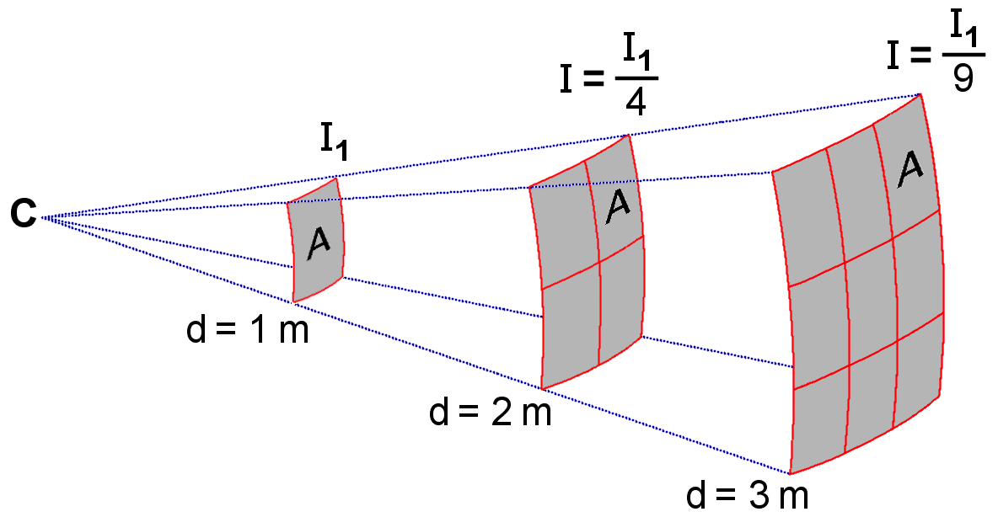
Caracteristic of ultrasound
Ultrasound :
low energy
geometric dispersion
attenuation frequency/distance
Faster absorbed.

Slide 6
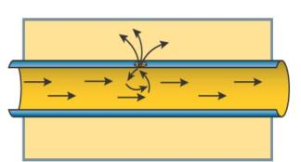
Origins of ultrasound
Turbulences
  Leaks of air compressed, gas or vaccum
  Leaks of hydraulic circuit
  Leaks of steam circuit
Shocks and friction
  Bearings and gears
  Lubrication
  Pump cavitation
Partial discharges
  Corona effect
  Tracking
  Arcing

Slide 7
Overview of the applications

Slide 8
Applications
Air compressed/vaccum/gas
Steam traps/valves
Lubrication
Mechanical
Electrical
Control of tightness

Slide 9
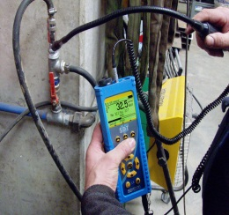
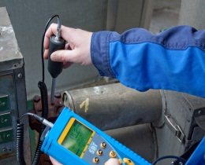
Applications
Energy saving program
Maintenance applications
Air compressed
vaccum/gas
Lubrication
Mechanical
Electrical
Steam traps/valves
Reduce the energy cost
Increase the avaibility of the rotating machines
→ Preventive maintenance

Slide 10
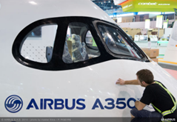
Applications
Control of thightness
Quality control

Slide 11
Energy saving program

Slide 12
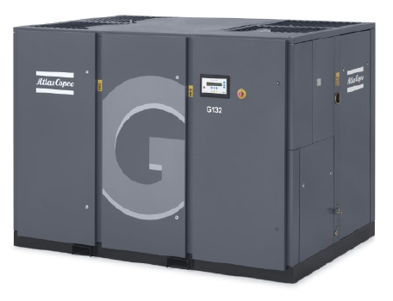
Air compressed
The main application covered by the ultrasound
Precognized by the major actors of this market
  Atlas Copco
  Festo
  Kaiser
  Ingersoll Rand
ROI instantanous

Slide 13
Air compressed
Consumption of the equipment | 43 %
Inappropriate use | 16 %
Purged air | 5 %
Faulty valves | 2 %
Leaks | 34 %
International average: from ADEME

Slide 14
Air compressed
Without maintenance program of leaks detection, network losses is around 30 to 40 % of the total consumption.
With maintenance program of leaks detection, network losses is 5 % of the total consumption.

Slide 15
Air compressed
3 reasons to do in priority a maintenance program to look for the leaks:
Low investment is required
The highest economy source
ROI very fast.

Slide 16
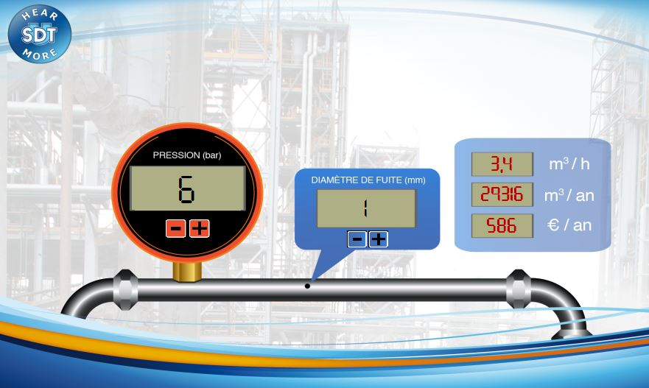
Air compressed
International average: from ADEME

Slide 17
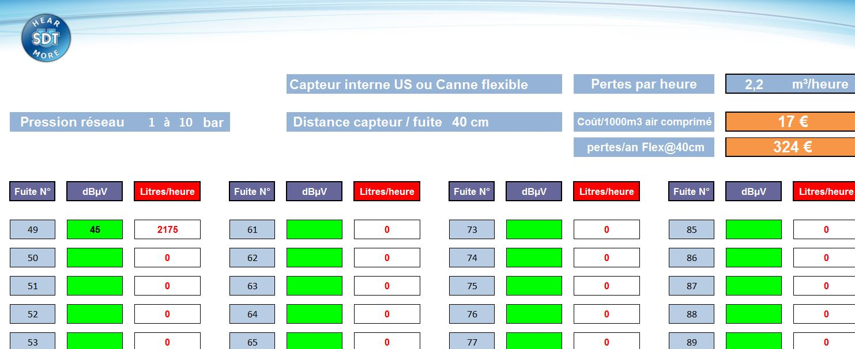
Air compressed
Developped in collaboration with ATLAS COPCO

Slide 18

Air compressed

Slide 19
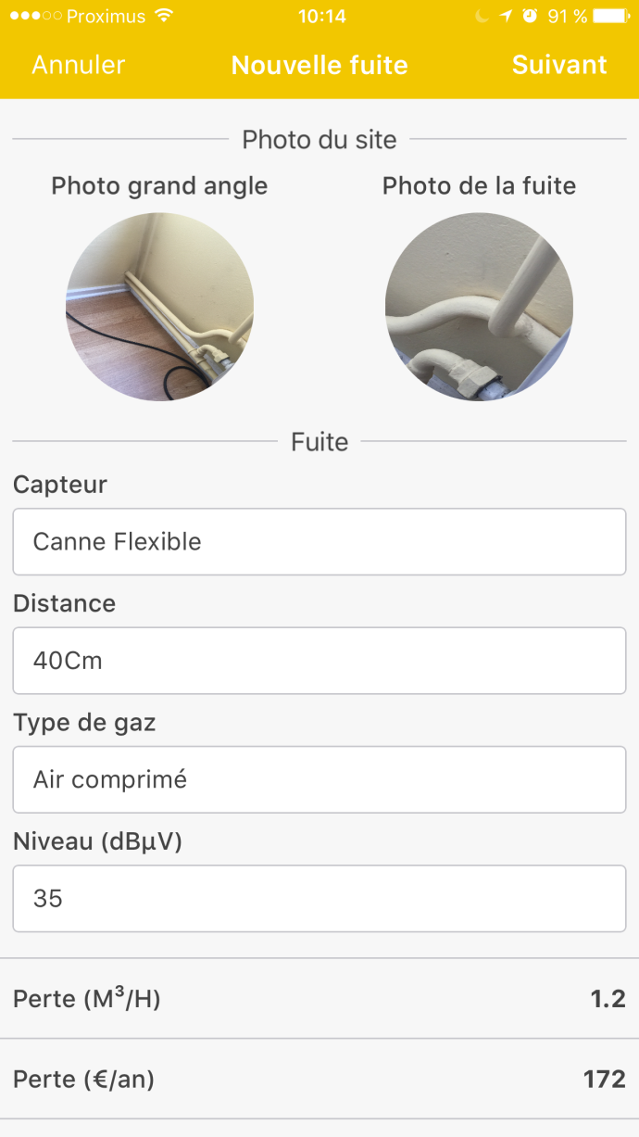
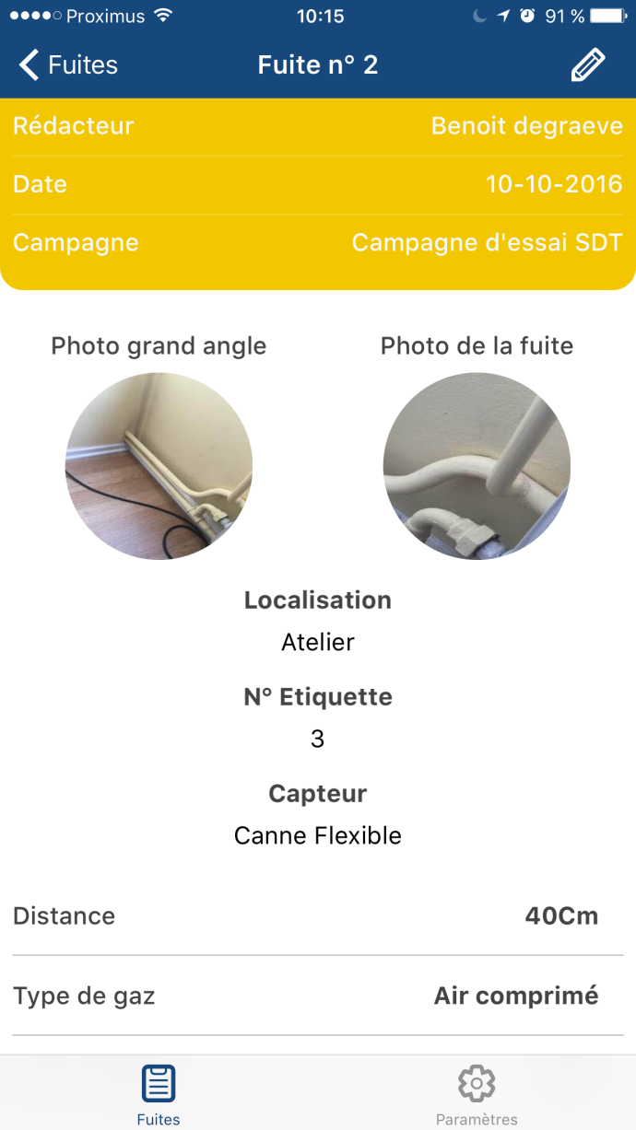
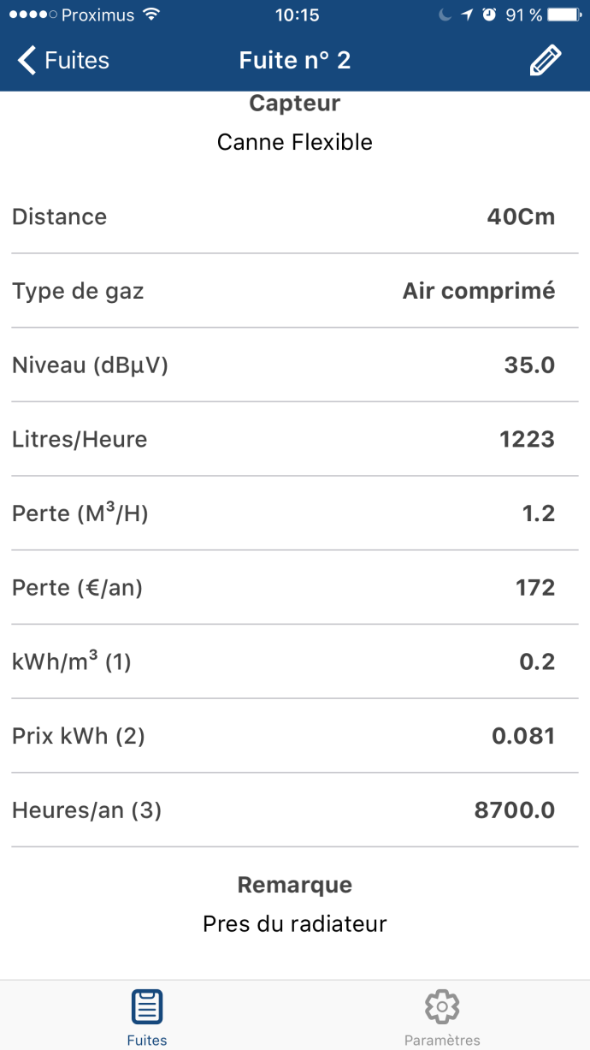
Air compressed

Slide 20
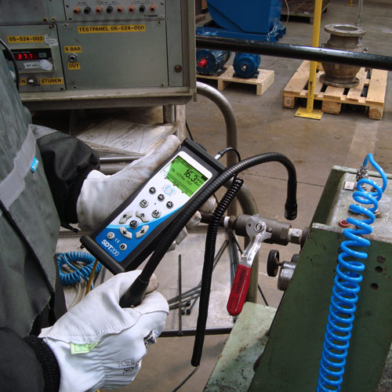
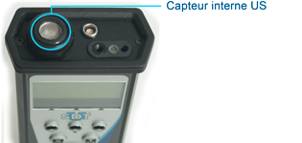
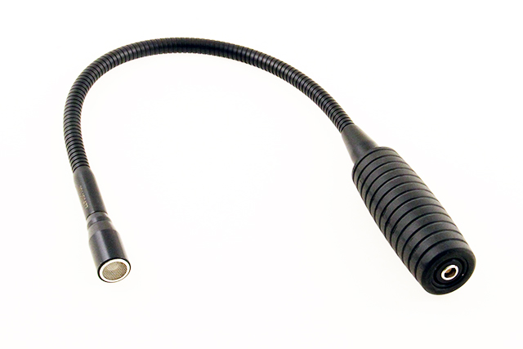
Air compressed
Sensor choice
Airbonne sensor in short distance (up to 2m) :
- Internal US sensor: close to the inspected element.
- Flexible rod: close and difficult acces zones

Slide 21
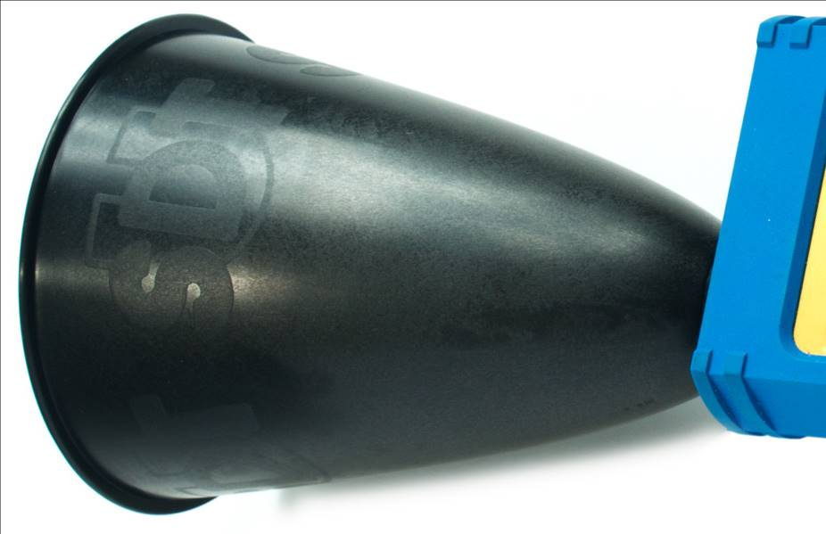
Air compressed
Sensor choice
Airbonne sensor in medium
distance (up to 5 m): internal sensor
+ EDS (Extended Distance Cone)

Slide 22
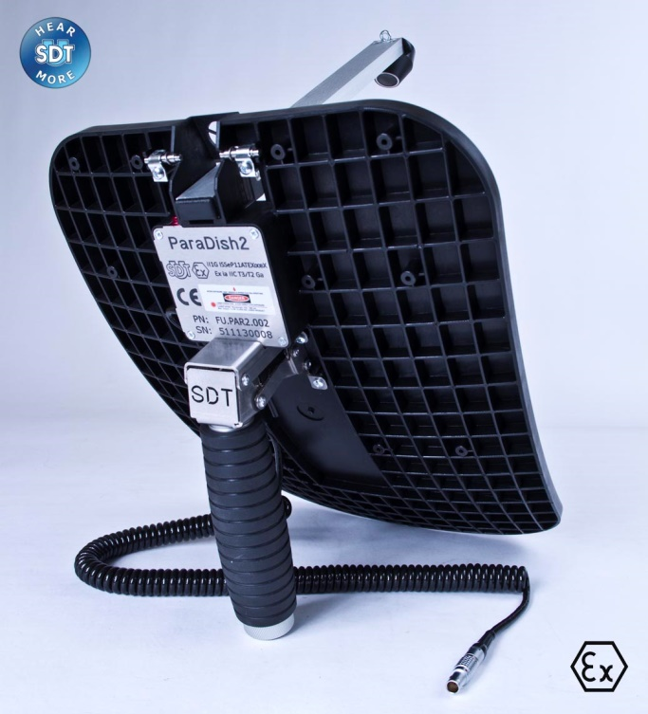
Air compressed
Sensor choice
Airbonne sensor in long distance:
(5m up to 30 m)
Parabol dish

Slide 23
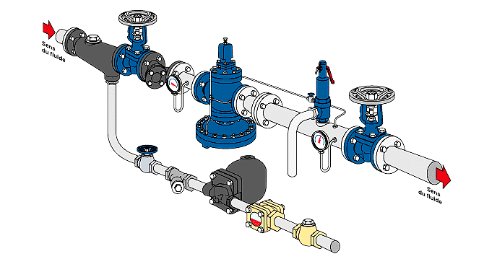
Steam traps
Precognized by the major actors of this market
  Spirax
  Armstrong
  TLV
  Blok
Easy to use
ROI very fast

Slide 24
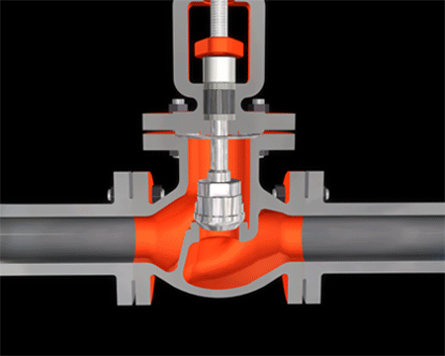
Steam traps
Reminder
Steam traps are automatic valves which must open for draining condensate, air and CO2 and must be closed for maintaining live steam.

Slide 25
Steam traps
3 possibilities
Failed close:
  Accumulating condensates, air and CO2
    → Hammer shocks
    → Installation dammage
Failed open
  Energy waste
    → Energy overconsumption
    → Deterioration in production quality.
    → Efficiency drop = waste of money
Normal status

Slide 26
Steam traps
Key figures
Cost of steam | 30€/T
Steam traps failed | 20-30 %
Cost of one steam trap failed open | 2.500€/an
International average: from Spirax Sarco

Slide 27
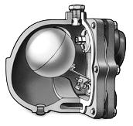
Steam traps
Example
Drain orifice ∅ 3mm
  4.000€/year at 6 bar
  6.500€/an at 10 bar
International average: from Spirax Sarco

Slide 28
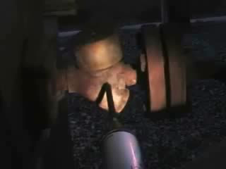
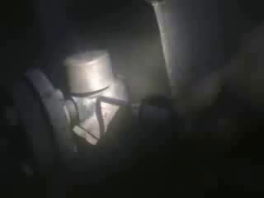
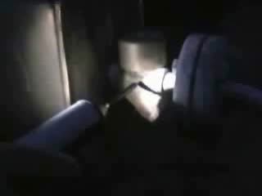
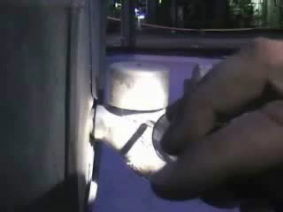
Steam traps
Examples

Slide 29
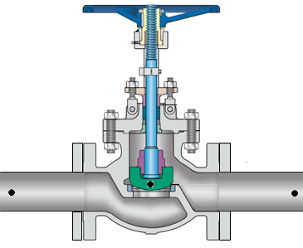

Valves
Methodologies
If the valve is leaking, the valve seat measurement will be higher.
Collect a measurement upstream, valve seat and downstream.

Slide 30
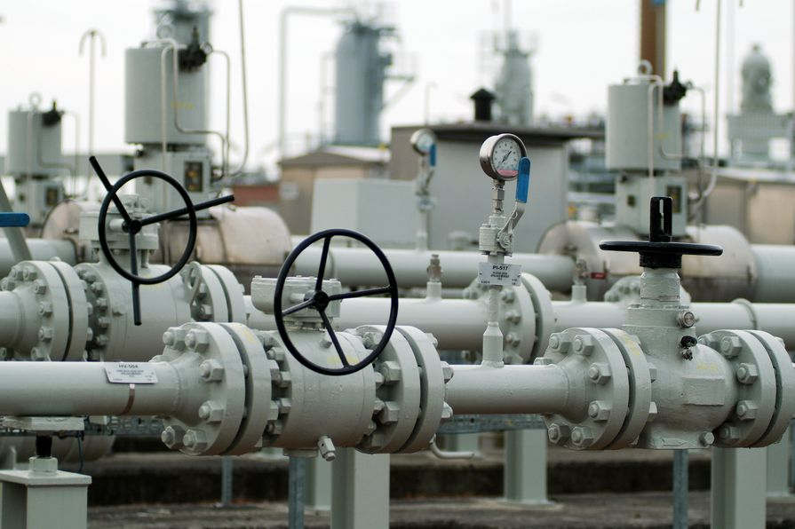

Valves: case strory
independent operator of the natural gas transmission infrastructure in Belgium

Slide 31
Valves: case story
1st methodology: upstrean/body/downstream
Upstream
Body.seat
Downstream

Slide 32
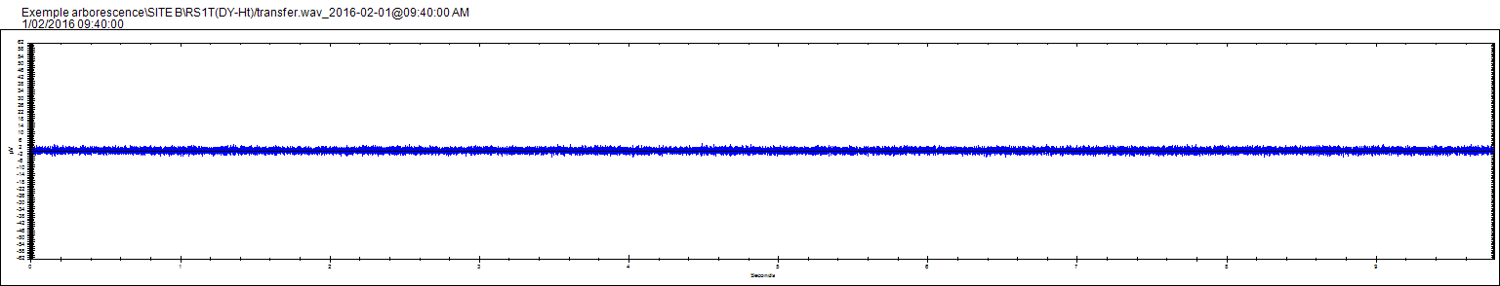

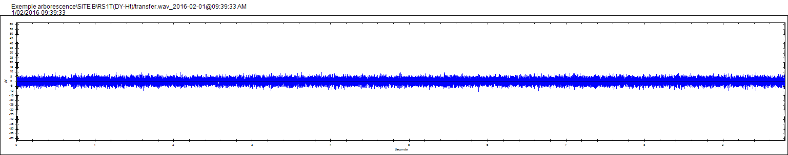
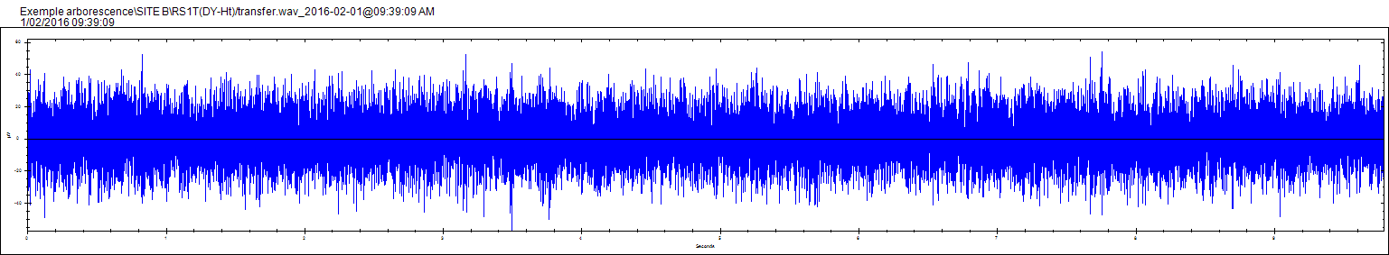
Valves: case story
Upstream
8 dB/µV
Body/seat
10 dB/µV
Downstream
21 dB/µV

Slide 33
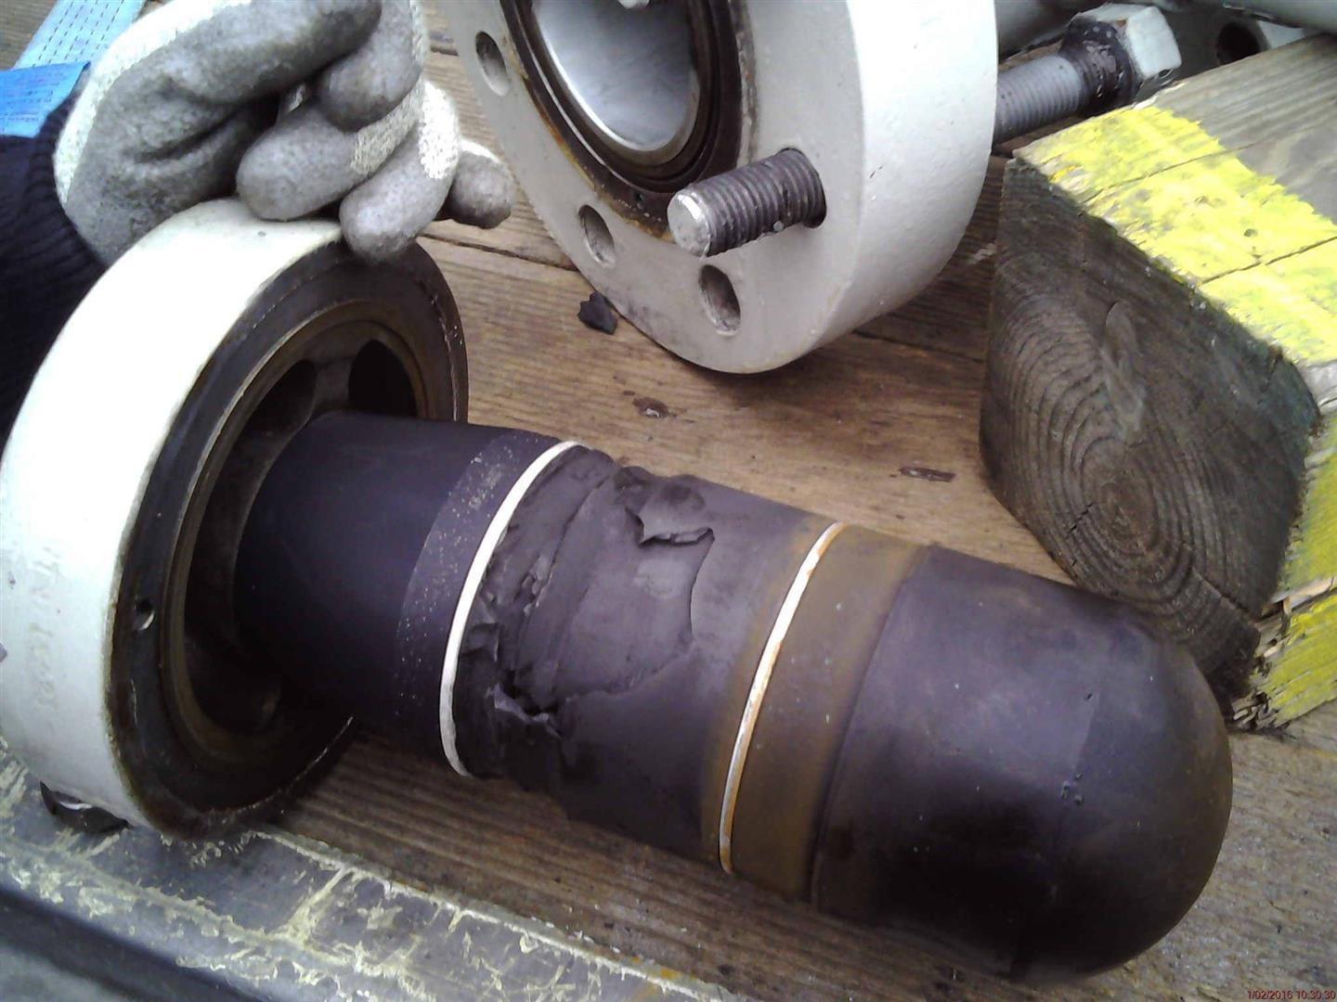
Valves: case story

Slide 34
Applications of rotating machines

Slide 35
Rotating machines
Theorical
Two mechanical phenomena generated US:
  Shocks
  Friction
Several mechanical applications:
  Optimization of the lubrication
  Bearings low/high speed
  Gears
  Pump cavitation

Slide 36
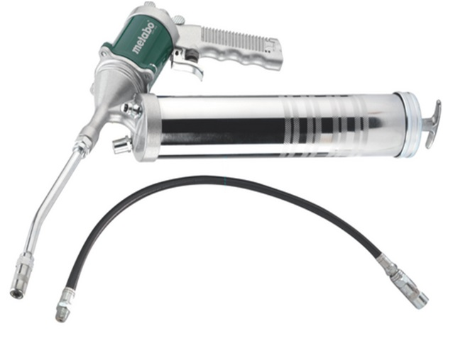
Optimization of the lubrication
Ultrasound is a selective method highlighting bearing and lubrication failures.

Slide 37
Optimization of the lubrication
Key figures
Mechanical failures are due to improper lubrication. | 60%
Bearing failures are due to inappropriate lubrication. | 50%

Slide 38
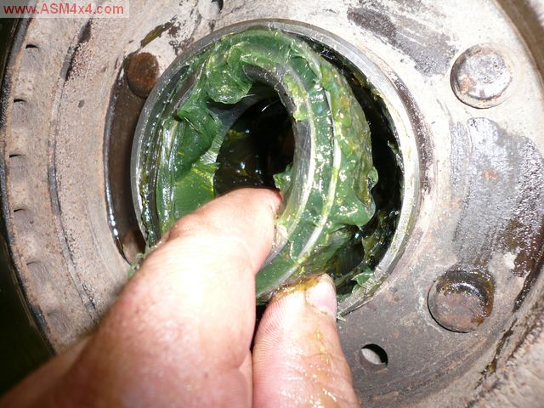
Optimization of the lubrication
3 origins of the bearing failures
Over greased
Inadequate lubricant
Under lubricated

Slide 39
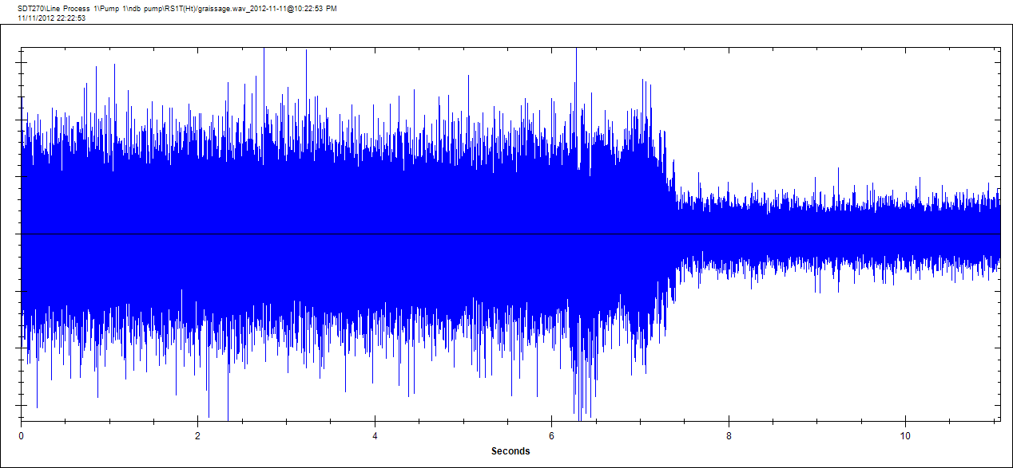
Optimization of the lubrication
Example: perform a bearing lubrification

Slide 40


Optimization of the lubrication
Ultrasound answers the 3 problems posed by lubrication:
Must be re-lubricate?
Which quantity?
What is the periodicity of re-lubrication?

Slide 41
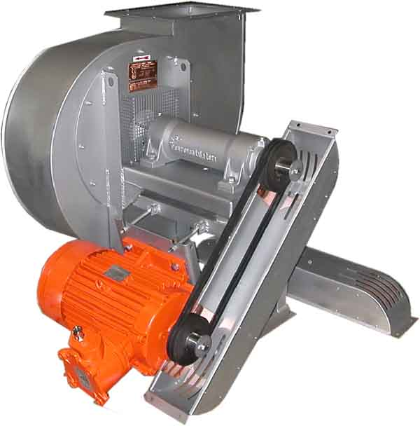
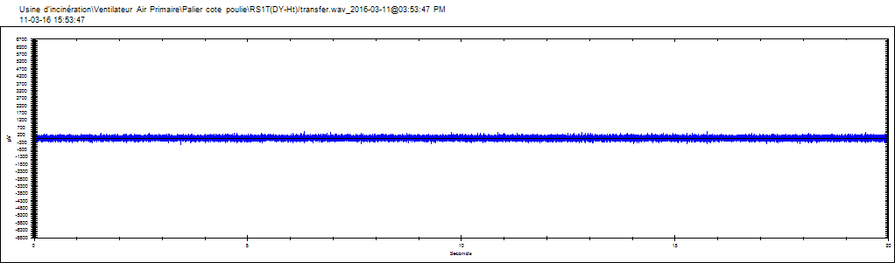
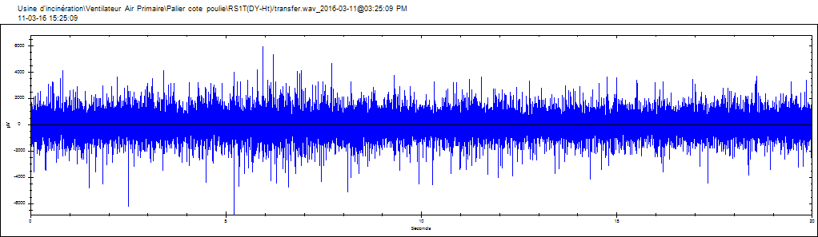
Optimization of the lubrication
Example
ULTRASOUND MEASUREMENTS BEARING PULLEY SIDE
dB µV RMS | dB µV Peak | Actions
54,1 | 75,4 | Before lubrication
37,9 | 53,4 | After lubrication
Before
Lubrication
After
Lubrication
Bearing Pulley side
Palier CA
Fan Bearing Pulley side – After lubrication
Fan Bearing Pulley side – Before lubrication

Slide 42

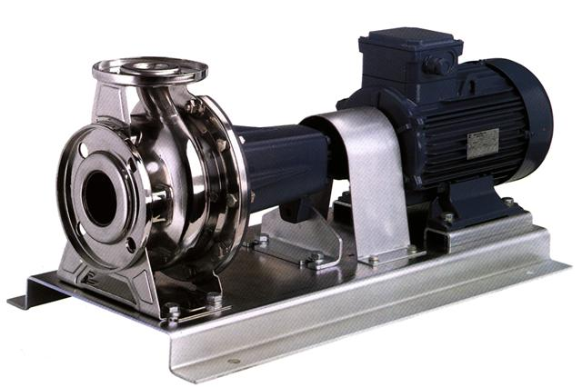
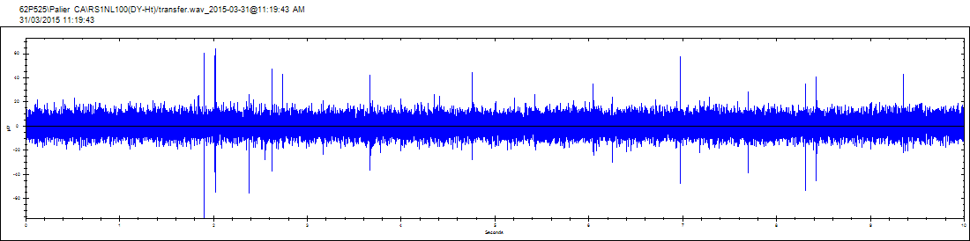
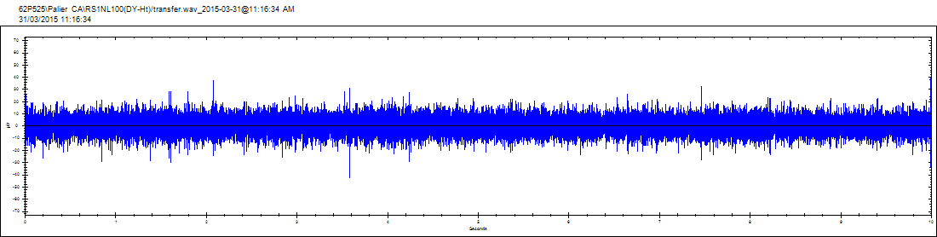
Optimization of the lubrication
Example
Lubrication
ULTRASOUND MEASUREMENTS BEARING END DRIVEN PUMP
dB µV RMS | dB µV Peak | Actions
15,2 | 31,5 | Before lubrication
17,3 | 36,5 | Lubrication
15,2 | 36 | After lubrication
Before lubrication
After lubrication
Shocks
After lubrication
Before lubrication
Bearing End Driven
Bearing non end driven

Slide 43
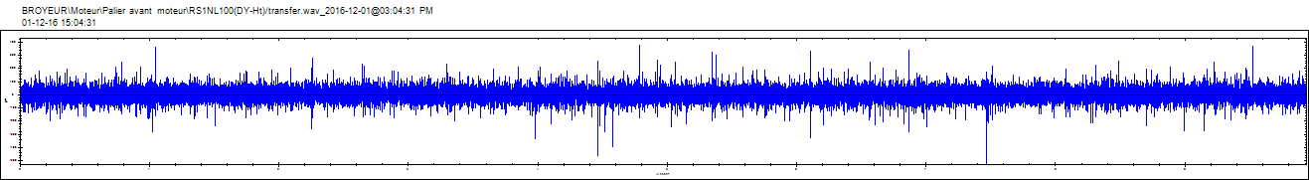
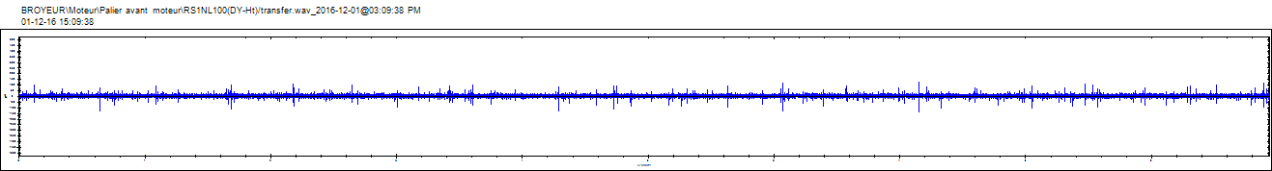
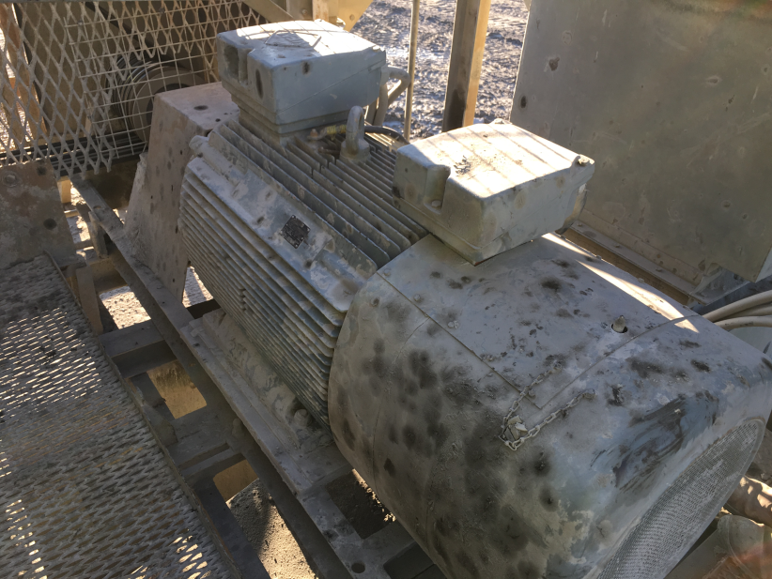
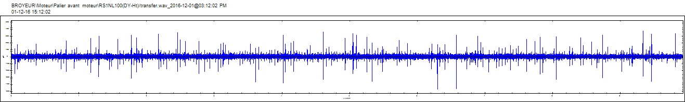
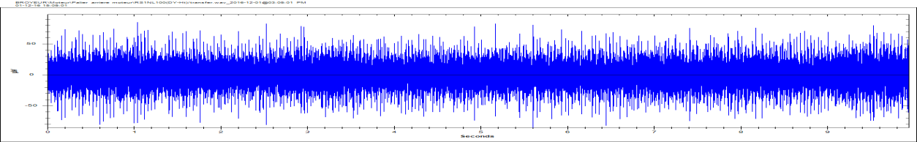
Optimization of the lubrication
ULTRASOUND MEASUREMENTS CRUSHER – ELECTRICAL MOTOR
dB µV RMS | dB µV Peak value | Location
31,9 | 51,5 | DE (Before lubrication)
18,7 | 42,3 | DE (Before lubrication)
26,3 | 51,3 | DE (After lubrication)
23,9 | 38,6 | NDE
Electrical motor DE – Before lubrication
Electrical motor DE – After lubrication
Zone de chocs
Electrical motor DE – After lubrification
Electrical motor NDE

Slide 44
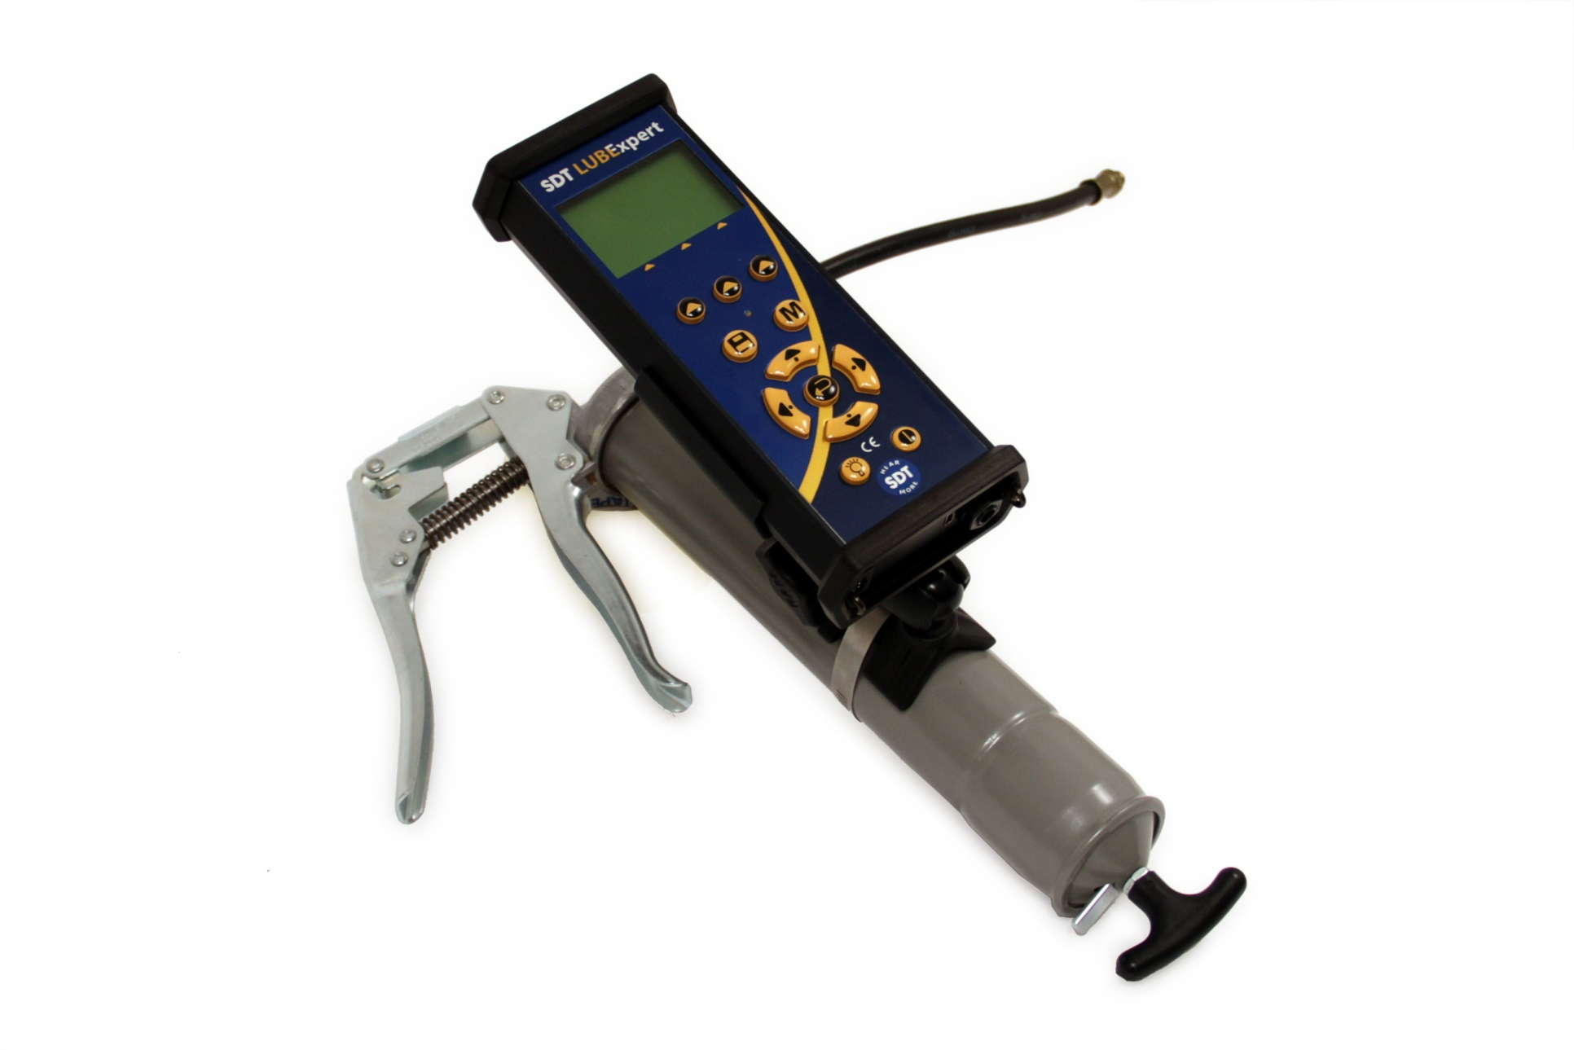
LUBExpert

Slide 45
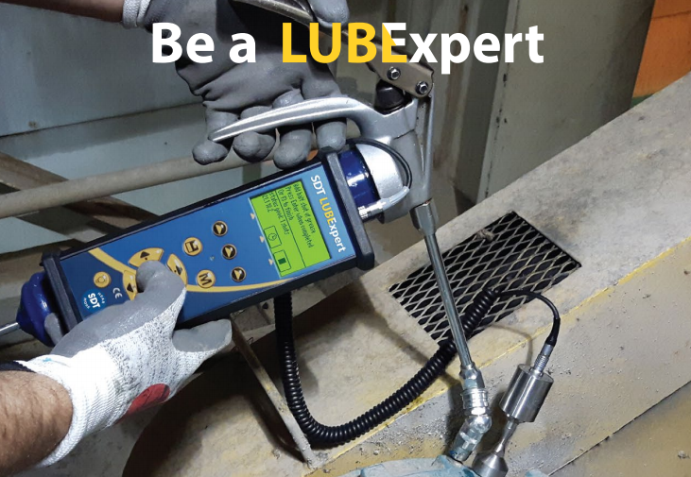
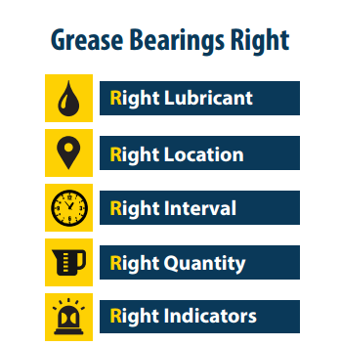
Optimization of the lubrication : LUBExpert

Slide 46
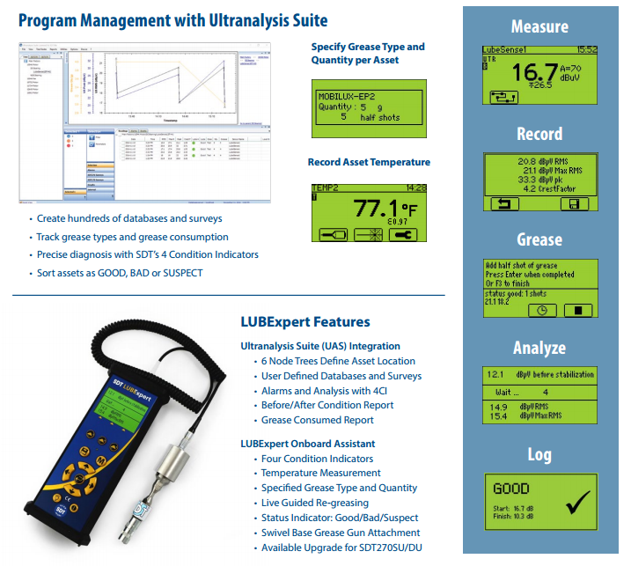
Optimization of the lubrication: LUBExpert

Slide 47
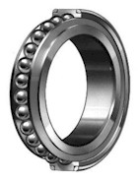
Bearings
1st step:
  Listening: simple, intuitive and quick
2nd step:
  Recording of the static measurement
    → confirms listening
3rd step:
  Recording of the dynamic measurement
    → confirms listening and static measurement

Slide 48


Bearings: listening

Slide 49

Bearings: static measurement
Irrversible failure
+16
Early stage failure
+8
Grease defect
Healthy bearing
+6

Slide 50
Bearings: static measurement

Slide 51



Bearings: dynamic measurement
GENERATOR DA1 – Bearing end driven
 | dB µV (RMS)
Bearing DE DA1 | 47,1
Bearing DE DA2 | 24,9
GENERATOR DA2 – Bearing end driven

Slide 52



Slow bearings
Example: oven bearing 4 RPM
 | dB µV (RMS) | dB µV (Peak)
Bearing 1 | - 9,6 | 11,2
Bearing 2 | -9,7 | 15,8
Bearing 3 | 12,8 | 32,1
Bearing 4 | 14,2 | 32
Bearing 5 | -9,9 | 21,7
Bearing 6 | -10 | 7,5
Bearing 7 | -10,3 | 13
Bearing 8 | -6,8 | 30,5

Slide 53

Gears
If ultrasound methodology let the control of the bearing, you can do also the gear control (gear boxes, multiplicator, …)
The dynamic measurements is recommanded on this case to identify the gear problem or bearing failure.

Slide 54

Gear: Case story
KINEMATICS OF THE PUMP
PLANETARY GEAR BOXE | FREQUENCiES
Axial gear 21 teeth | 68,09 Hz
Solar gear 98 teeth | 4,86 Hz
Outer ring of gear 223 teeth | 6,41 Hz
Output speed 128,4 RPM | 2,14 Hz
Gearmesh frequency | 476,62 Hz
KINEMATICS OF THE PUMP
PUMP | FREQUENCiES
 | 1,03 Hz
Wheel 6 blades | 12,82 Hz

Slide 55

Gear: case story
On the housing bearing 21R1 of the reducer, there is a regular shock with an interval of 0.1518 s, ie 6.58 Hz, which corresponds to the frequency of the outer ring of the gear.
This phenomenon could be related to a broken tooth of the outer gear.
It would be recommended to do a video endoscopy of the reducer.
Location 22R1 – Outer ring of the gear frequency

Slide 56


Gear: case story
ULTRASOUND MEASUREMENTS OUTPUT SHAFT- 4 RPM
dB µV RMS | dB µV Peak Value | GEAR BOXE
7,4 | 34,7 | Right Mixer
1
2
3
4
5
On the output shaft of the reducer there are two shocks at each rotation. Not having the exact frequencies of the kinematics of the reducer it is difficult to make an accurate diagnosis. It would seem that it would be a problem of teeth clearance (excessive or tight). To monitor
An inspection with an endoscope would be recommended.
1
Tour de rotation de l’arbre de sortie du réducteur

Slide 57



Gear: case strory
Example: planetary gear
BEARING 2 PLANETARY GEAR – INPUT LEFT
Input speed: 11 RPM
Output speed: 2 RPM
BEARING 2 PLANETARY GEAR – OUTPUT RIGHT

Slide 58


Pump cavitation: listening
The cavitation is the steam bubbles forming du to pressure drop.

Slide 59

Pump cavitation: listening
Cavitation of pump with immediate corrective action

Slide 60
Applications of Partial discharges localisation

Slide 61



Electrical inspection
The partial discharges produce the ultrasound
The detection and the analysis avoid the harmful consequencies of the security of the electrical installations and production

Slide 62



3 kind of defects
Corona:
  Air ionization
  Produces ozone and nitric acid (>2kV)
Tracking
  Moitsure and humidity
  Affects the surface of electrical components.
Arcing
  Plasma discharges

Slide 63
Thightness control

Slide 64



Thightness control
An ultrasound transmitter is located inside the area who you will perform the test. The transmitter floods the area of ultrasound. The ultrasound escapes by the holes, defect seals or cracks.
The technician checks outside of the area using SDT200 or SDT 270 like ultrasonic receiver, who detect, localize and measure the proportion of ultrasound who escape.

Slide 65





Thightness control
Sectors:
  Industry : white rooms, refrigerated storage rooms, boilers, composite tanks…..
  Marine : hatchcover, weathertight and water tight door, wheelhouse…
  Automotive : acoustic transparency of the cars.
  Transport : trucks, bus, trains, airplanes, helicopters.
  Construction : roofs, door and windows.
  Military : submarine, space vehicles, armored vehicles, tank….
  Nuclear – intégrity of the wall between the reactor and outside.

