Slide 1
SDT Ultrasound Solutions
LEAKReporter user management
WALKTHROUGH

Slide 2
LEAKReporter
Notes:
Here is a short presentation video of the major update of the CMS part of our mobile application.

Slide 3
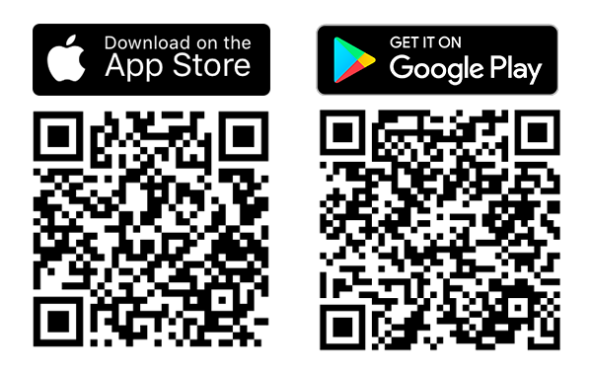
LEAKReporter
Notes:
For those who do not know this application yet, here is a GooglePlay and App store link to download it.

Slide 4
MEASURE
MANAGE
MASTER
Your leak detection program
Notes:
LEAKReporter is a mobile app and a web-platform to detect, log, and generate reports that show how your initiatives contribute to a more sustainable environment.
Measure
The app allows for easy leak documentation. Take a picture of any leak within the app and input its ultrasonic reading.
Manage
It makes the transition from creating surveys within the app or web browser, to searching for leaks out in the field fast and easy.
Master
It takes all the labor, time and effort out of generating reports. Plug in your findings and let LEAKReporter create comprehensive, detailed reports for you.

Slide 5
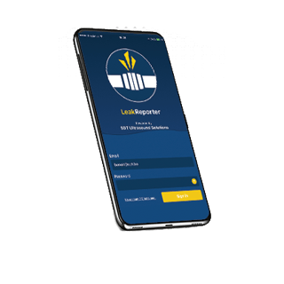
LEAKReporter
Notes:
Today once downladed

Slide 6
Account creation
Notes:
First you create an account

Slide 7
1 user
=
1 database
Notes:
Today for each user there is a database.

Slide 8
Problem IF…
1 organisation
=
Several users
Because
Notes:
For some large organizations with multiple LEAKReporter users, managing the team's work can be complicated to manage because…

Slide 9
1 organisation
=
several databases
Notes:
the application had not been designed to manage several databases within a single account.

Slide 10
How will I be able to manage the work of my team?
Notes:
For this reason, we were frequently challenged by the energy manager or the realiability leader concerned about how to manage teamwork.

Slide 11
INTRODUCING
LEAKReporter
Major CMS update
Notes:
And it is for this reason that we have deployed this update to now be able to

Slide 12
MEASURE
MANAGE
MASTER
Your leak detection program…
& users working inside your organisation
Notes:
Measure, manage and finally, master both the energy saving campaigns and the actors who participate in them.

Slide 13
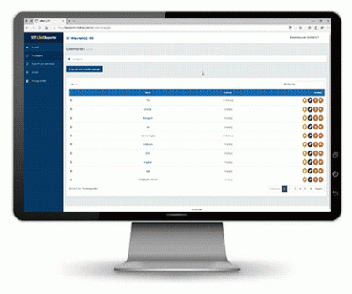
Simple user
Admin
Simple user
Notes:
So we now have the possibility of having several simple users managed by a manager within an ADMIN account

Slide 14
V Send a request to existing users for joining an organisation
V attribute user’s role: admin/user
V See and modify surveys from all users inside the organisation
V Change credential of a user inside a company (informations, password, …)
V Block access to existing user
Admin
Simple user
V Create and manage his leak surveys

Slide 15
SDT Ultrasound solutions
CREATING A COMPANY - From existing user account
Notes:
Here's how to quickly and efficiently deploy this update. If you don't have an idea of the number of users within your organization and the associated logins, don't panic SDT can help you, just ask us.

Slide 16
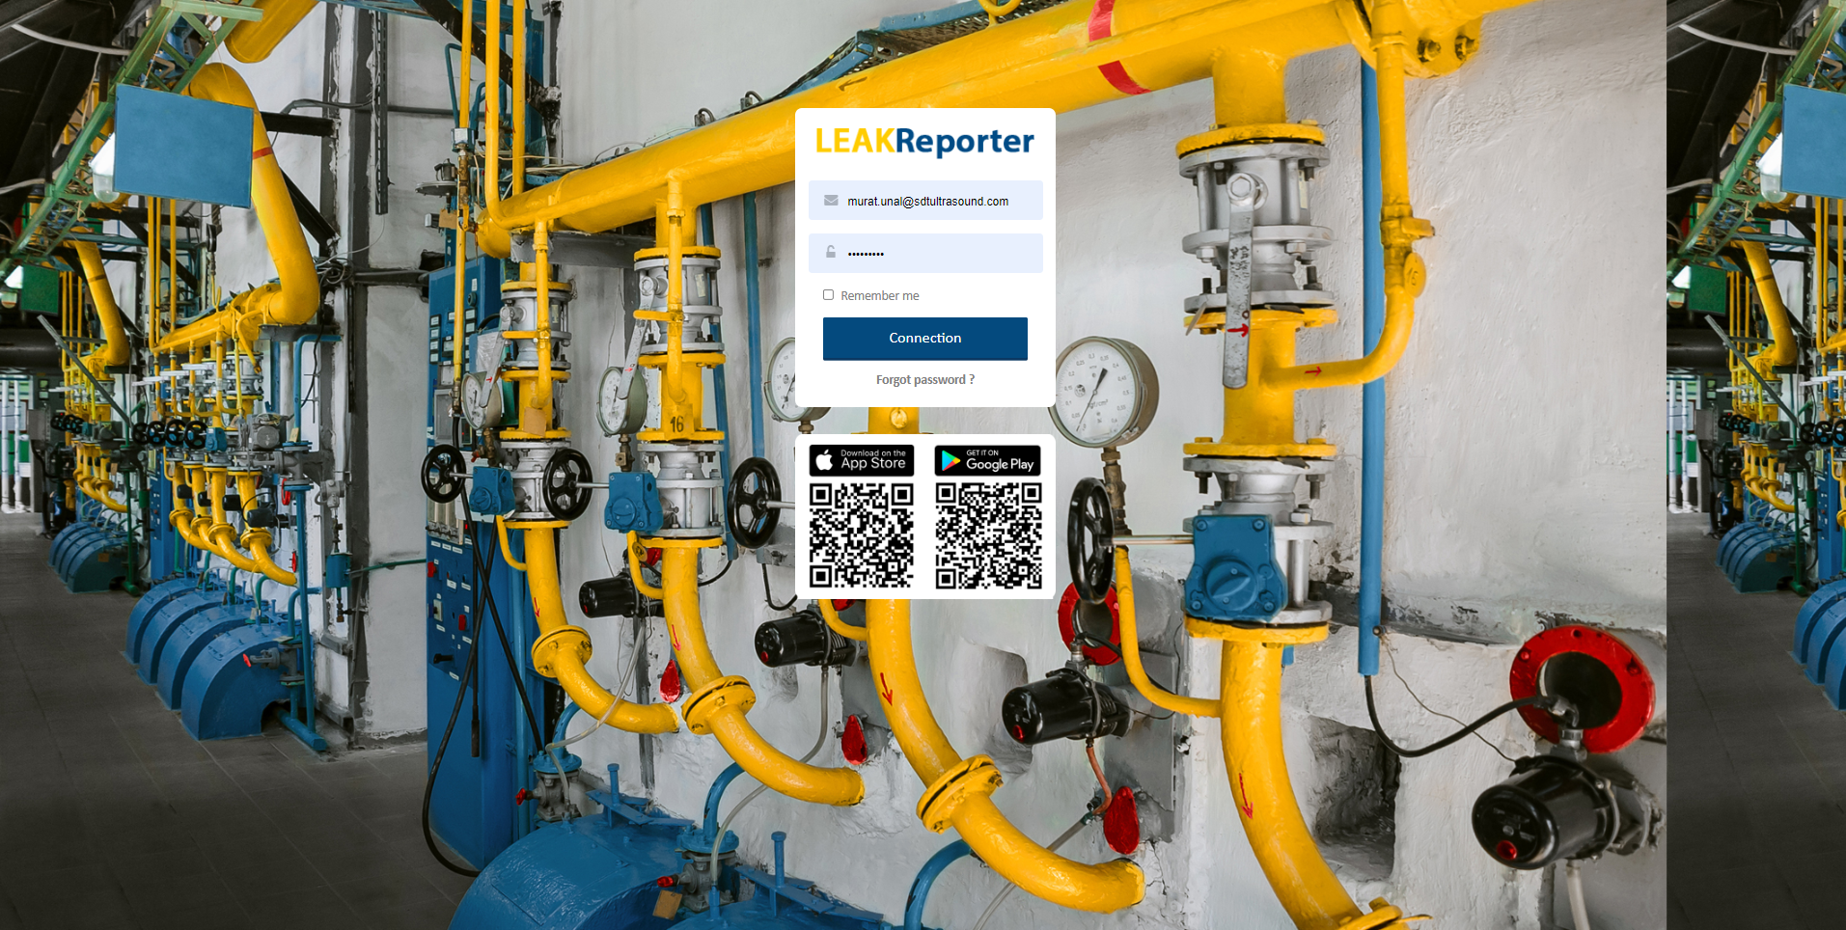
Notes:
All existing accounts are "single user" by default. Log into your account.

Slide 17
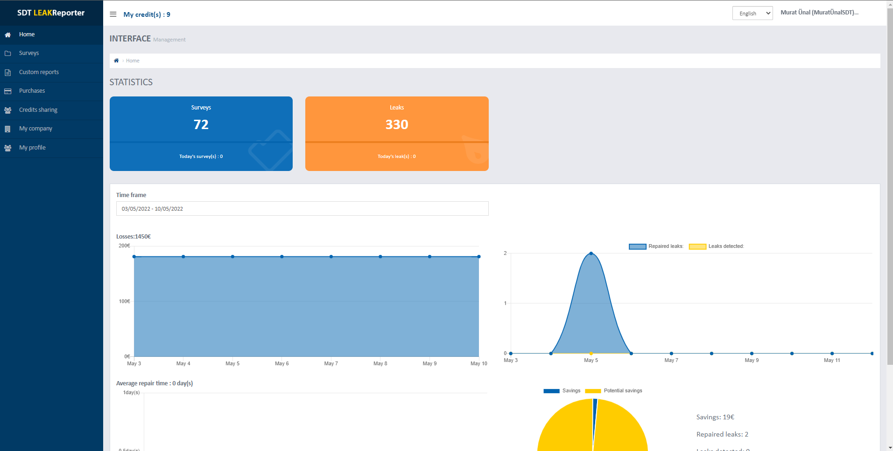

Slide 18
Notes:
See now this new tab: "my company"

Slide 19
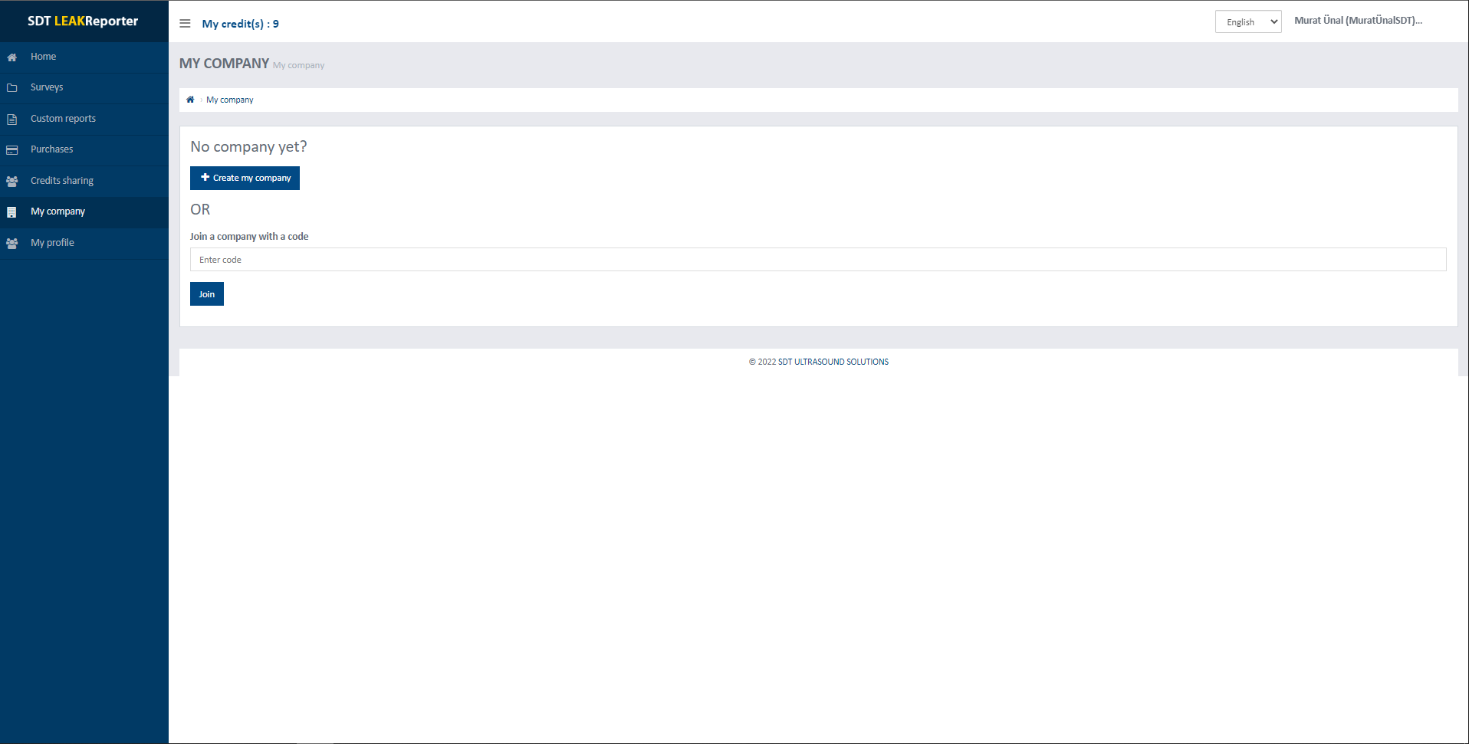
Notes:
In this tab, click on add your company.

Slide 20
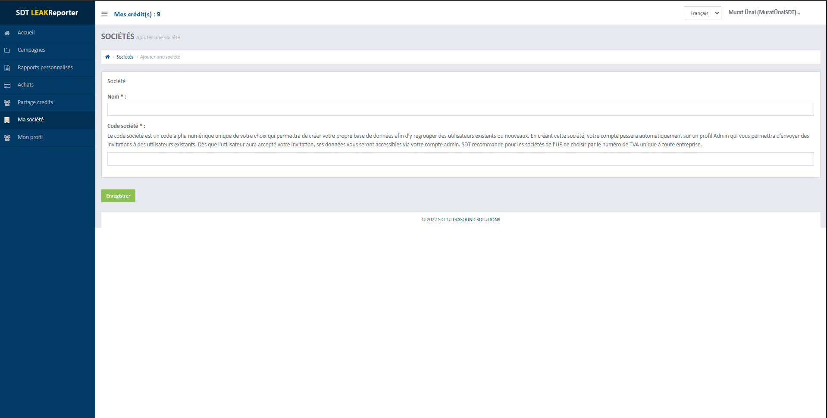
Notes:
Give your company a name and a unique code that will avoid duplicate companies

Slide 21
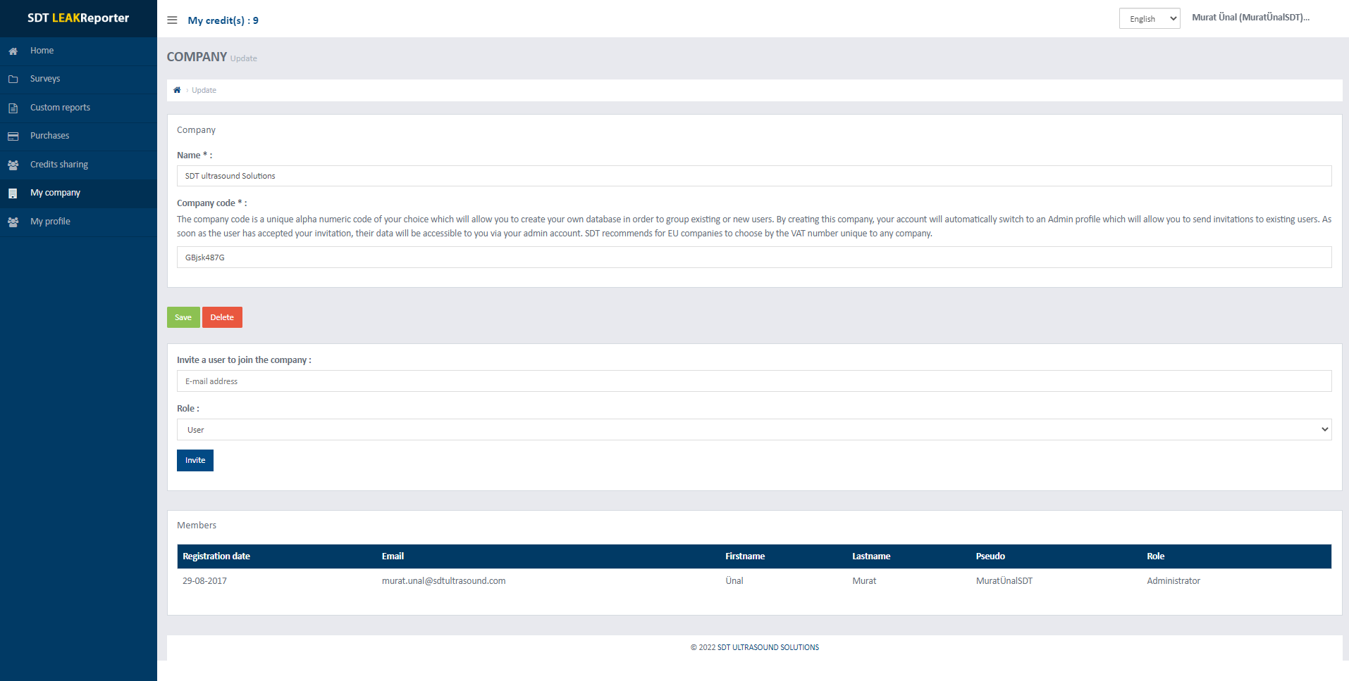

Slide 22
Notes:
Once created, invite existing users by inserting the email address they use on their LEAKReporter account

Slide 24
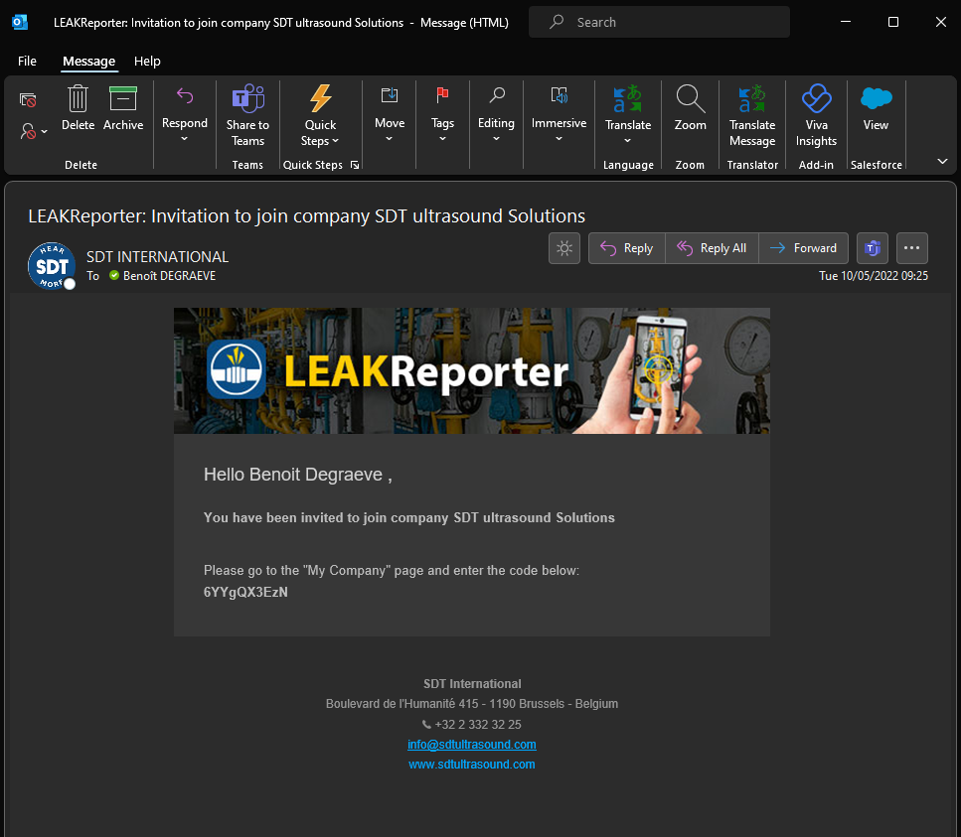
Notes:
Once added, the user will receive an email notification.

Slide 25
Notes:
The user will then need to copy the unique code and copy it to the "my company" section, join an existing company

Slide 26
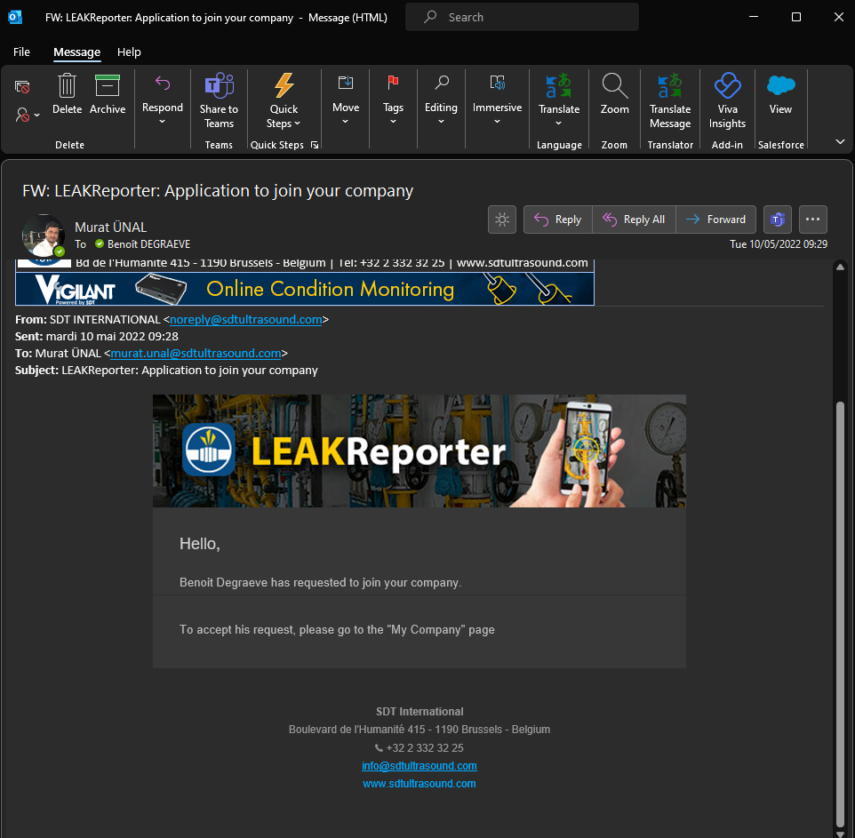
Notes:
His request will then be notified to the admin of the company by email

Slide 27
Notes:
He will then have to accept or refuse this application for membership. This allows the admin to have strict control over the people within their team.

Slide 28
Notes:
Once the request has been accepted, the admin will then have full power and a 360° view of all the work carried out by the team in the field as well as KPIs calculated for all the campaigns.

Slide 29
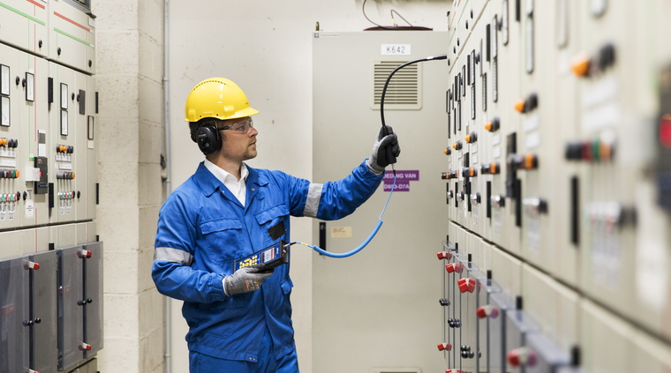
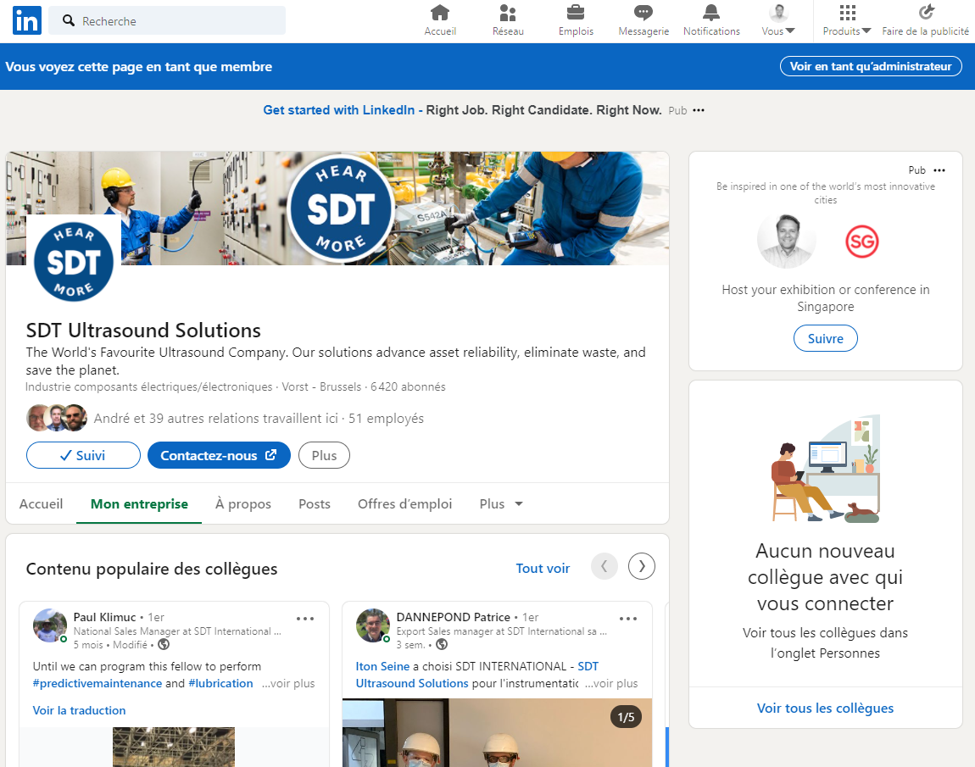
Merci
www.sdt.training
www.sdtultrasound.com
Benoit.degraeve@sdtultrasound.com
#HEAMORE
Notes:
N’hésitez pas à nous rejoindre sur SDT.TRAINING: « La plateforme des techniciens, responsables et managers de maintenance confinés à l’écoute et en soif d’apprendre. »
Lieu d’échange, de partage et d’apprentissage organisés autours des live webinars et de quizzs

Slide 30
