Slide 1
SDT LUBExpert

Slide 2
Agenda
Theory of ultrasound
The Lubrication Nightmare
Solution
Kit LUBExpert

Slide 3
Theory of ultrasound

Slide 4
Frequency range of sound
Infrasound < 20 Hz.
Audible sound: between 20 Hz and 20 kHz.
Ultrasound = > 20 kHz.
Infrasound
Audible sound
Ultrasound
Sound
20 Hz
16 KHz/20 KHz

Slide 5
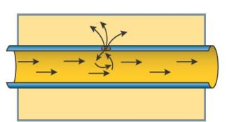
Ultrasound hears
Turbulence
  Pressure and vacuum leaks
  Hydraulic leaks
  Steam leaks
Impacting and friction
  Bearings, gears, belts, couplings, valves, hydraulics
  Lubrication
Partial discharge
  Corona effects
  Tracking
  Arcing and sparking

Slide 6
The Lubrication Nightmare

Slide 7
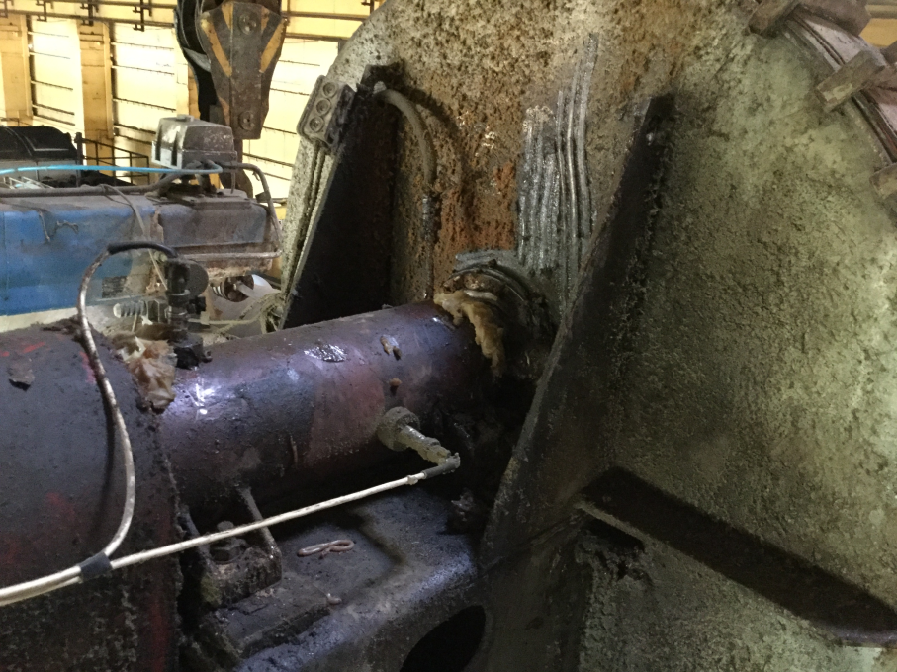
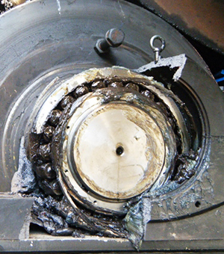
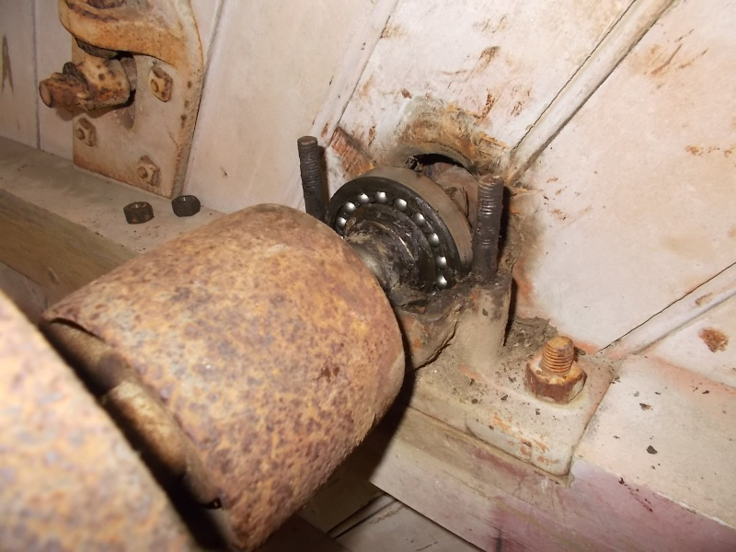
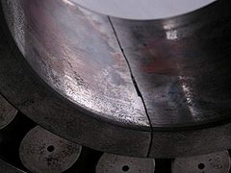
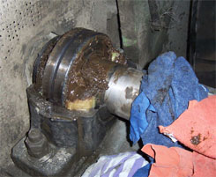

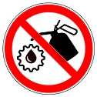
The Lubrication Nightmare

Slide 8
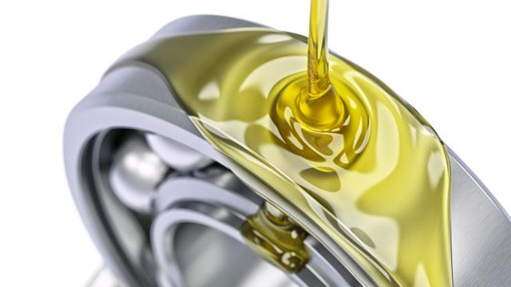
The Importance of lubrification
Lubrification :
  Has a direct impact on the life expectancy of your equipment
Inappropriate lubrification:
  50 % of all bearings are replaced prematurely due to inappropriate lubrication (SKF, FAG…)
  Bad lubrication is responsible for over 60% of machine failures (SKF, FAG…)
  Only 10% of the brearings reach their expected lifespan
  All industries are concerned!

Slide 9
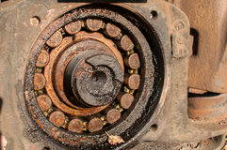
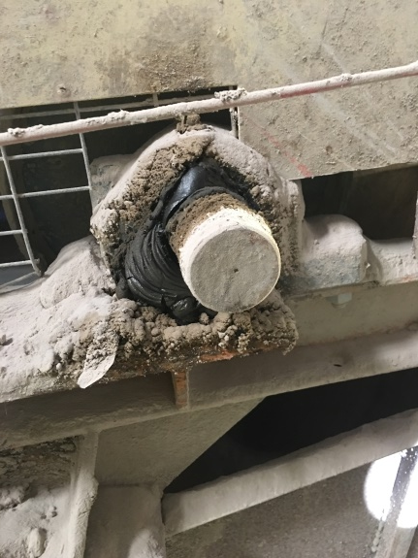
The Importance of lubrification
The main problems concerning lubrication:
  Not enough grease
  Too much grease
  Inappropriate periodicity

Slide 10



Lubrification: A paradox
Paradox 1
An important and unavoidable task but in many cases done in an uncontrolled manner without any objective data showing the effectiveness of the action.
Paradox 2
Experts can detect a great number of problems related to inappropriate lubrication but why is there so little done to avoid these problems.

Slide 11
Greasing….. A simple task?
A grease gun, some grease, a predefined number of shots of grease and that’s all we need…..to kill a bearing!
Calendar based lubrication or autolube?
The statistics show that current practice is far from perfect
  10% of all bearings attain the lifespan they are engineered for.
OEM’s know best…:
90 grams every 400 runnng hours for normal conditions .
What are normal conditions? How do we measure normal?
Correction factors:
Load: High, Medium, Low, Very High?
Take your pick………and, good luck!

Slide 12
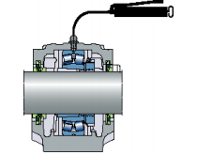
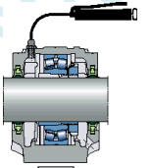
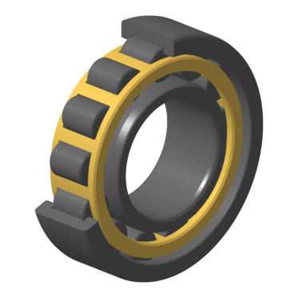
Calculating the right amount and interval for re-greasing
Step1: Quantity
  Easy
  G = 0,005*D(outer diameter)*B(width)
  G = 0,002*D(outer diameter)*B(width)
Example: NU234
  Inner diameter = 170 mm
  Outer diameter = 310 mm
  Width = 52 mm
  Quantity = 81 grams

Slide 13

Calculating the right amount and interval for re-greasing
Step 2: Theoretical interval
  Easy to determin
  Rotation speed
  Bearing type
  Grease type
  Running hours/day
Example: NU234
  Normal grease
  1500 rpm
  24 h/j
  Theoretical interval= 500 hours

Slide 14
Calculating the right amount and interval for re-greasing
Step 3: Corrected interval
  Easy?.....not realy
  Correction factor %
  Environnemental conditions
  Ambient temperature, pollution, humidity
  Operating conditions
  Impacts, Load, bearing temperature
  Influence of the correction?
  Negligible? little? Important ?

Slide 15
Calculating the right amount and interval for re-greasing
Example1 : NU234
  1500 rpm and 24 Hours/day
  load‘’normal’’, no impacts, Contamination/Humidity ‘’normal’’
  Corrected Interval= 500 hours
Example 2: NU234
  1500 rpm and 24 Hours/day
  load‘’very high’’, impacts present, Contamination/Humidity ‘High’’
  Corrected interval= 100 heures

Slide 16

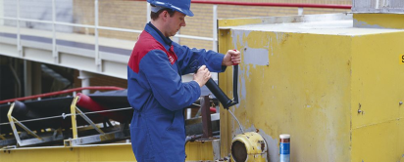
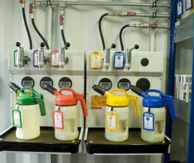
Problems encountered when (re) greasing
Problem 1: Quantity and grease Quality
  Two aspects that need to be considered
  The theoretical quantity can be calculated, the actualy needed quantity is something completely different
  Grease quality is relatively easy.
Problem 2 : Determining the right interval based upon the actual need of the bearing
Very complicated to calculate in a reliable way and rarely done correctly .
Example :
  Quantity and interval differs between DE and NDE bearing
  Cause: difference in load (misalignment, unbalance)

Slide 17
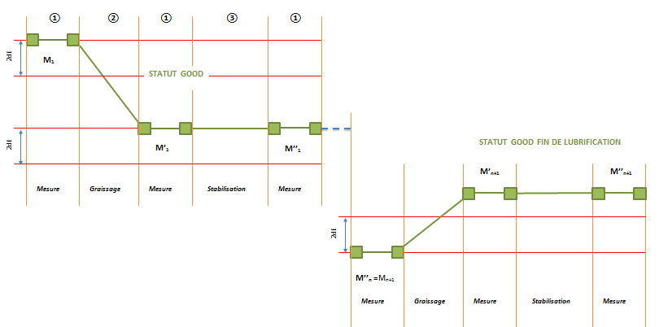
Benefit of Ultrasound
The simple answer to problem 1 : The right Quantity
Add grease until a slight increase in dBmV is measured.
At this time the optimal quantity is reached.

Slide 18
Benefit of Ultrasound
Answer to problem 2 : the right Interval
Start your Ultrasound assisted lubrication by adding 1 shot of grease
If the measurement value decreases continue with the next shot of grease.
If the measurement value increases or stabelizes stop greasing
If a relatively large quantity grease was needed plan the next inspection on a shorter interval
Re-adjust the interval in function of the situation
Measure - Adapt - Evolve

Slide 19
Solution

Slide 20
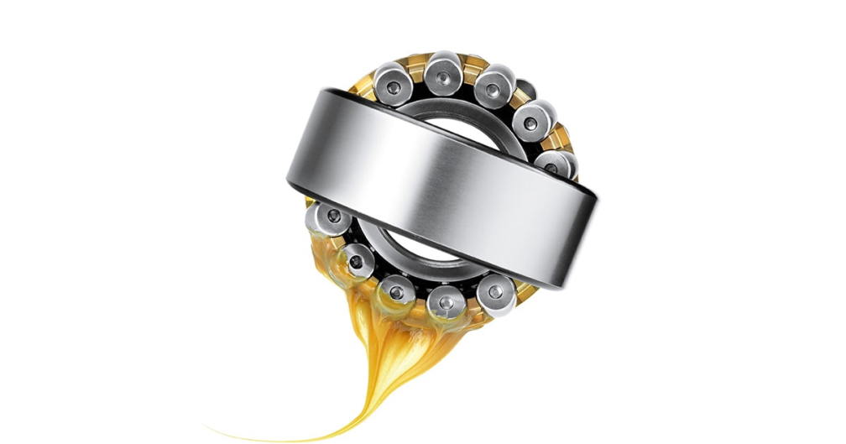
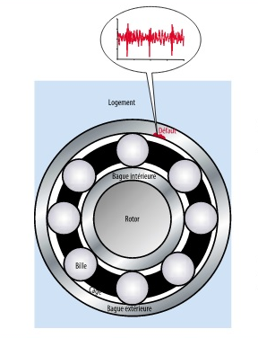
Rotating machinery
Theory
Two mechanical phenomena generate Ultrasound :
  Friction
  Impacts

Slide 21
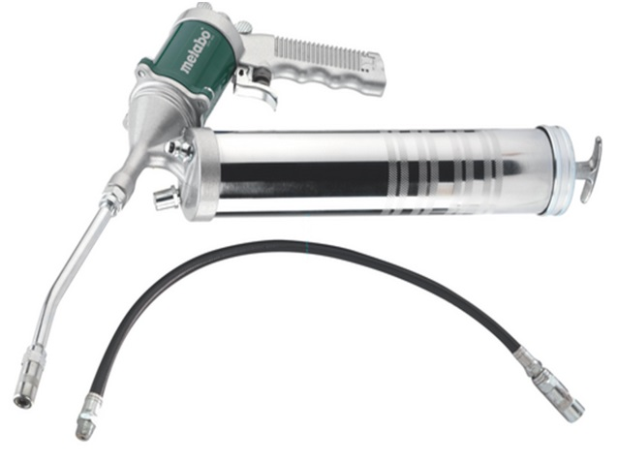
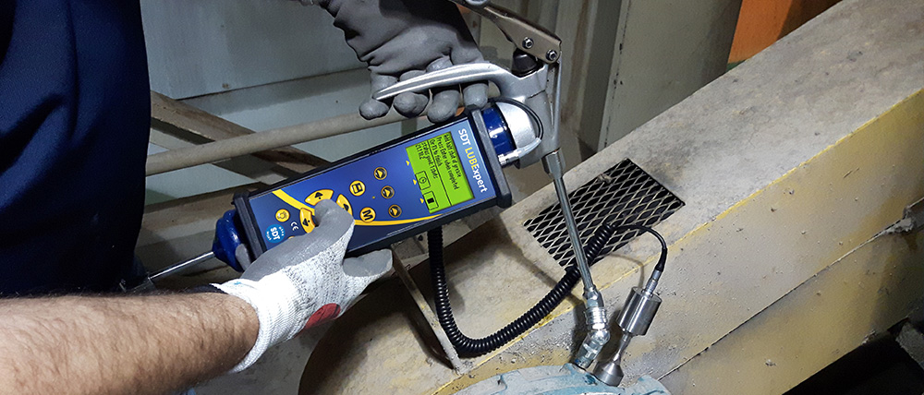
Lubrication optimization
Only Ultrasound is suitable for this application.
Listen and measure in one go.

Slide 22
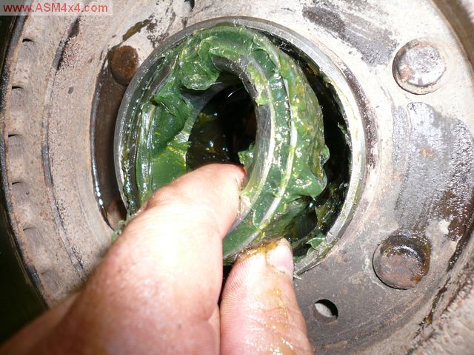
Lubrication optimization
3 causes of bearing failure
Over lubrification
Wrong lubricant
Under lubrification

Slide 23
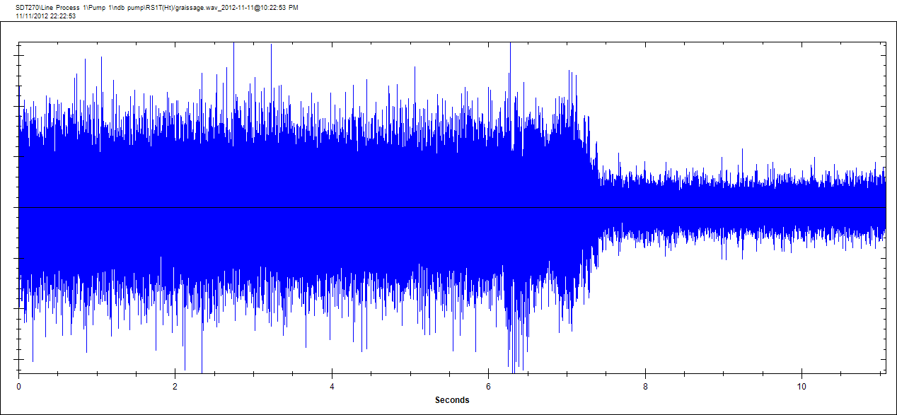

Lubrication optimization
Example

Slide 24
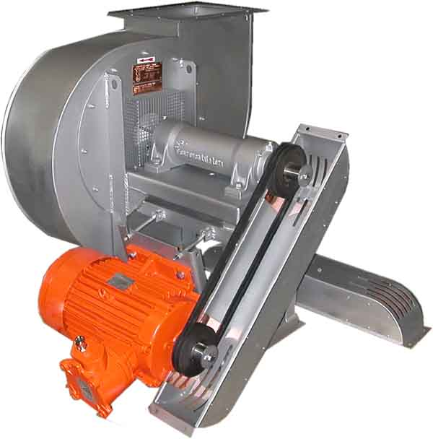
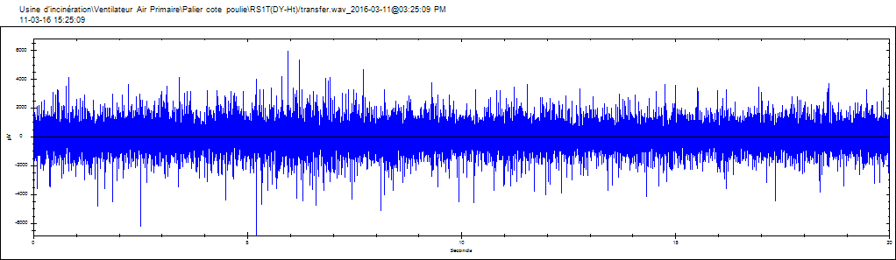
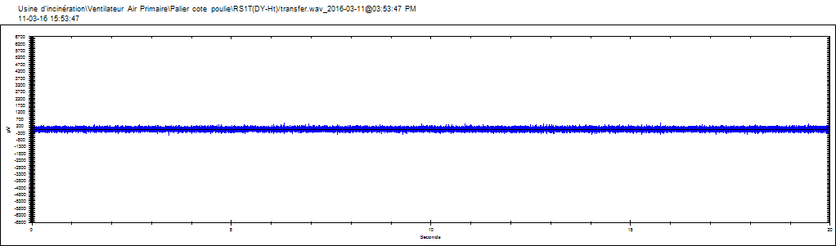
Greasing example
Example
Ultrasound measurements Bearing Belt side
dB µV RMS | dB µV Peak
54,1 | 75,4 | Before lubrification
37,9 | 53,4 | After Lubrification
Before
lubrification
After
Lubrification
Bearing Belt side
Palier CA
Bearing Belt side – Before lubrification
Bearing Belt side - After lubrification

Slide 25
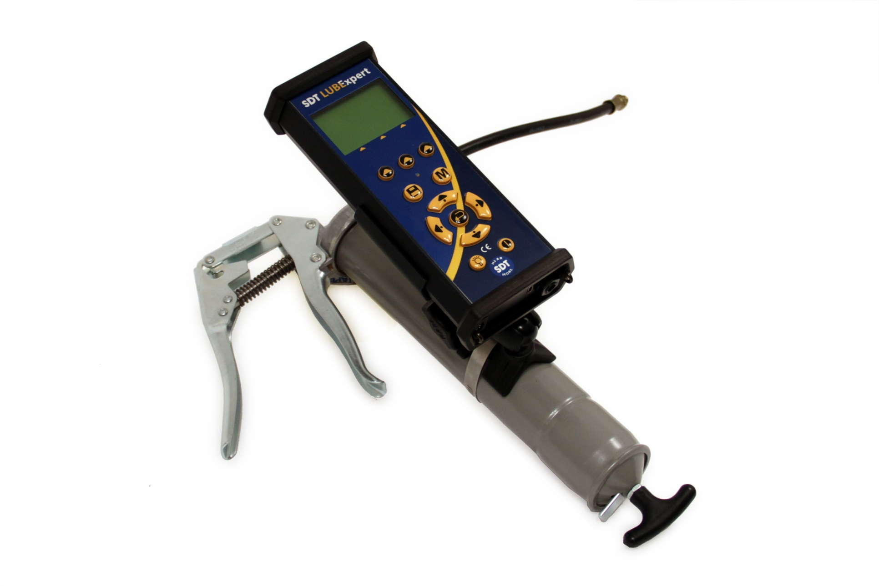
LUBExpert

Slide 26
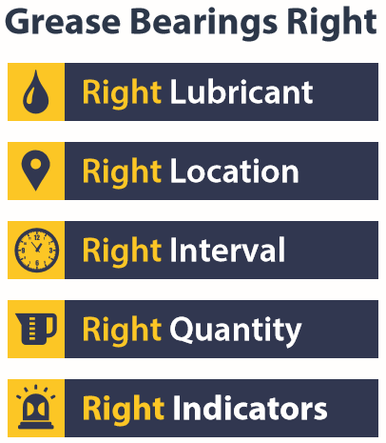
Philosophy

Slide 27
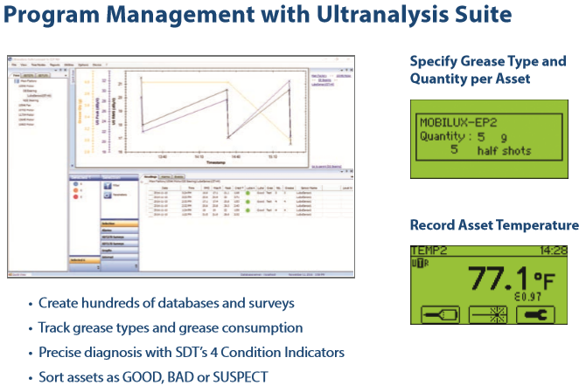
Dedicated UltrAnalysis Suite Software

Slide 28
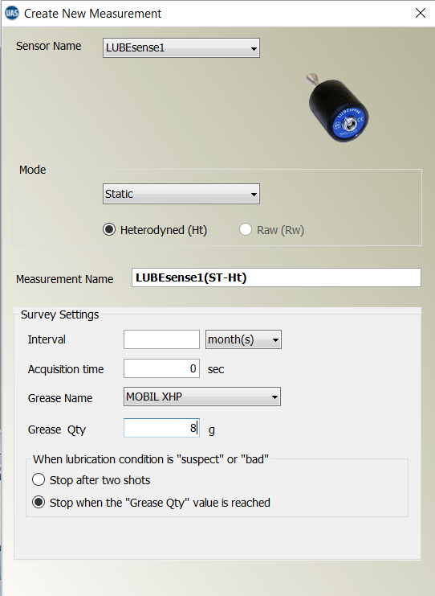
Dedicated UltrAnalysis Suite Software
Grease point configuration
  Lubricant type
  Calculated theoretical quantity
  Lubrication state

Slide 29
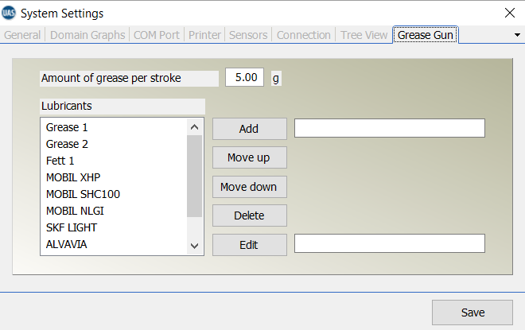
Dedicated UltrAnalysis Suite Software
Grease and Grease gun information
Notes:
Every 3269 hours apply 32.7 grams of grease.
See any problems with this?
3269 is an odd number and therefore cannot be an integer multiple of 24 – it is 136 days and 5 hours!
Could you deliver 32.7 grams of grease?
Do you really believe that this OEM is that good????

Slide 30
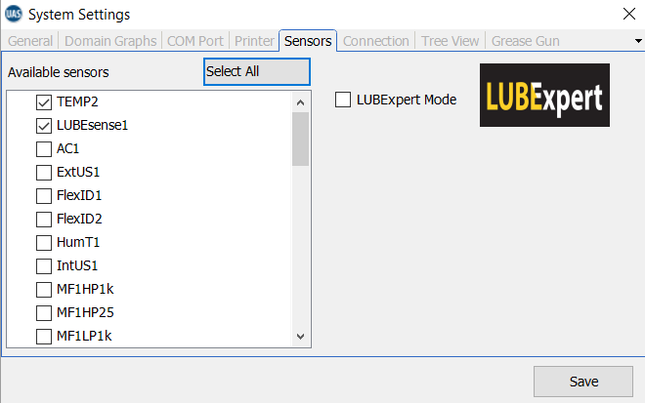
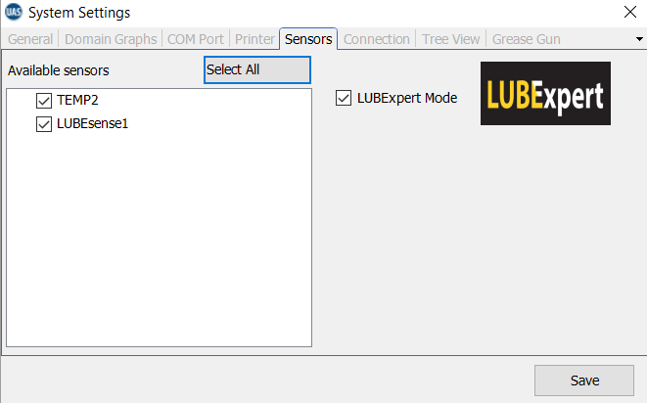
Dedicated UltrAnalysis Suite Software
LUBEsense and/or Temperature sensor parameters
Notes:
Every 3269 hours apply 32.7 grams of grease.
See any problems with this?
3269 is an odd number and therefore cannot be an integer multiple of 24 – it is 136 days and 5 hours!
Could you deliver 32.7 grams of grease?
Do you really believe that this OEM is that good????

Slide 31
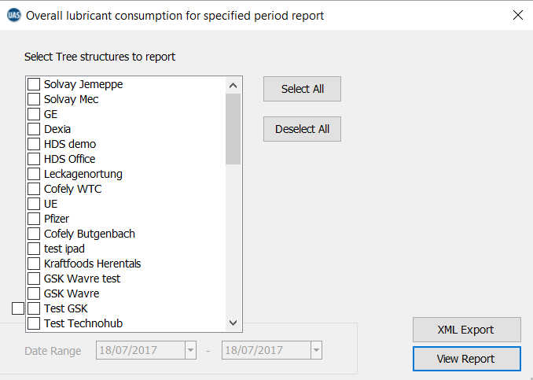
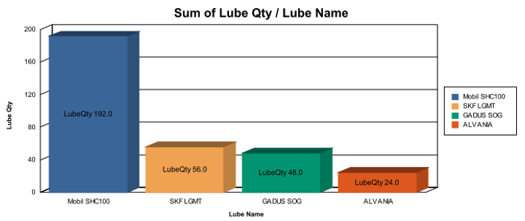
Dedicated UltrAnalysis Suite Software
Automated Reports
Average grease consumption
Notes:
Every 3269 hours apply 32.7 grams of grease.
See any problems with this?
3269 is an odd number and therefore cannot be an integer multiple of 24 – it is 136 days and 5 hours!
Could you deliver 32.7 grams of grease?
Do you really believe that this OEM is that good????

Slide 32
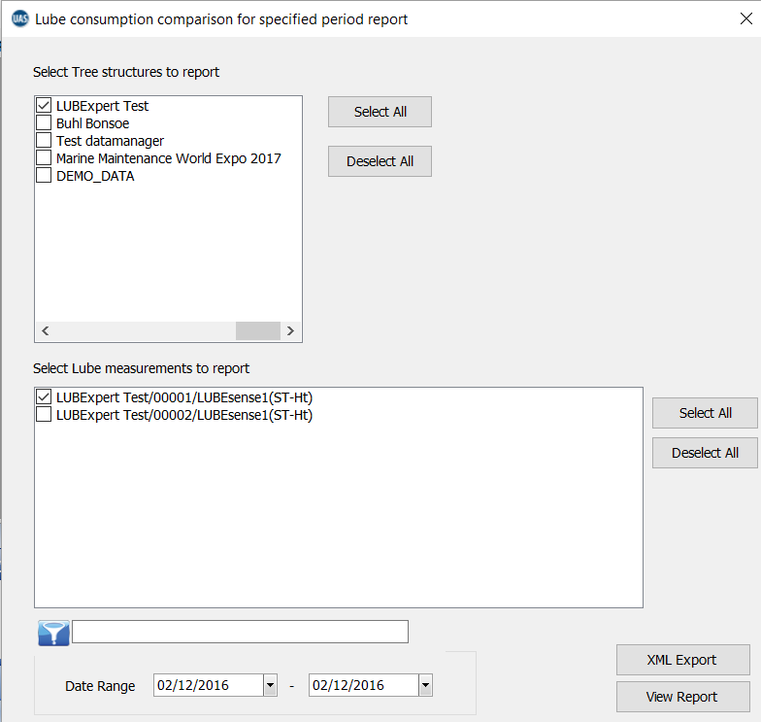
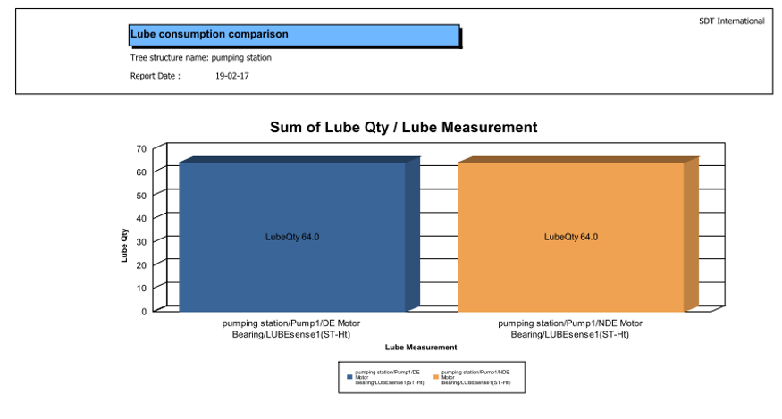
Dedicated UltrAnalysis Suite Software
Automated Reports
Grease consumption by grease point
Notes:
Every 3269 hours apply 32.7 grams of grease.
See any problems with this?
3269 is an odd number and therefore cannot be an integer multiple of 24 – it is 136 days and 5 hours!
Could you deliver 32.7 grams of grease?
Do you really believe that this OEM is that good????

Slide 33
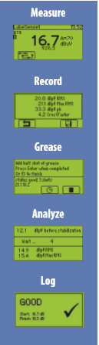
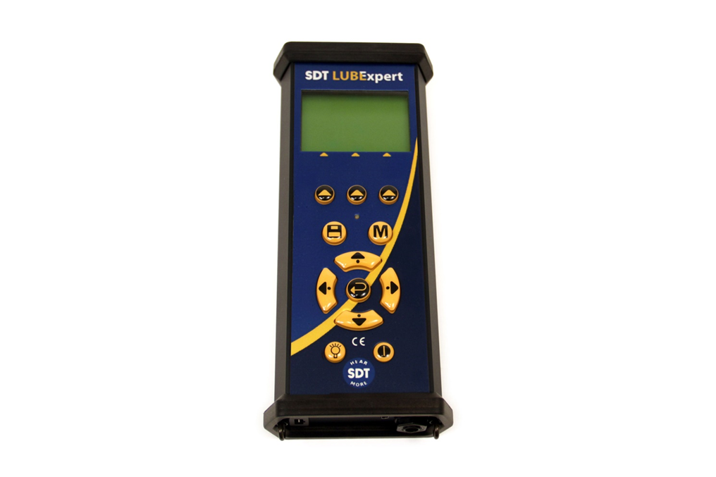
Dedicated LUBEXPERT Firmware

Slide 34
Dedicated LUBEXPERT Firmware
Main characteristics
In the Survey mode you have
a sorted, filterd and logically arranged list of the bearings that need lubrication. (Lubrication surveys)
the type of grease to be used for the bearing and the expected maximum quantity. (UAS)
The added quantity of lubricant
Pre-set signal amplification and volume.
A live view of the evolution during the lubrication process.
Direct information concerning the status of the lubricated bearing « Good », «Suspect » or « Bad »
Complete tracebility of the measurement before, during and after lubrication

Slide 35
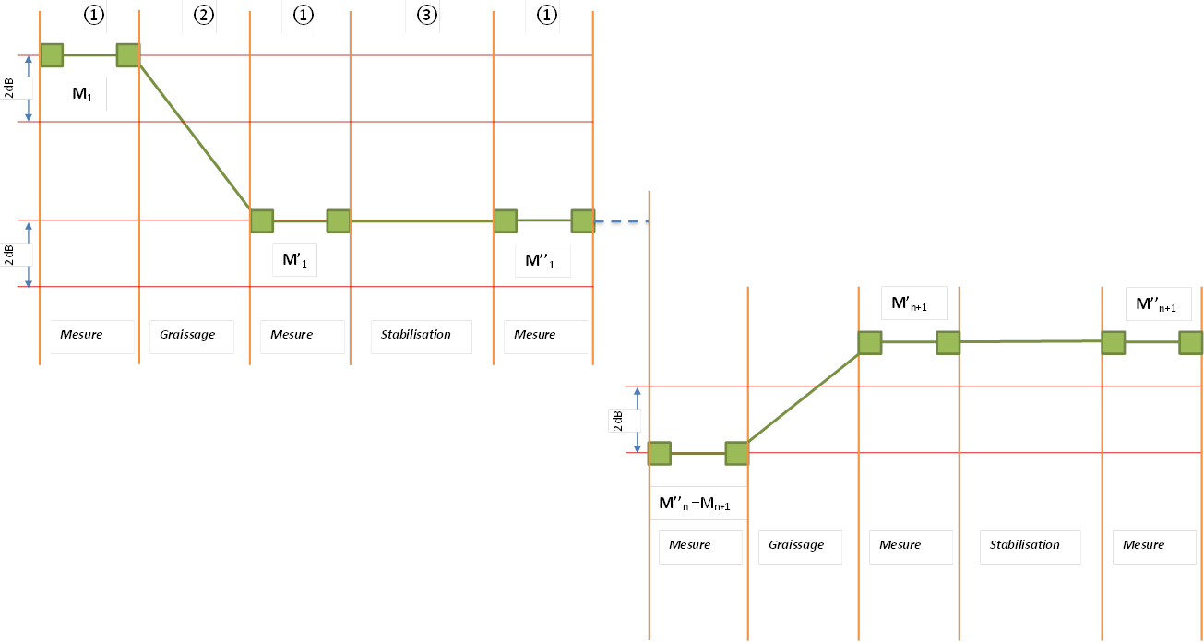
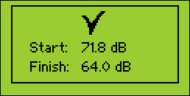
LUBExpert: Status GOOD
Status is GOOD :
when the second measurement (after applying the first shot of lubricant and a stabilization period) shows a decrease of at least 2dB and when the last measurement shows an increase of more than 2dB compared to the previous one.
*In this case the information concerning
the theoretical maxim quantity of grease
is not used.

Slide 36
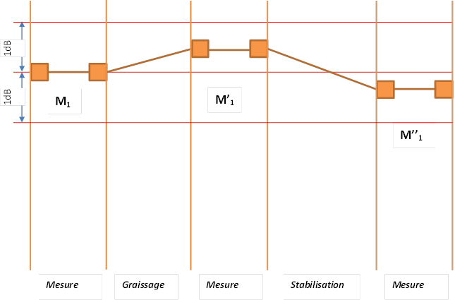
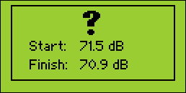
LUBExpert: Status SUSPECT
Status is SUSPECT :
When, after applying the lubricant and the stabilization period , there is less than 2 dB difference (higher or lower) compared to the initial measurement and when the calculated maximum quantity is reached or when 2 shots of grease are applied *.
*Depending on the slected setting in UAS

Slide 37
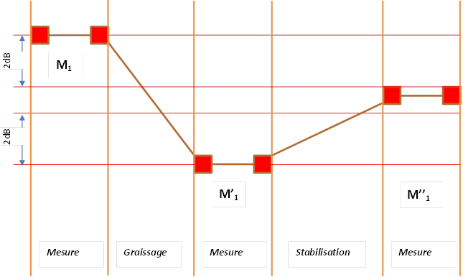
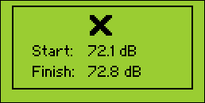
LUBExpert: Status BAD
Status is BAD:
When, after the first shot of grease, the device measured a decrease of at least 2dB and when during the stabilization period there is an increase of at least 2dB. The lubrication process is then stopped

Slide 38
LUBExpert Kit

Slide 39
LUBExpert

Slide 40
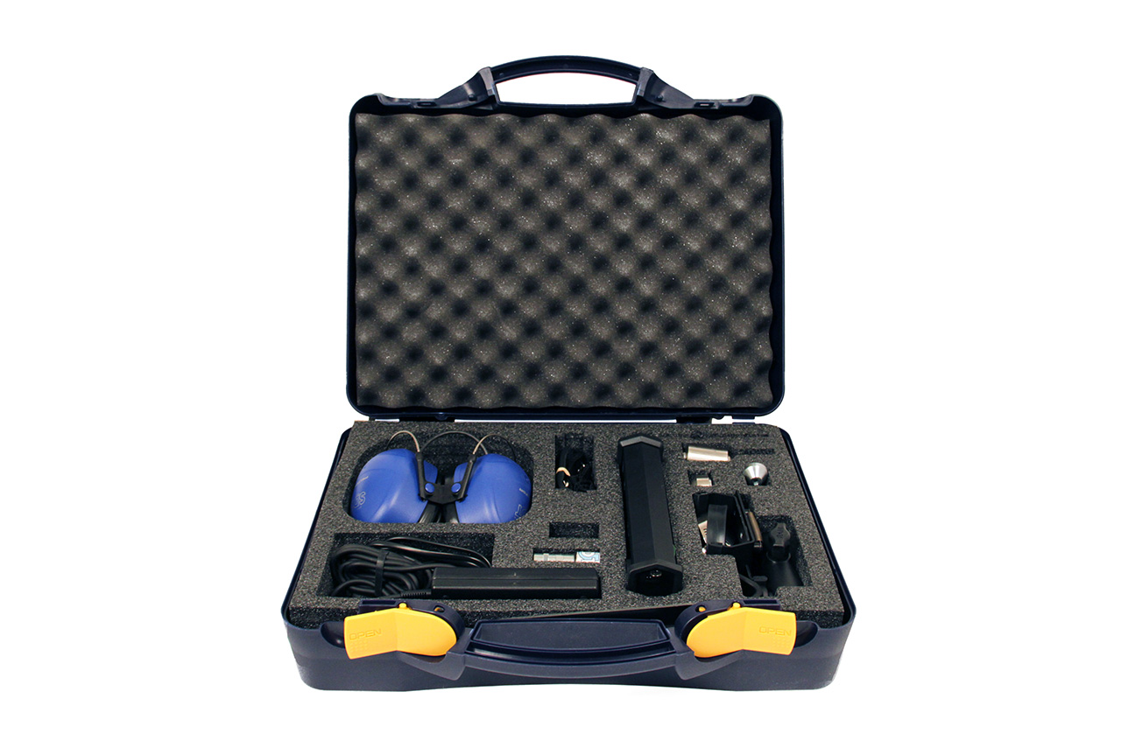
LUBExpert

Slide 41
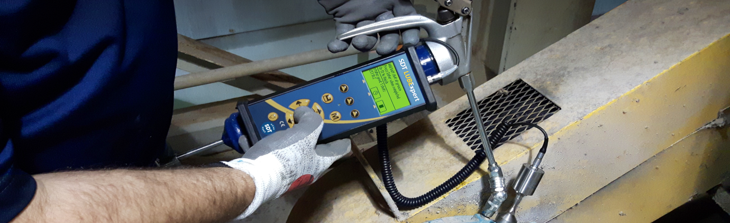
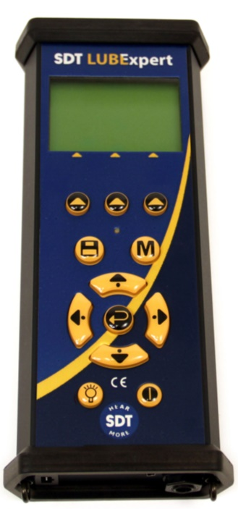
LUBExpert
Use the SDT LUBExpert
And put a halt to bad lubrication practises
Onboard lubrication assistant
Onboard temperature sensor
Dedicatd Lubrication survey management software
All the needed hardware
  Cradle with articulated mount for fixing the device on any grease gun.
  Sensor, Magnets, Grease adapter,...
Become a LUBExpert
PRIX: 5020 €

Slide 42
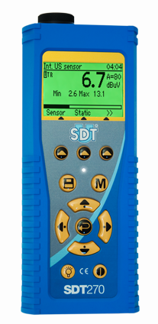
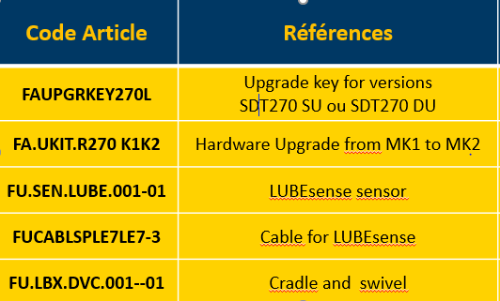
LUBExpert key for SDT 270
Compatible with SDT270 SU and DU devices* :
available for ATEX verions shortly
Price
*Only compatible with generation MK2 devices

