Slide 1
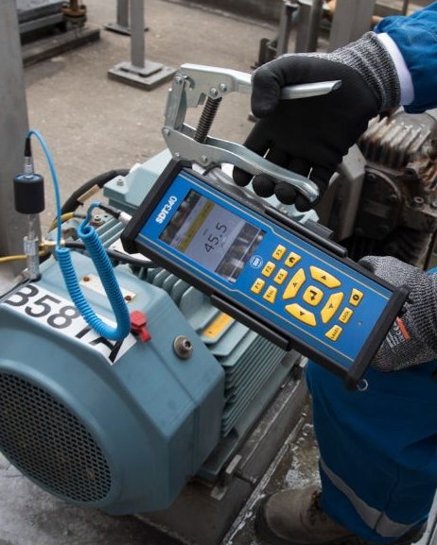


Firmware Upgrade Launch
SDT340 +
LUBExpert Mode
"One handheld. All the right decisions."
Powered by LUBrain algorithm
Bridging Lubrication & Condition Monitoring

Slide 2
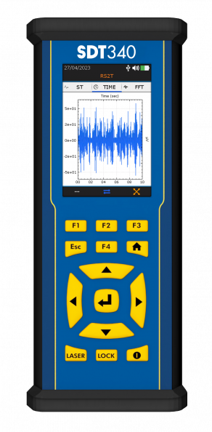



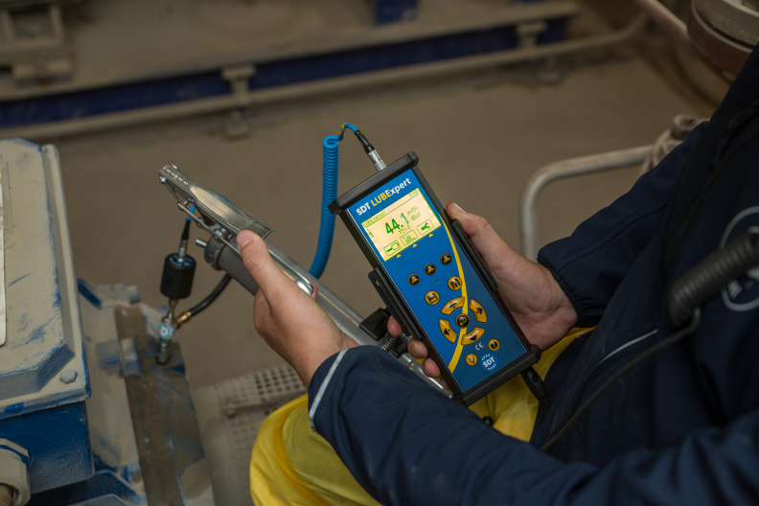
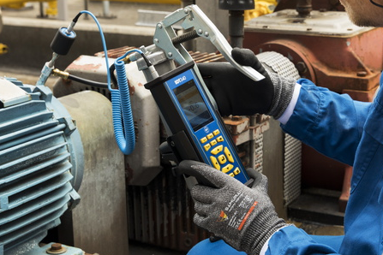
POSITIONING: SEPARATE VS. INTEGRATED
RECOMMENDED
LUBExpert
SDT340 + LUBExpert
Dedicated Device
Integrated Solution
Purpose-built specifically for lubrication teams
Same LUBExpert guidance, now fully inside the SDT340
VS
Simple, rugged workflow they control entirely daily
Ideal for programs where one instrument must "do it all"
Ensures constant availability for scheduled greasing routes
Elevates lube techs to collect valuable condition insights

Slide 3







THE SOLUTION: SDT340 LUBEXPERT CAPABILITIES
Guided Lubrication
Condition Check
Smart Routes
Ultrasound-guided lubrication with live trend and instant OK/STOP guidance.
Perform Before & After bearing condition checks within one seamless workflow.
Efficient route-based data collection mapping to specific asset IDs.
Quantity Control
Full Compatibility
Data & Reports
Precise grease quantity control ensuring active over-lubrication protection.
Works seamlessly with all SDT sensors and common industry grease guns.
Comprehensive data logging capabilities for advanced analysis and reporting.
Condition Monitoring
Lubrication Management
SDT340 + LUBExpert Mode Upgrade

Slide 4



FUTURE VISION
75%
5% - SNIPERS
multiple technologies in the hands of a top expert
This certainly includes 340 (or its successor)
Remote Monitoring including Lubrication
20% - WHAT ABOUT THEM ?
Focus on remote monitoring & execution
LUBExpert ON-GUARD
People will need to do better, be better equipped, and better trained – this includes the Lube team
Future Vision: 75% Remote Monitoring

Slide 5
FUTURE VISION
What about 20%?
  People will need to do better, be better equipped, and better trained – this includes the Lube team
“Not my job”, “I don’t know”... is no longer the option
Lube team and CM team – one team?
  If your Lube team collects high-quality CM data during lubrication - YES

Slide 6




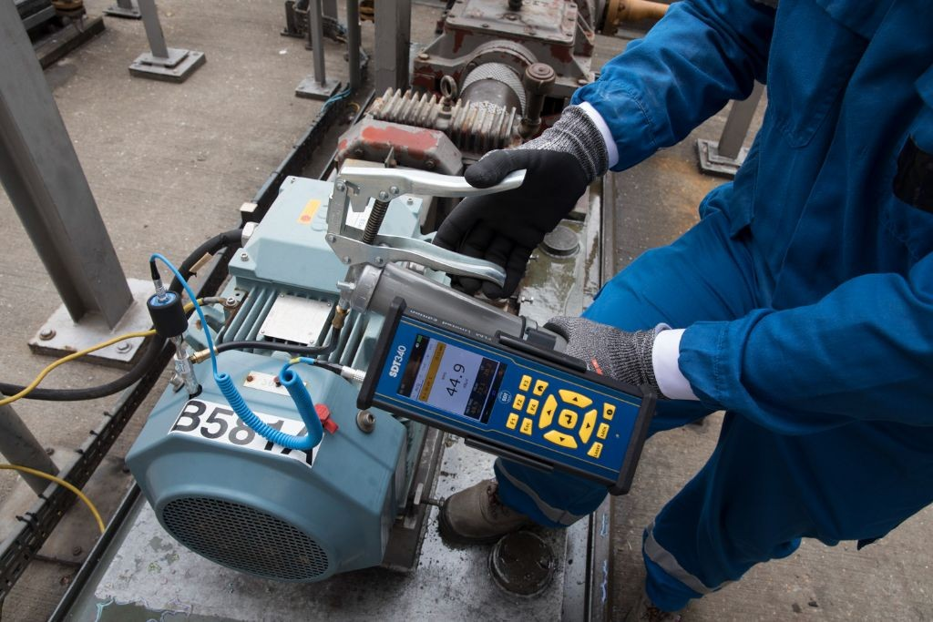
THE CHALLENGE
Two Teams, One Mission
Keep rotating assets reliable and operating efficiently
Two Teams, One Mission
Working in Silos
Two teams working separately to keep rotating assets reliable. Lubrication creates the condition; condition monitoring assesses it.
Lubrication creates the condition; condition monitoring assesses it — often in silos. Lack of integration between teams.
Shared Device Issues
Lubrication Risks
Lube technicians need a dedicated tool all shift; shared devices tend to stay with CM teams.
Greasing without live condition feedback risks over/under-lubrication, wasted time, and unexpected failures.
Condition Monitoring
Lubrication Management

Slide 7






KEY BENEFITS & VALUE
5 critical advantages for your lubrication and condition monitoring program
Connect Proactive & Predictive
Extend Bearing Life
Empower Teams
Foster Collaboration
Ensure Repeatable Results
Unify lubrication and condition monitoring in a single solution
Dramatically reduce grease consumption and prevent failures
Enable lubrication teams to capture critical condition data
Shared platform breaks down silos, accelerating ROI
Simple training leads to safer, reliable operations

Slide 8


SDT340 + LUBExpert Mode
Walkthrough Guide
Connecting the best of both worlds - CM and lubrication with the same sensor

Slide 9
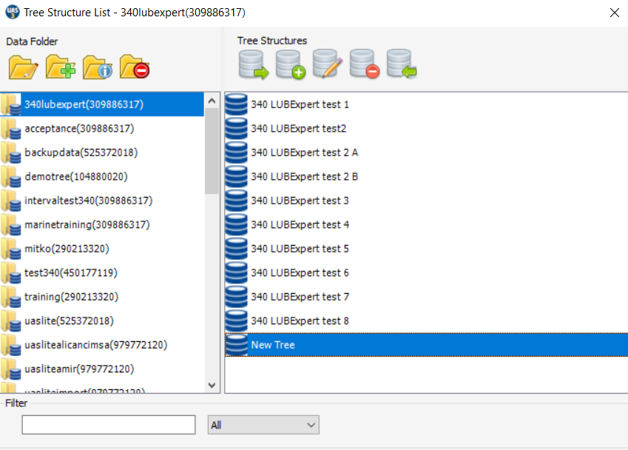
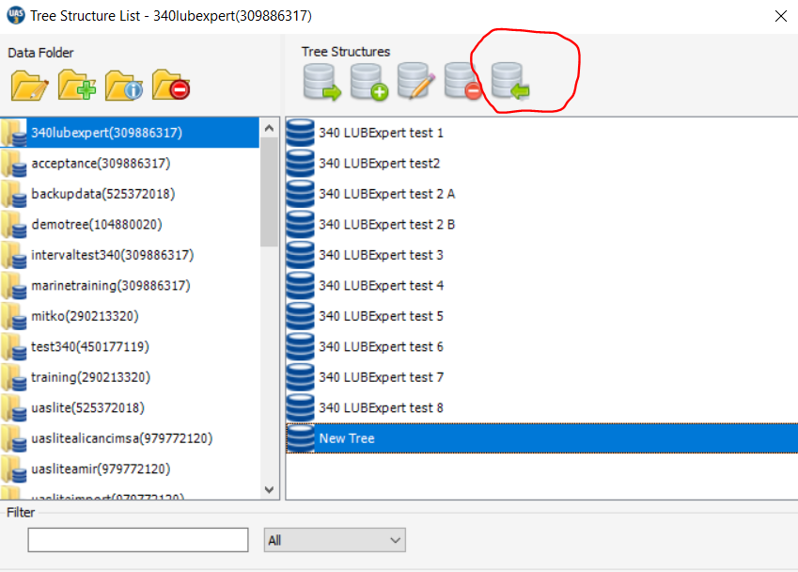
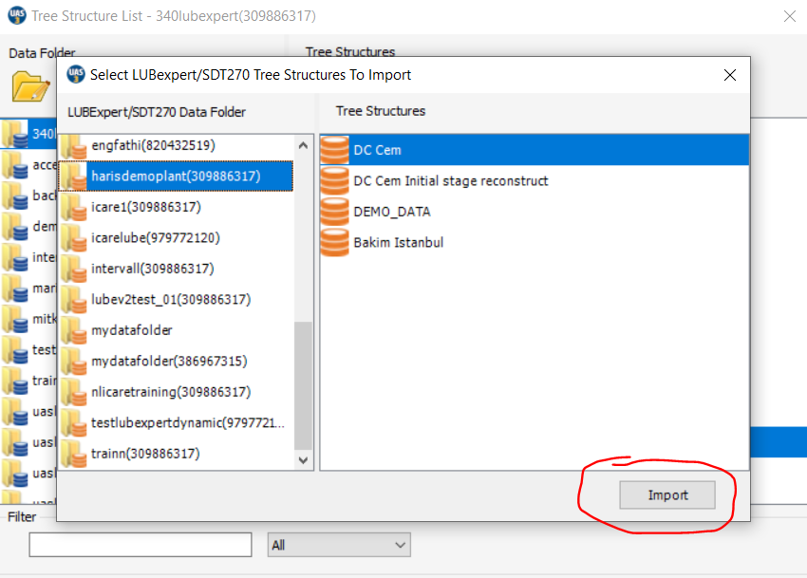
UAS3 – DATABASE TRANSFER
Existing Lubrication database in 270/LUBExpert folder
  Can be transferred to 340 folder

Slide 10
SDT340 LUBExpert Mode – SENSOR PERSPECTIVE
The SDT340 functionality operates with both Lubesense1 and RS2T
In case of upgrade of existing SDT340 that contains RS2T, user does not necessarily need to buy Lubesense1
This makes field work much easier, as CM and lubrication are done with the same sensor – RS2T
The sensor is named LUBEsense1/RS2T in UAS3
SDT340 recognizes both to initiate the Lubrication sequence

Slide 11
SDT340 LUBExpert Mode – SENSOR PERSPECTIVE
LUBExpert function – use sensor named LUBEsense1/RS2T
  The SDT340 will recognize both LUBEsense1 or RS2T and perform
  RS2T will do the job both as LUBEsense1/RS2T and RS2T itself
  LUBEsense1 will only do the job as LUBEsense1/RS2T
A measurement point can contain only one lubrication setting
  One LUBEsense1/RS2T sensor in measurement point
LUBEsense1/RS2T can be 32ksps, 128ksps, and 256ksps
RS2T can be added with the same or other sampling rate

Slide 12
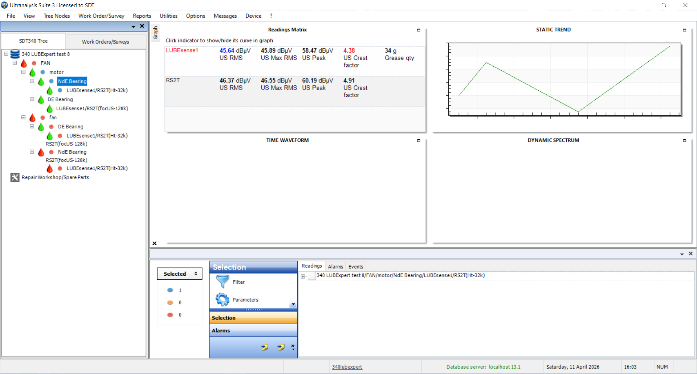
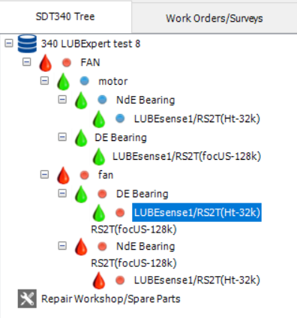
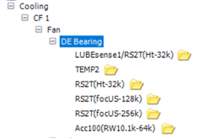
SDT 340 L – sensor perspective

Slide 13
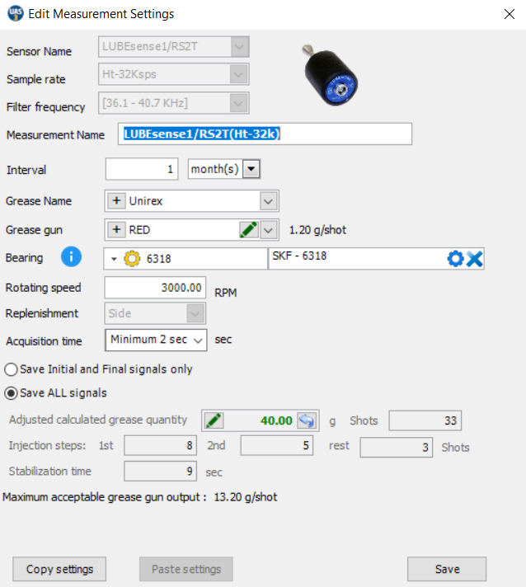
SDT340 LUBExpert Mode – UAS3 MP SETTINGS
Most of the settings are the same
You can now choose to save signals (TWF and Spectrum) from ALL steps or only Initial and Final

Slide 14
SDT340 LUBExpert Mode/UAS3 – INDICATORS, TWF, SPECTRUM
SDT340 LUBExpert Mode collects Dynamic measurements by default
User can choose to collect Dynamic measurements of ALL STEPS in the process, and it will apply to both GUIDED mode and FREE mode equally
It is very valuable, but in some cases uncomfortable: if the operator lubricates 60 bearings in one tour, with an average of 5 steps per process, that would be 300 dynamic measurements - a lot to download, and it is not always necessary

Slide 15
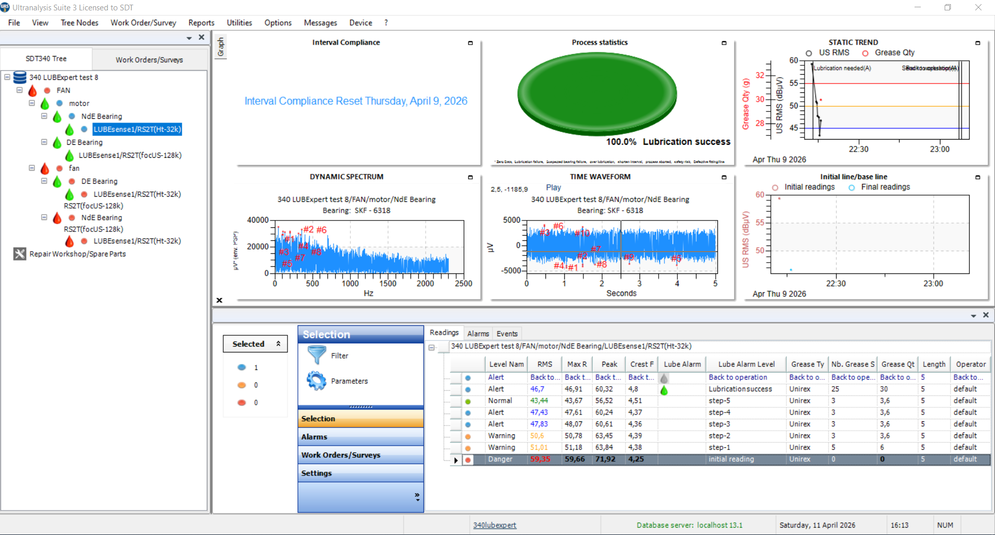
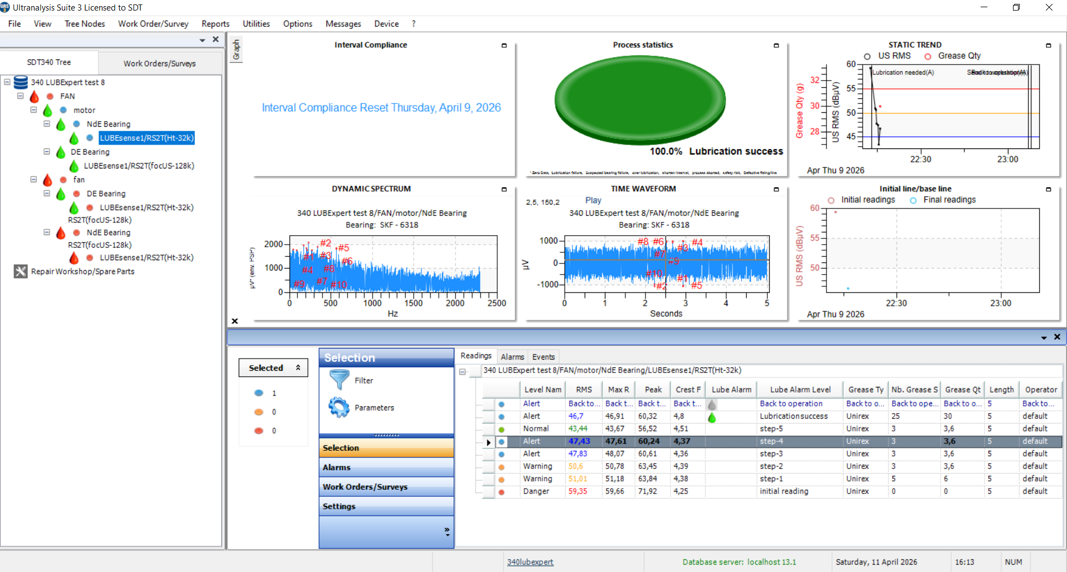
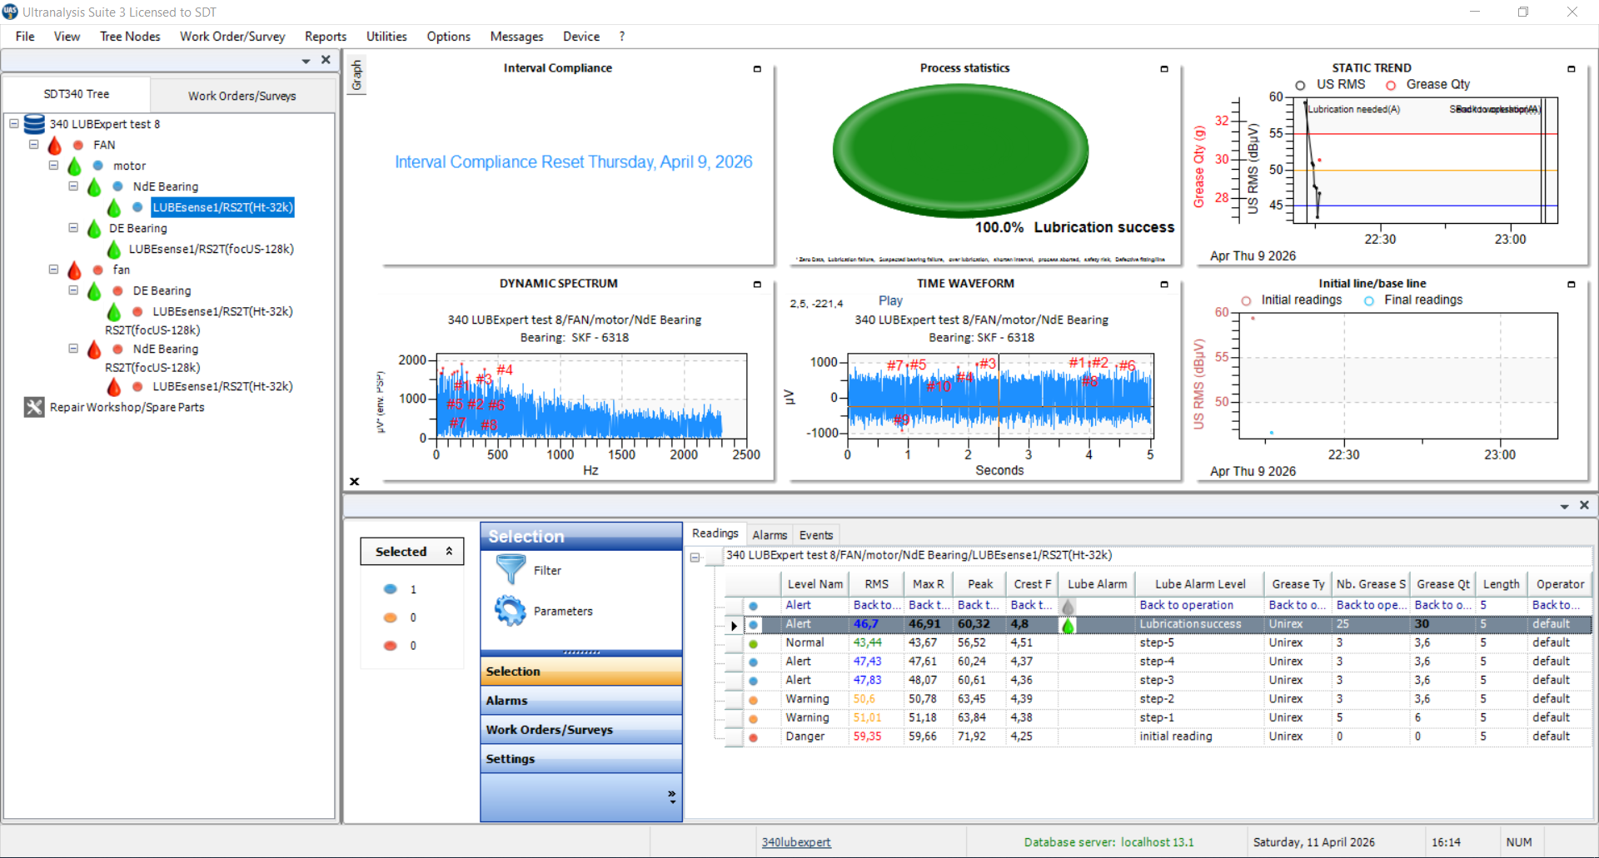
SDT 340 L – MP settings

Slide 16
SDT340 LUBExpert Mode/UAS3 – INDICATORS, TWF, SPECTRUM
SDT340 LUBExpert Mode collects Dynamic measurements by default
User can choose to collect Dynamic measurements of INITIAL AND FINAL STEP, and it will apply to both GUIDED mode and FREE mode
The initial and final steps will contain Dynamic measurements, while all steps in between will have Indicators (RMS, maxRMS, PEAK, CF, Grease quantity)

Slide 17
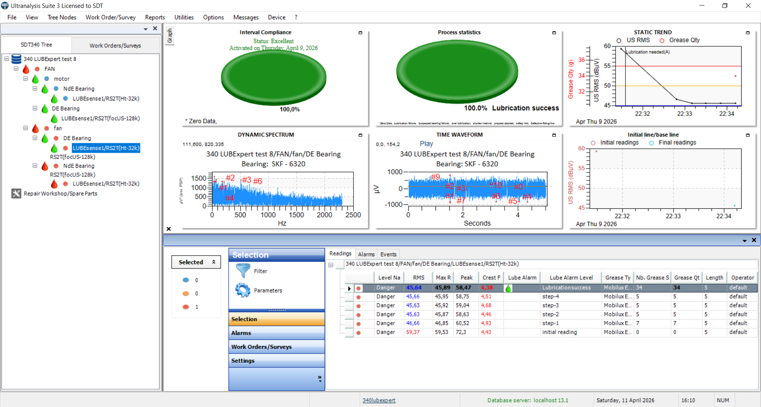
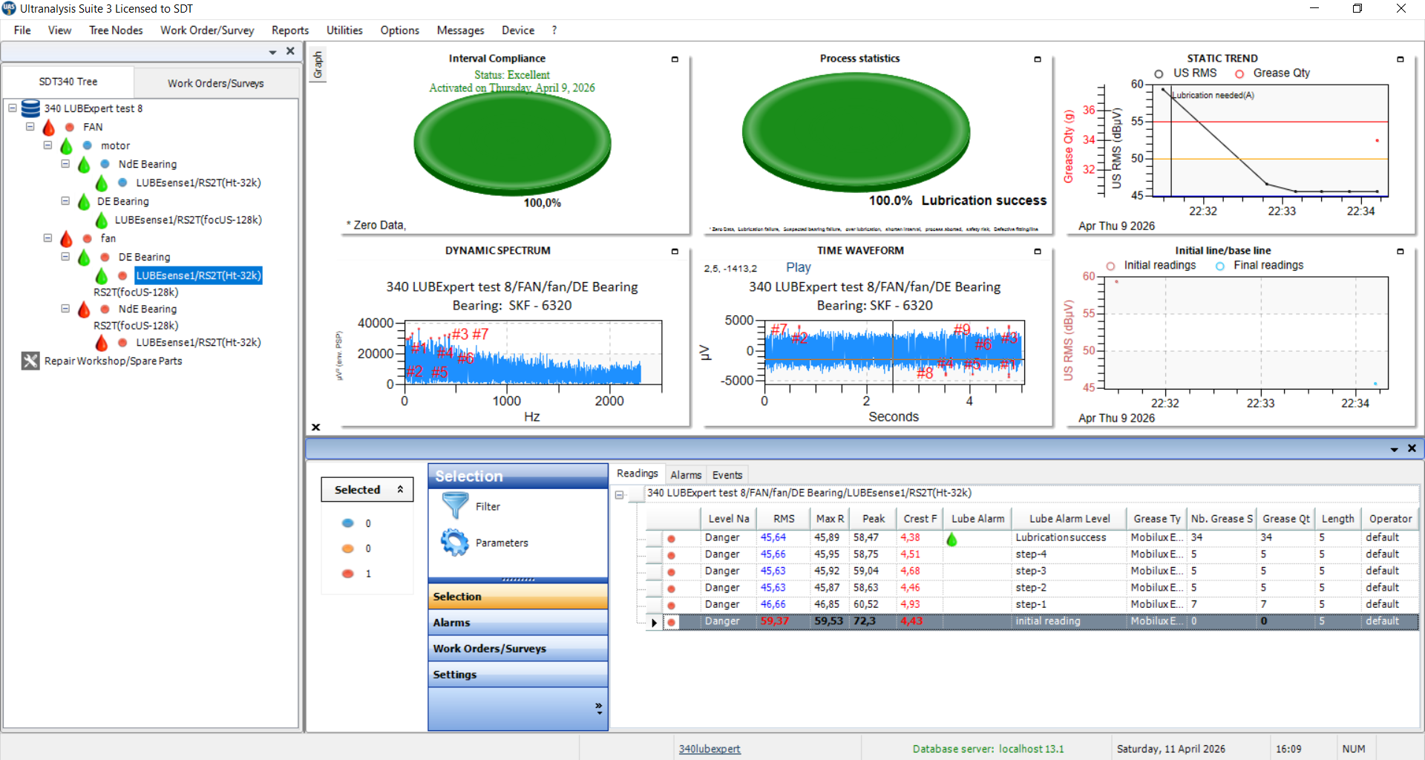
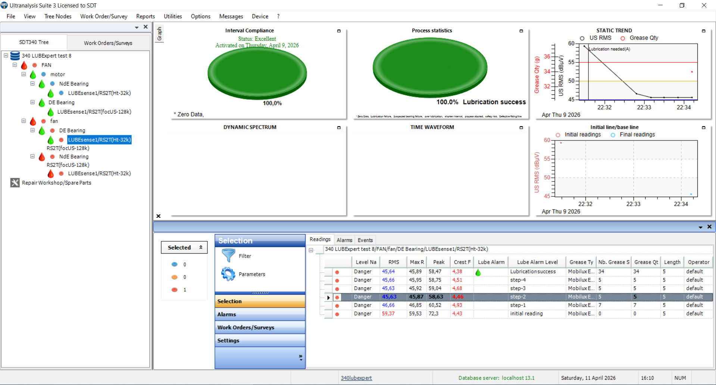
SDT 340 L – Indicators, TWF, Spectrum

Slide 18
SDT340 LUBExpert Mode – OTHER SETTINGS
Messages – as before
Work orders – as before
Interval Compliance Indicator – as before
Alarms – as before (RMS alarm triggers Lubrication sequence)

Slide 19
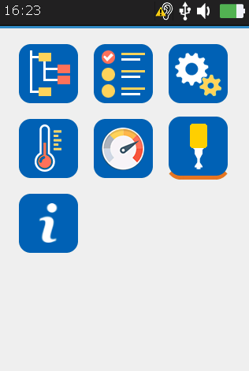
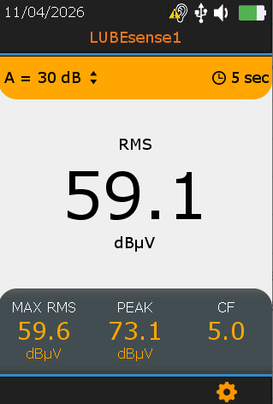
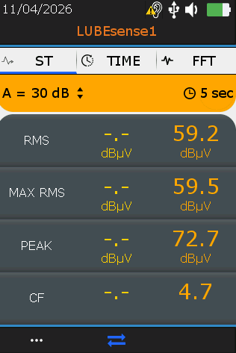
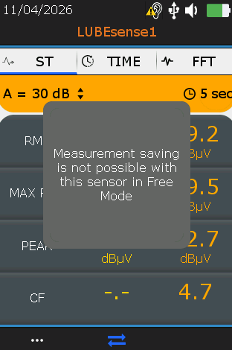
SDT340 LUBExpert Mode
LUBEsense1 cannot be used in Free Sensor Mode on the SDT340
Only as a functional test

Slide 20
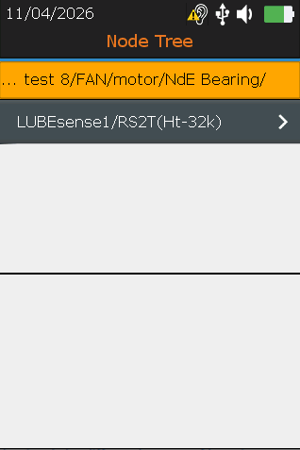
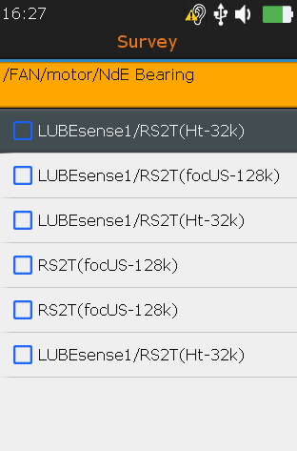
SDT340 LUBExpert Mode
Use Tree Mode or Work Order/Survey Mode

Slide 21
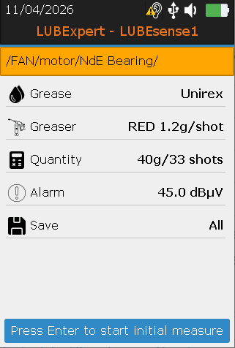
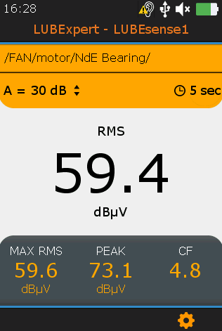
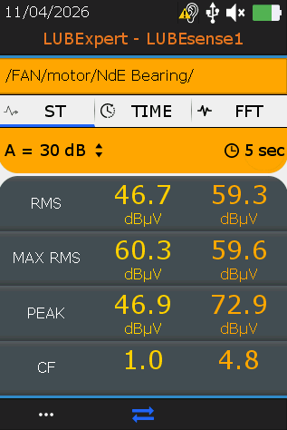
SDT340 L
Once LUBEsense1/RS2T is selected:
Location
Grease type
Grease gun
Calculated quantity
Alarm
Selected measurements saving option

Slide 22
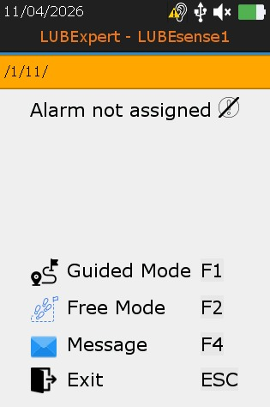
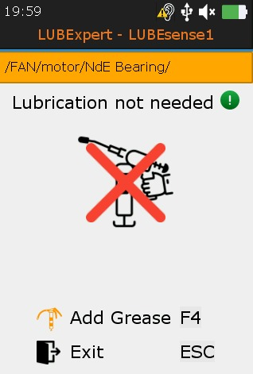
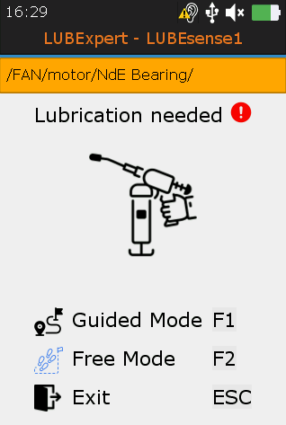
SDT340 LUBExpert Mode
After the initial measurement is saved:

Slide 23
SDT340 LUBExpert Mode
Alarm not assigned
All options available
  Add grease
  Assign a message
  Exit

Slide 24
SDT340 LUBExpert Mode
Alarm assigned and not triggered:
Exit – done
Add grease only after adding a message

Slide 25
SDT340 LUBExpert Mode
Alarm assigned and triggered:
Add grease – Guided of Free mode
Exit only after adding a message

Slide 26
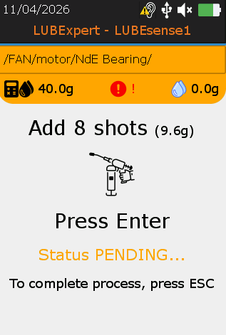
SDT340 LUBExpert Mode – Guided Mode
Screen – follow the instructions:
Alarm status
Added quantity
Calculated quantity
Instructions
Current status
Emergency exit, abort process

Slide 27
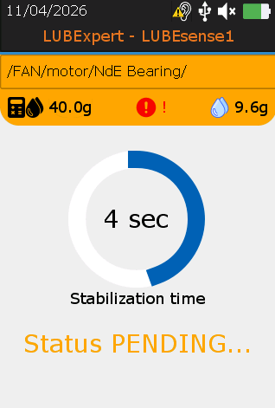
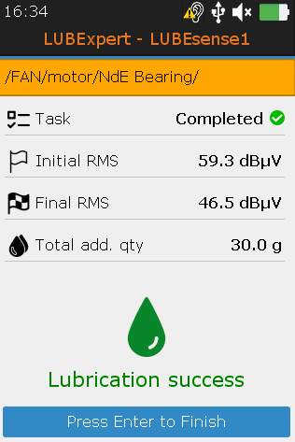
SDT340 LUBExpert Mode – Guided Mode
Follow the steps, complete the process:

Slide 28
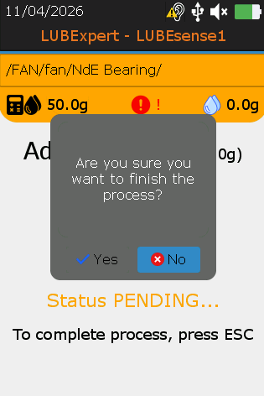
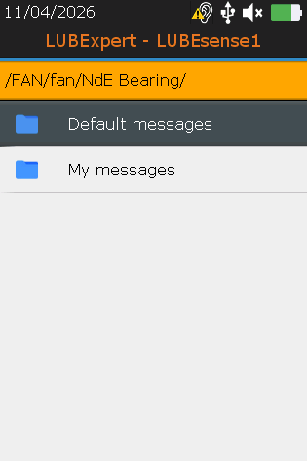
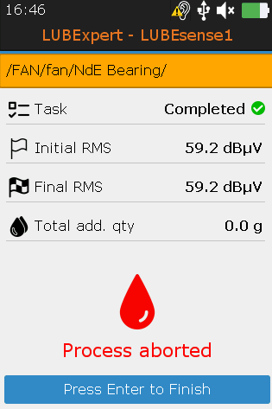
SDT340 LUBExpert Mode – Guided Mode
Emergency exit/aborting the process – press ESC
Add message from Default messages

Slide 29
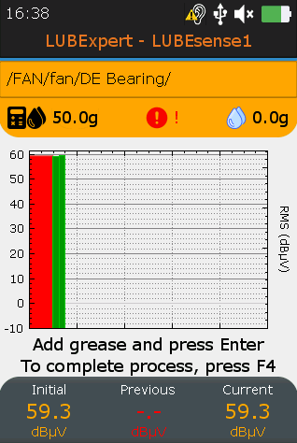
SDT340 LUBExpert Mode – Free Mode
Readings displayed in bar graph/numerically
Each measurement, new bar
Between the measurements, temporary bars
“Floating bars” between two readings, during the grease adding, refreshed every 2 seconds.
Initial reading
Ending the process

Slide 30
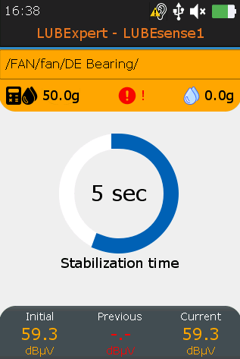
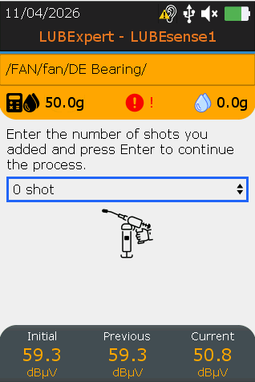
SDT340 LUBExpert Mode – Free Mode
Add grease (watch development) and press enter for measurement
Once measurement saved – enter the number of shots
  No forgetting

Slide 31
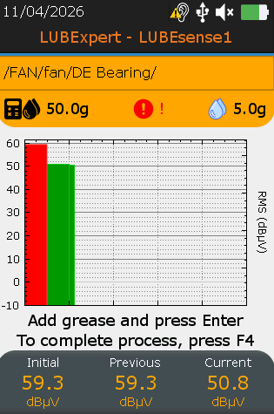
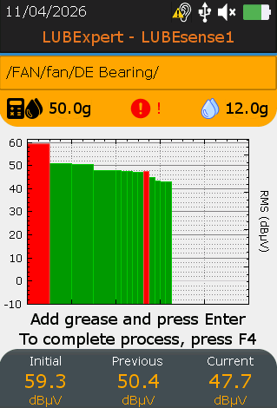
SDT340 LUBExpert Mode – Free Mode
Step 1 is shown as a next bar, new floating bars continue
Continue steps
“Floating bars” between two readings, during the grease adding, refreshed every 2 seconds.
Initial reading
Step 1

Slide 32
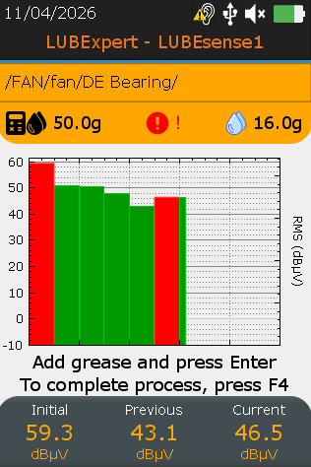
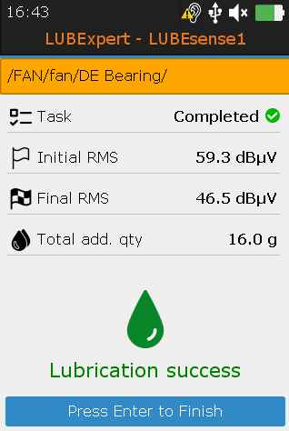
SDT340 LUBExpert Mode – Free Mode
Once it deflects, complete the process by pressing F4
Confirm the completion summary screen

Slide 33
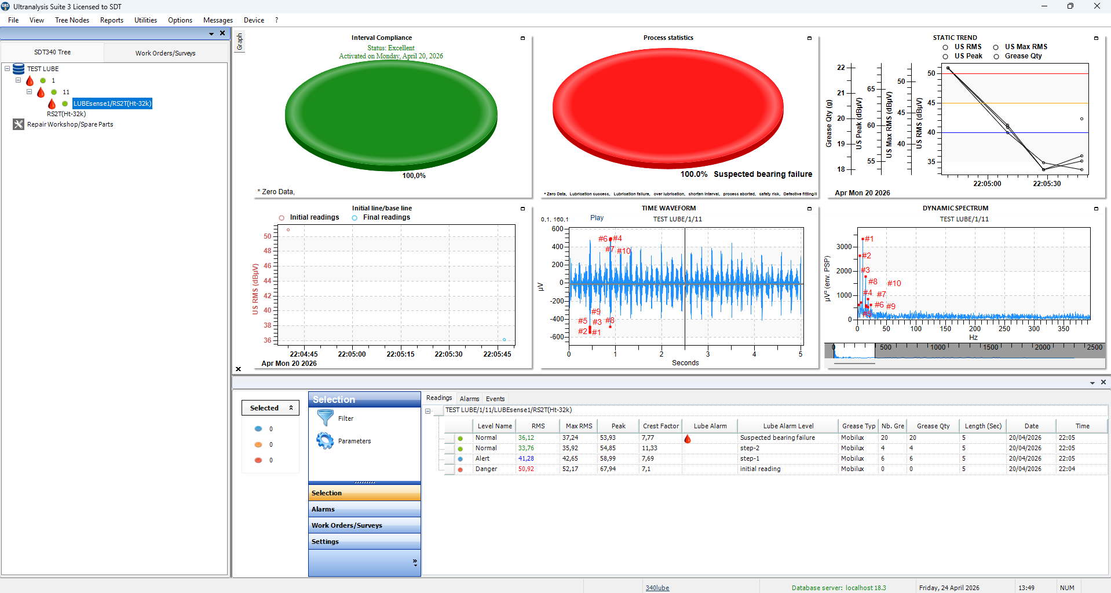
SDT340 LUBExpert Mode – UAS3
Download the data and use UAS3

Slide 34
SDT340 LUBExpert Mode & UAS3
Let us see it in practice

Slide 35




BIG THANKS
Great work by Mohammed and Murat
Wise advice from Merlin
I helped

Slide 36


BIG THANKS
It all needs to be nicely packed and published by Fred and Gauthier

Slide 37


BIG THANKS
It never works without proper leadership, Benoit and Fabrice

Slide 38




VALUE HAS A PRICE
Choose the right package for your lubrication needs
RECOMMENDED
Key Only
€1,859.50
Full Kit
€2,975.30
Kit Light
€2,326.00
Ref: FAUPGRKEYR340LBX
Ref: FA.UKIT.R340.LBX-01
Ref: FA.UKIT.R340.LBXL-01
Upgrade key code R340 LUBE only
Upgrade key code R340 LUBE
Upgrade key code R340 LUBE
Device cradle
Device cradle
Device cradle
LUBESense1 sensor with cable
LUBESense1 sensor with cable
LUBESense1 sensor with cable
Flat magnetic foot
Flat magnetic foot
Flat magnetic foot
Curved magnetic foot
Curved magnetic foot
Curved magnetic foot
Lube adapter with G-coupler
Lube adapter with G-coupler
Lube adapter with G-coupler
USB manual & software
USB manual & software
USB manual & software
Total: €1,859.50
BASIC
Total: €2,975.30
COMPLETE
Total: €2,326.00
STANDARD
Condition Monitoring
Lubrication Management
Choose the package that fits your needs

Slide 39
OPTIONS FOR YOUR DEMO KIT – PARTNERS ONLY
Full Kit
Ref: FA.UKIT.R340.LBX-01
Upgrade key code R340 LUBE FREE OF CHARGE
Device cradle
LUBESense1 sensor with cable
Flat magnetic foot
STANDARD PARTNER PRICES
Curved magnetic foot
Lube adapter with G-coupler
USB manual & software

Slide 40


NEXT STEPS: ACTION PLAN
01
02
03
04
Upgrade
Equip
Pilot
Rollout Plan
Add the LUBExpert mode license key to your existing SDT 340 to unlock integrated capabilities.
Provide your lubrication teams with dedicated kits and focus implementation on critical assets first.
Run a 90-day pilot program to measure clear reductions in dBµV levels, grease usage, and failures.
Collaborate with our experts to formalize pricing models and build a scalable plant-wide strategy.
Let's Connect for a Live Demo & Custom Pricing
GET STARTED
info@sdtultrasound.com | www.sdtultrasound.com

Slide 41
TARGETED MARKETS
  Small & medium organizations
    All-in-one investment, small team often covering multiple tasks
  Medium organizations
    Already using CM, expanding to Lubrication with modest investment
  Large organizations
    Expanding coverage, optimizing tasks, connecting data
  Service providers
    Optimization, one-man-all-tasks, expanding services offer

Slide 42
WE DID THE FIRST PART OF OUR PART
  Let’s do the rest of it together!
  QUESTIONS TIME

