Slide 1
SDT 270 TankTest

Slide 2
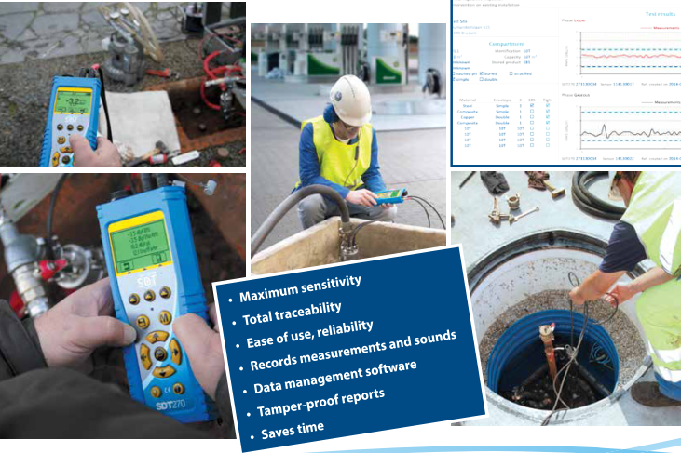
SDT 270 TankTest
Acoustic testing of underground storage tanks and associated pipe work

Slide 3
SDT INTERNATIONAL SDT 270 TankTest
Principle
6 steps to test an underground storage tank
1 – The two dedicated sensors are placed in the tank. One in the liquid and the other in the air phase.
2 – The SDT 270 measures the background noise on the installation (reference value) in dBµV
3 – The tank is placed in a partial vacuum
4 - The diagnosis is established based on a comparison between the reference value at atmospheric pressure and the measurement obtained with the appropriate vacuum level aplied.
5 – The measurements and sound files can be recorded, and inspection reports can be printed out.
6 –The measured dBµV values and recorded audio files are available at any time on the device as well as in in the software.

Slide 4
SDT INTERNATIONAL SDT 270 TankTest
SDT270 Tanktest, one device two possible test procedures.
1. Test procedure in "measurement" mode, without recording data.
Notes:
C = client
A = agent
D = dealer
Forte implantation en EU et en Amerique

Slide 5
SDT INTERNATIONAL SDT 270 TankTest
SDT270 Tanktest, one device two possible test procedures.
2. Test procedure in "measurements + data recording" mode:
Data automatically recorded by the device
- Full date and time stamp of the test
- Device and sensor serial numbers
- Measurements, at the ratio of one measurement per second, over the total duration of the test, with identification of the sensor for each measurement
- possibility to record the sound for each sensor
Notes:
C = client
A = agent
D = dealer
Forte implantation en EU et en Amerique

Slide 6
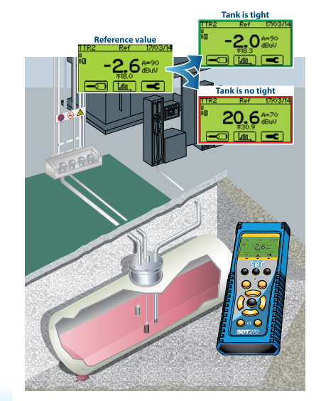
SDT INTERNATIONAL SDT 270 TankTest
SDT 270 TankTest – Set up
Notes:
C = client
A = agent
D = dealer
Forte implantation en EU et en Amerique

Slide 7
SDT INTERNATIONAL SDT 270 TankTest
The method that valorizes and reassures the operator…..
1. The sensitivity of the SDT 270 and the associated sensors offer the system’s unequalled accuracy.
The system detects even the smallest perforations or “mini defetcs” not yet generating a significant degree of pollution.
2. Tank and associated pipping are tested in one single operation.
3. Results are recorded and stored for reporting purposes; the graphs generated in the software confirm the diagnosis.
Notes:
C = client
A = agent
D = dealer
Forte implantation en EU et en Amerique

Slide 8
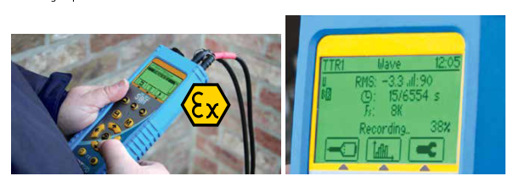
SDT INTERNATIONAL SDT 270 TankTest
The method that valorizes and reassures the operator…..
3. Completely safe, rugged and fully ATEX certified equipment
4. Exceptional ease of use.
…………………in the field
Notes:
C = client
A = agent
D = dealer
Forte implantation en EU et en Amerique

Slide 9
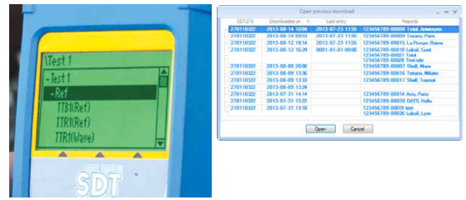
SDT INTERNATIONAL SDT 270 TankTest
The method that valorizes and reassures the operator…..
5. SDT270TT records measurements in dBµV as well as sound files.
Gives complete and irrefutable test results.
Notes:
C = client
A = agent
D = dealer
Forte implantation en EU et en Amerique

Slide 10
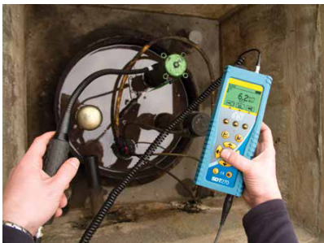
SDT INTERNATIONAL SDT 270 TankTest
The method that valorizes and reassures the operator…..
7. Included flexible sensor is essential for detecting and locating leaks on fittings, joints and plugs.
An installation should not be judged un tight because of a defective fitting.
Notes:
C = client
A = agent
D = dealer
Forte implantation en EU et en Amerique

Slide 11
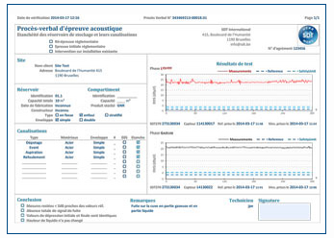
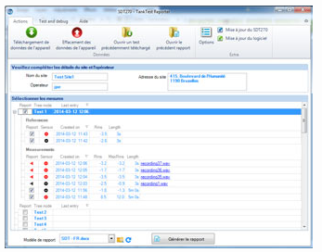
SDT INTERNATIONAL SDT 270 TankTest
SDT 270 TankTest Reporter
1 – Data management software generating detailed and complete reports.
2 – Unique and automatic numbering of reports: simplified data and file searching.
3 – Personalization of reports.
Notes:
C = client
A = agent
D = dealer
Forte implantation en EU et en Amerique

Slide 12
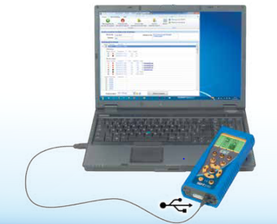
SDT INTERNATIONAL SDT 270 TankTest
SDT 270 TankTest Reporter
4 – Connection via a standard USB port.
5 – Memory within a three-level data structure.
6 – Free license for an unlimited number of inspections.
7 –Free hardware and software updates.
Notes:
C = client
A = agent
D = dealer
Forte implantation en EU et en Amerique

Slide 13
SDT INTERNATIONAL SDT 270 TankTest
Advantages of the SDT acoustic method
1 – No need to empty and clean the tank
2 – No stabilization time
3 – Immediate result, no further analysis required
4 – Testing possible regardless of liquid level (up to 80m³)
5 – Widely recognized and approved method.
Notes:
C = client
A = agent
D = dealer
Forte implantation en EU et en Amerique

Slide 14
SDT INTERNATIONAL SDT 270 TankTest
5 reasons to HEAR MORE with the SDT TankTest acoustic method
1- Ecological
In the event of a leaking tank, no fuel is wasted, and no extra pollution is provoked during the test.
No water used so no water to be depolluted /recycled as is the case with the hydraulic method.
Notes:
C = client
A = agent
D = dealer
Forte implantation en EU et en Amerique

Slide 15
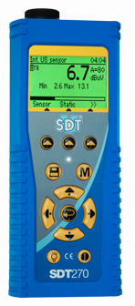
SDT INTERNATIONAL SDT 270 TankTest
5 reasons to HEAR MORE with the SDT TankTest acoustic method
2 -Fast
The acoustic method does not require emptying the tank and filling it with water as with the hydraulic method.
There is no down time.
Allows to test tank and piping in a single operation without opening the manhole.
Notes:
C = client
A = agent
D = dealer
Forte implantation en EU et en Amerique

Slide 16
SDT INTERNATIONAL SDT 270 TankTest
5 reasons to HEAR MORE with the acoustic SDT TankTest method
3 - Precise
The SDT TankTest method detects even
the smallest of perforations or
"mini faults" not yet causing a leak.
It allows you to locate the tightness
problem, on the tank,
around the manhole cover, on the pipes
and on connections.
Notes:
C = client
A = agent
D = dealer
Forte implantation en EU et en Amerique

Slide 17
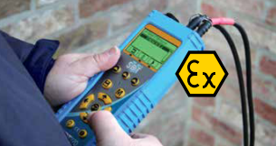
SDT INTERNATIONAL SDT 270 TankTest
5 reasons to HEAR MORE with the SDT TankTest acoustic method
4 - Reliable and safe
The test can be carried out whatever the liquid level (max. 2 meters) except if the tank is 100 % full. The SDT TankTest is not influenced by temperature, humidity or the angle of the tank. It is just as effective in dry environments as in wet.
The equipment is fully ATEX certified.
Flexible sensor included. The sensor is essential for detecting and locating leaks on fittings, joints and plugs.
An installation cannot be judged un tight for simply having a loose fitting!.
Notes:
C = client
A = agent
D = dealer
Forte implantation en EU et en Amerique

Slide 18
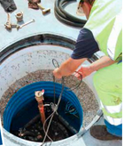
SDT INTERNATIONAL SDT 270 TankTest
5 reasons to HEAR MORE with the SDT TankTest acoustic method
5 - Easy to use
The equipment is simple to use , the test can easily be carried out by anyone who has received appropriate training.
Notes:
C = client
A = agent
D = dealer
Forte implantation en EU et en Amerique

Slide 19
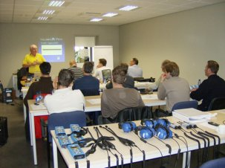
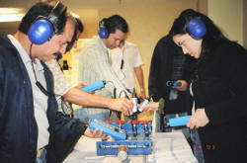
SDT INTERNATIONAL SDT 270 TankTest
SDT training programs, a good investment!
Companies that invest in training see the understanding and involvement of their inspectors increase significantly. The testing of underground tanks with the SDT acoustic method is more effective and therefore more reliable. A good training program is a guarantee for quick return on investment.
With more than 20 years of experience in training customers throughout the world, SDT offers collective and – private – on-site training programs. Courses focus on methodology, rapid familiarization with the detector and its accessories and use of the dedicated software.
Notes:
C = client
A = agent
D = dealer
Forte implantation en EU et en Amerique

Slide 20
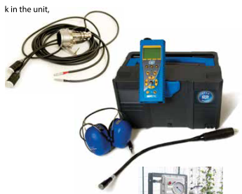
SDT INTERNATIONAL SDT 270 TankTest
The kit contains:
SDT270 TankTest-receiver with battery, blue rubber protection and user manual on USB stick
Precision indicator accessories
Noise isolating headphones
Battery loader
USB cable and "TankTest Reporter"-software on USB stick
Tube of water-detection paste
Storage case for ultrasonic sensors
Two watertight sensors (explosion proof and impervious to hydrocarbons)
Notes:
C = client
A = agent
D = dealer
Forte implantation en EU et en Amerique

