Slide 1
SDT Ultrasound Solutions
Who are we?

Slide 2
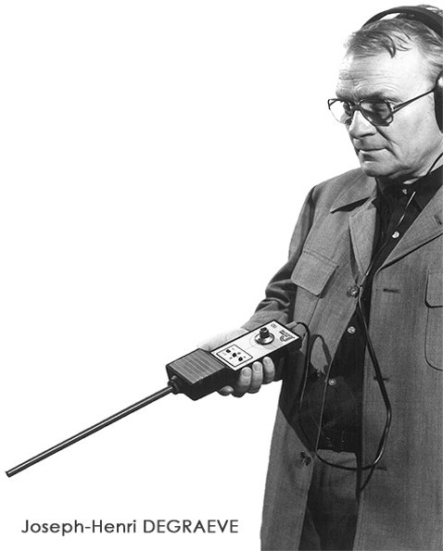
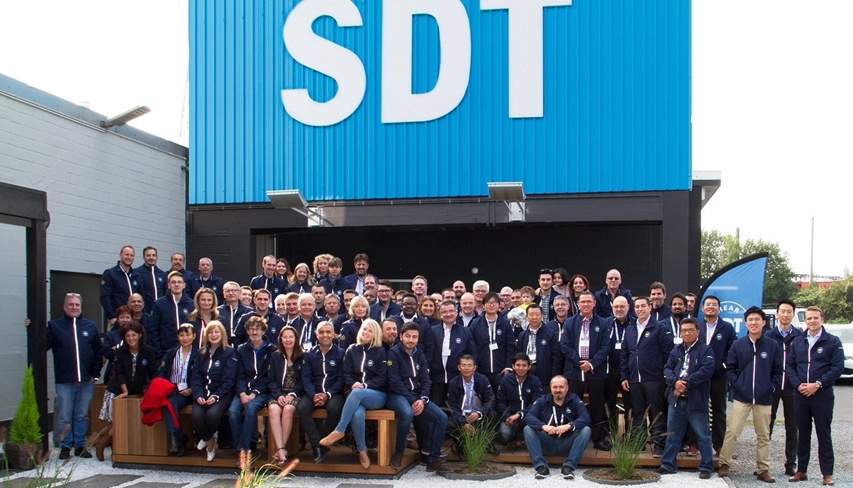
Founded 1975 by J.H. DEGRAEVE
Belgian manufacturer based in Brussels
SDT North America in Cobourg – Ontario (Canada)
SDT India
SDT Italia Milan
Delivers solutions in 64 countries, with 300 partners
Notes:
Founded in 1975 by Joseph Henry Degraeve, in Brussels, as a company focused on development and manufacturing of Ultrasound Solution. Today, SDT delivers solutions in 64 countries through 300 partners .. And growing. Besides SDT International in Brussels, there is SDT North America in Coburg – Ontario, Canada, SDT India and SDT Italy in Milan. In 45 years of continuous development we have become a technology leader and .. What we a especially proud of .. A favorite Ultrasound Solution provider. We moved quite a bit in those 45 productive years.

Slide 3
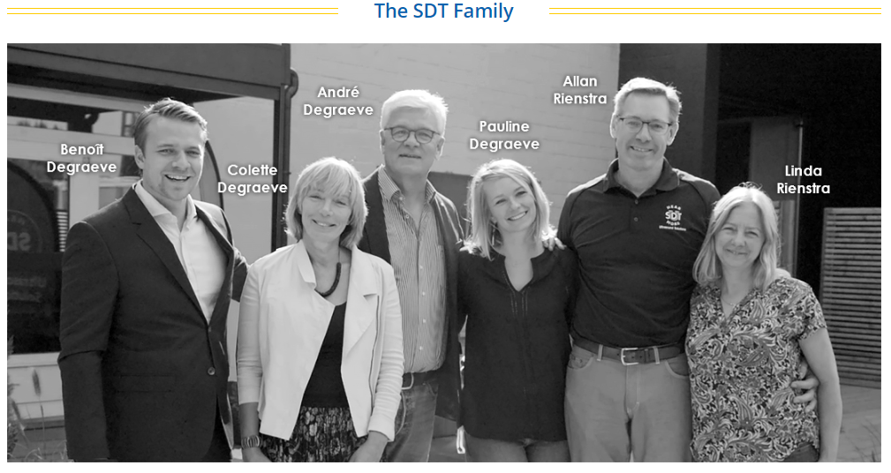
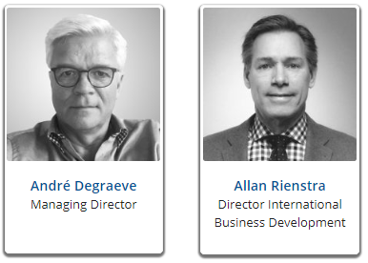
Family Spirit
core business
Since 45 years
Notes:
Family spirit of the company starts with Degraeves and Rienstras .. … and family grows ..

Slide 4
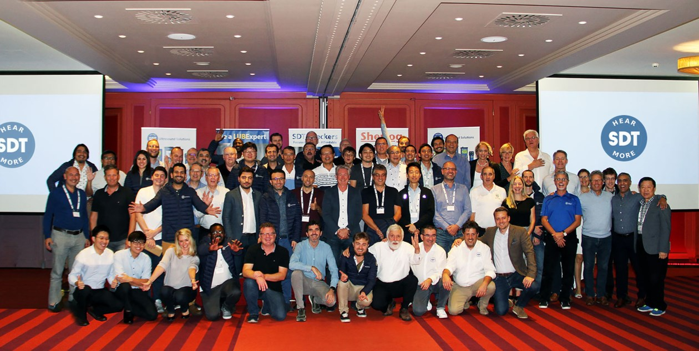
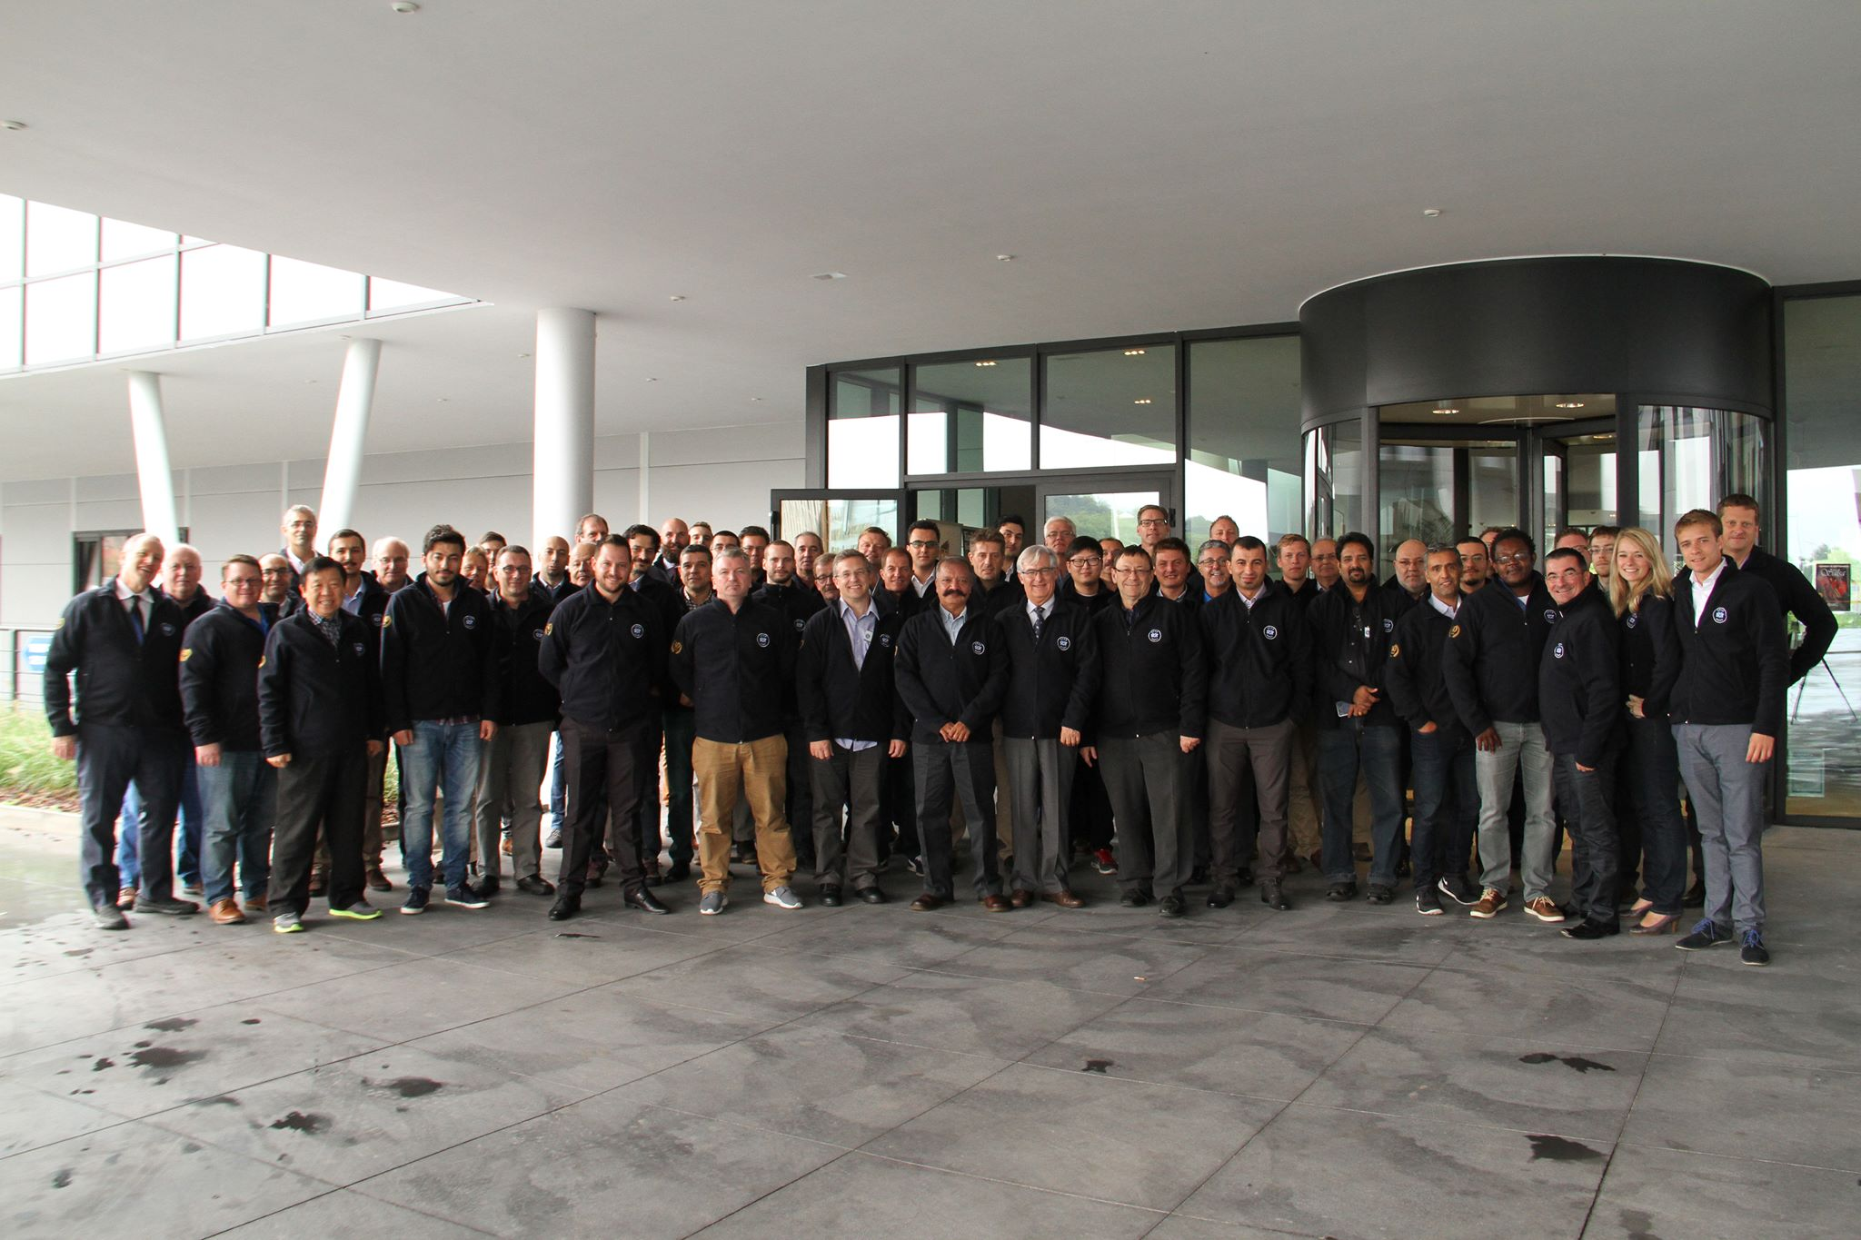
Notes:
.. It grows into big family of people that share same values, same beliefs … and same goal
.. Family that smiles

Slide 5
SDT Ultrasound Solutions
Mission
Industry that we would like to leave to our children
”
SDT's mission is to offer a simple solution to Reliability improvements in order to reduce energy consumption while extending the life of the assets
”
Notes:
Goal that entire family shares is making a positive impact on industry, making it more profitable, more environment friendly and much safer, through solutions tailored to be easily used
Therefore, our mission is clear .. to offer a simple solution to Reliability improvements in order to reduce energy consumption while extending the life of the assets

Slide 6
Wait for the problem
Develop solution
Implement it
Deliver benefit
Wait for the problem
Develop solution
Implement it
Deliver benefit
Anticipate the problem
Develop solution
Implement it
Deliver benefit
Notes:
Industry suffers from many different problems, when one is resolved, another one appears .. And that will never end, change is constant … and if it is not positive, it will be detrimental.
Balancing profit, clean environment and operation safety is changing daily, and we can not consider any of three elements less important
That puts a huge task in front of solution developers, now much more different task than before. Changes appear much faster than ever .. Waiting for problems is not an option .. We must be one step ahead of them

Slide 7
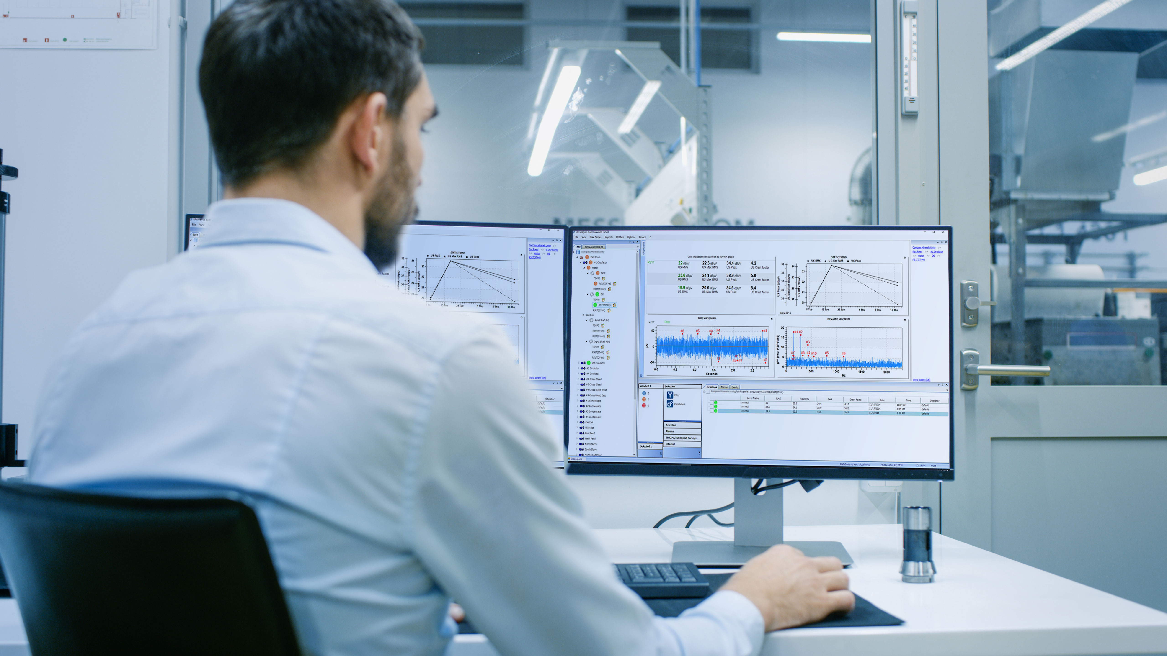
Time to change those bad statistics
Notes:
We face lots of bad statistics , from safety, through environment, .. To lost bottom line .. And one always causes other, none of them ever come alone..
Using science as a guide … and passion as a fuel .. It is time to change those bad statistics

Slide 8
Hardware
Software
Training & Implementation
Continuous support
Notes:
Our solutions are developed by people who are users themselves .. Experts who take responsibility for delivering benefit
That solution … benefit delivering solution .. Is built from several crucial elements
Hardware and software .. Converting symptoms into data and connecting assets with people
Training and implementation, … connecting people with data .. And connecting them with environment .. Reliability culture
Continuous support .. Removing roadblocks through entire journey

Slide 9
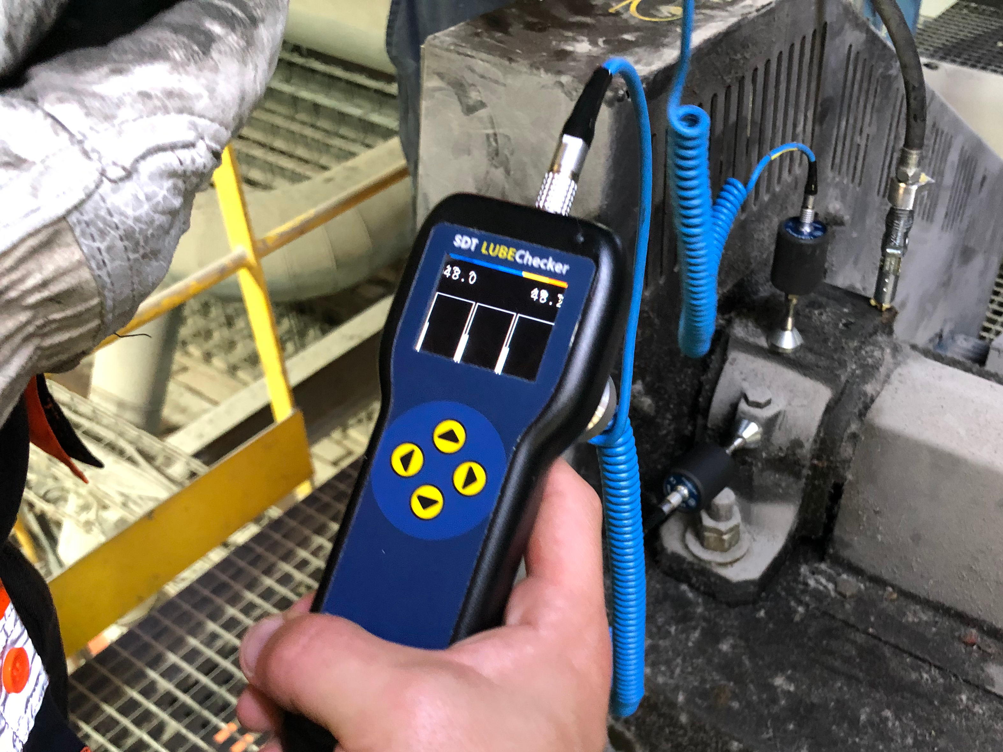
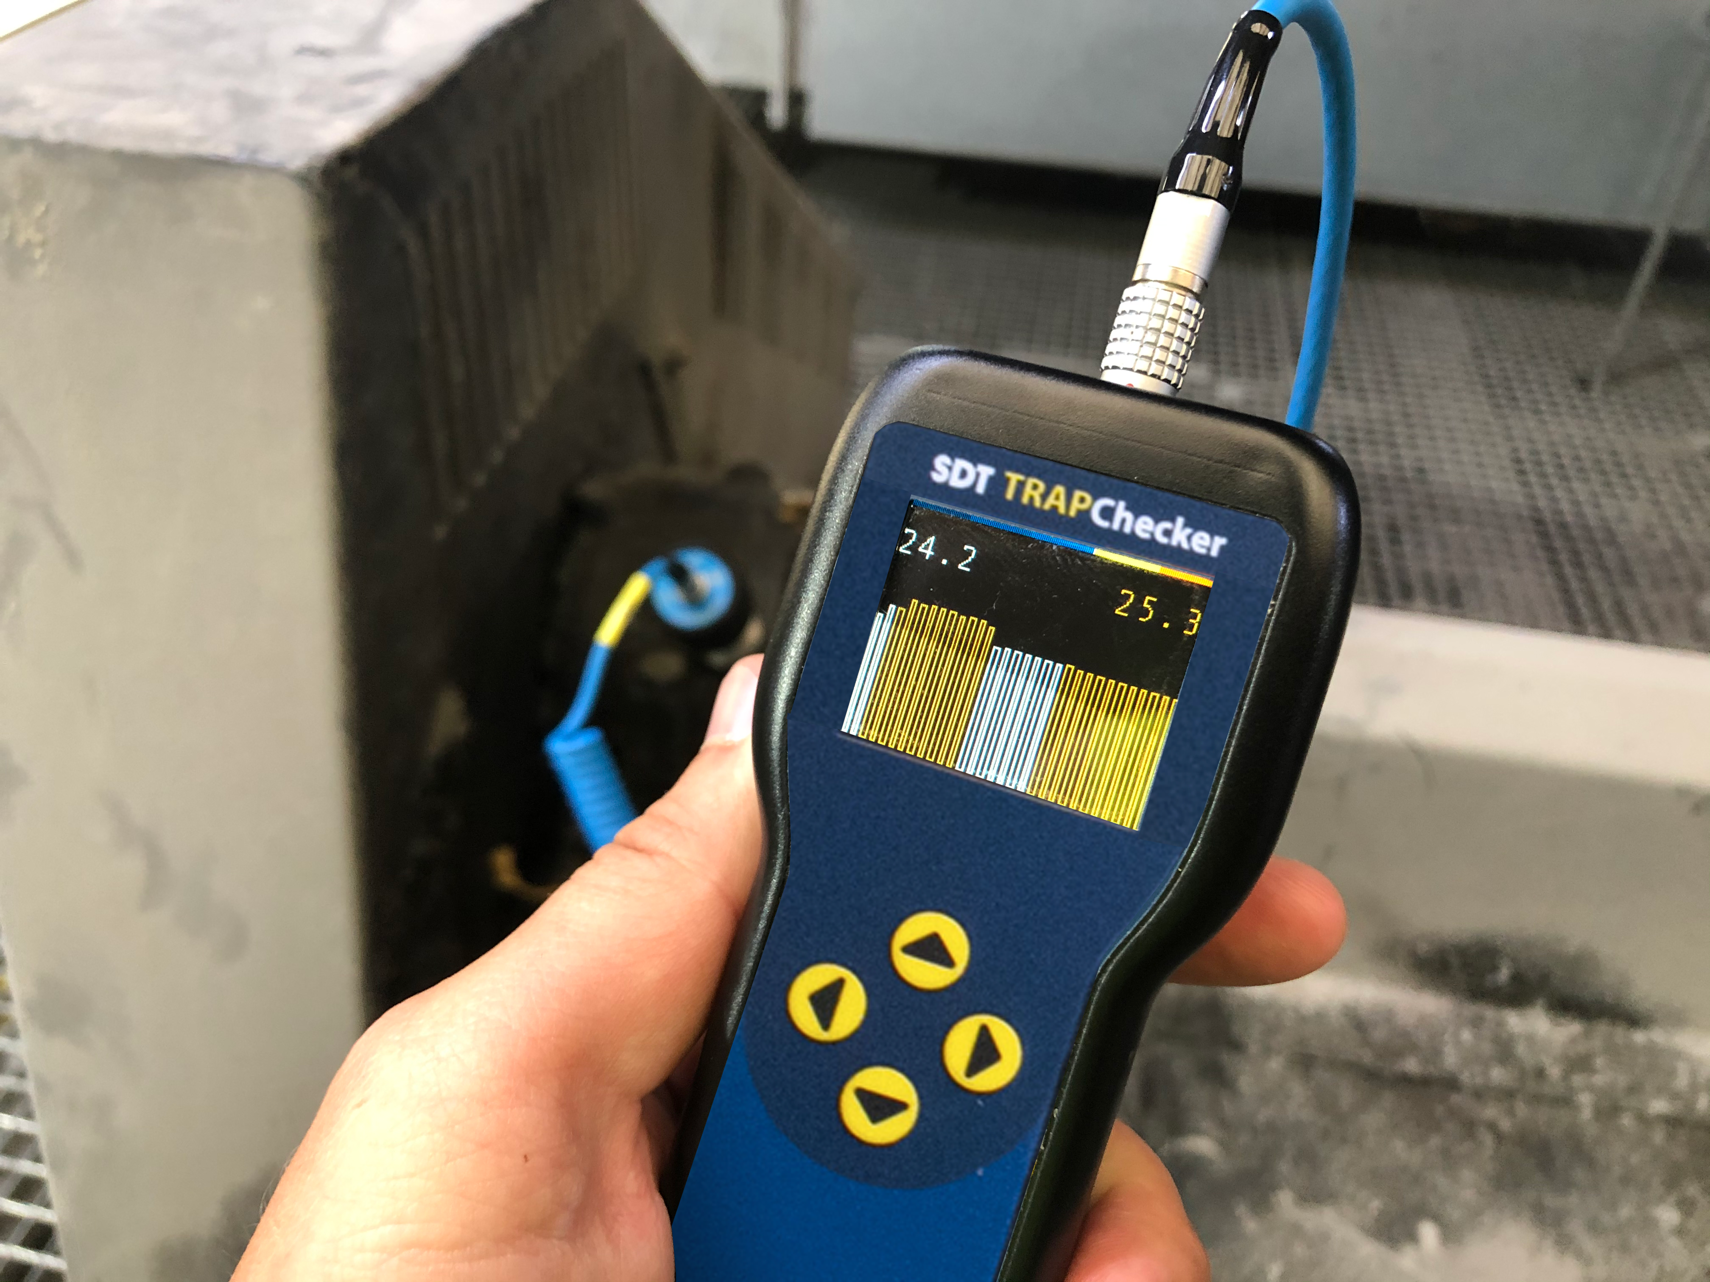
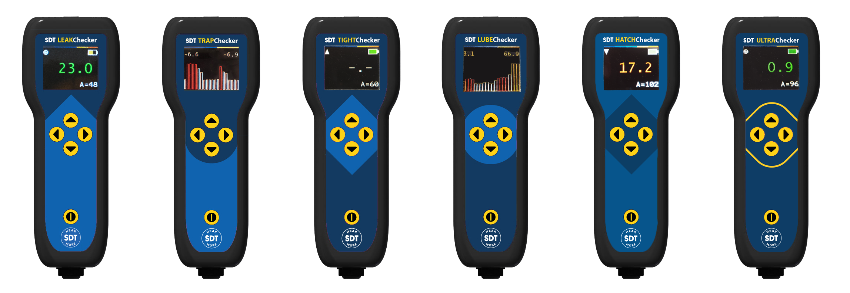
Notes:
From simple, affordable focused solutions .. Targeting one specific applications … in Checkers Range

Slide 10
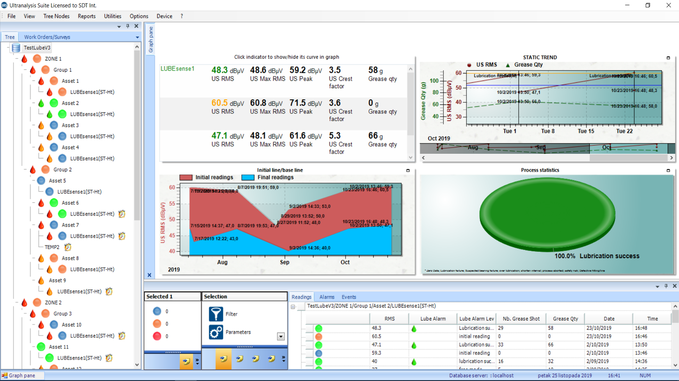
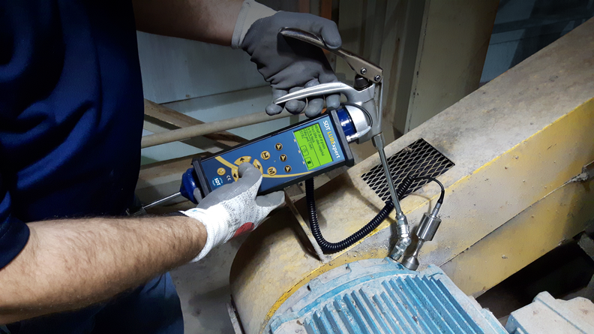
Notes:
Specialized solutions .. Like LUBExpert Unique, game changing technology .. Slubrication strategy that thinks with you and thinks for you

Slide 11
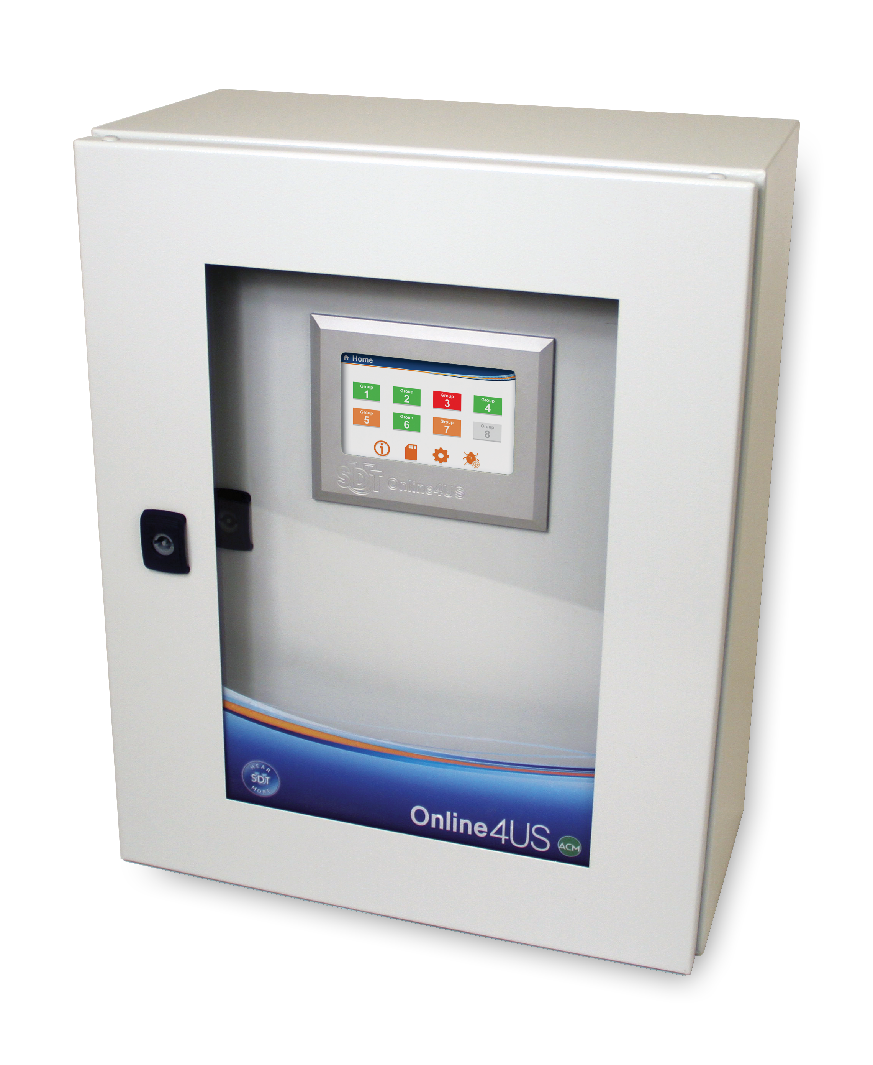
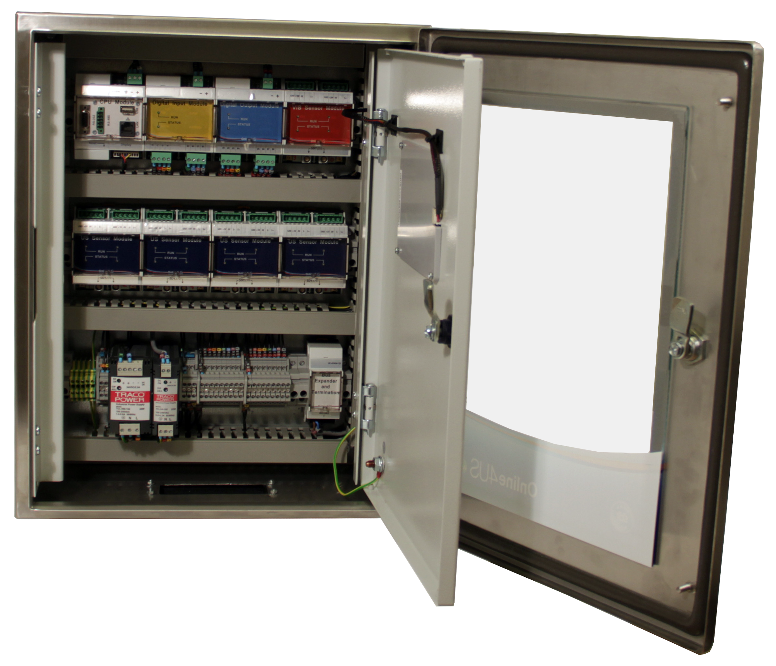
Notes:
Online4US

Slide 12
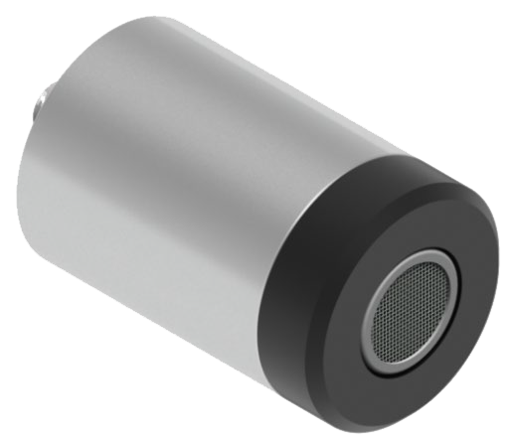
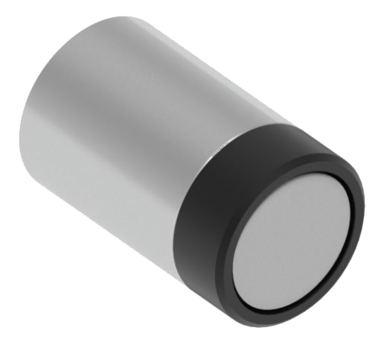
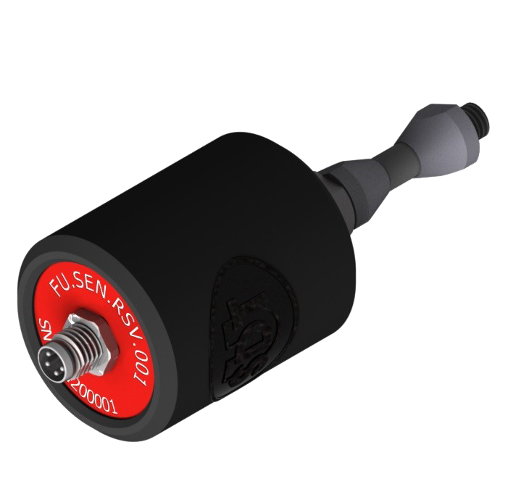
Notes:
CONMONSense range

Slide 13
Notes:
VIGILANT

Slide 14
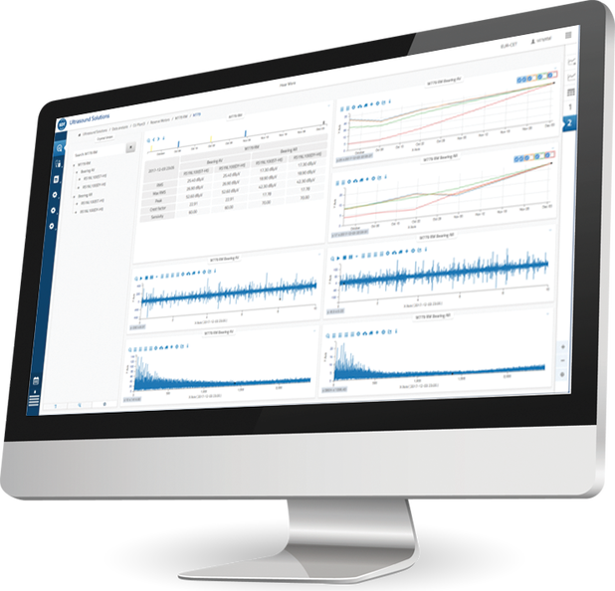
Notes:
Advanced technology Condition Monitoring Solutions … SDT 340 & UAS 4.0

Slide 15
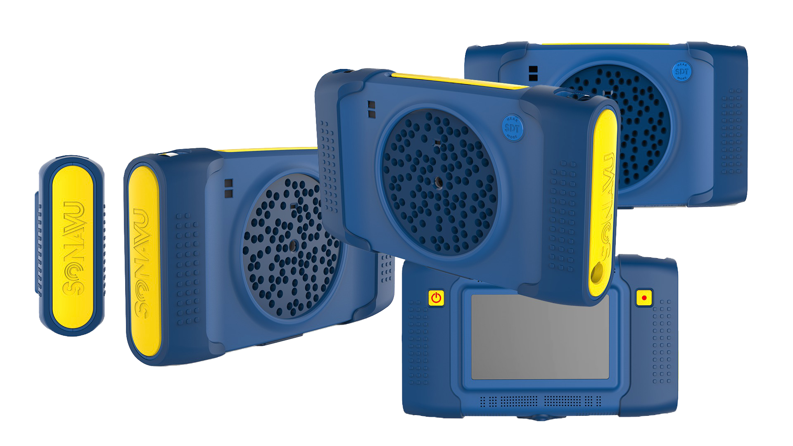
Notes:
Advanced technology Condition Monitoring Solutions … SDT 340 & UAS 4.0

Slide 16
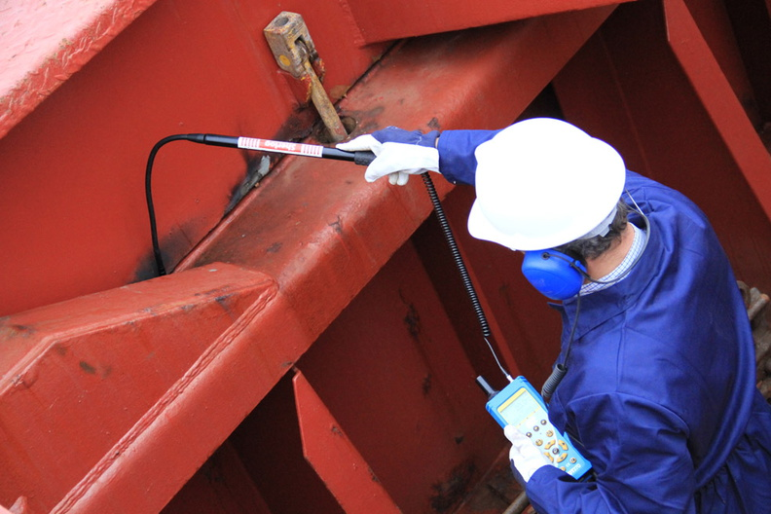
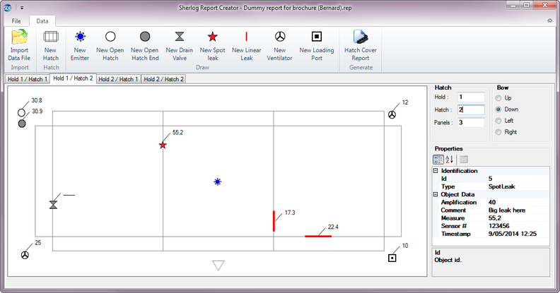
Notes:
Specialised solutions for marine industry – Sherlog ..

Slide 17
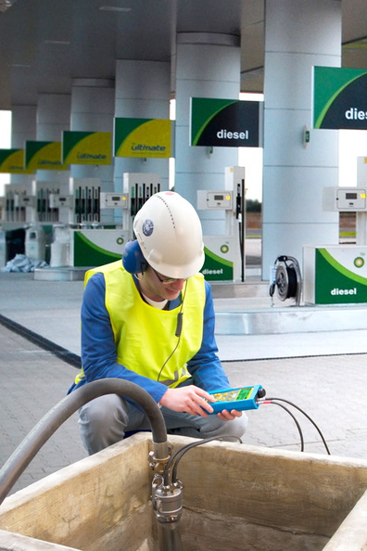
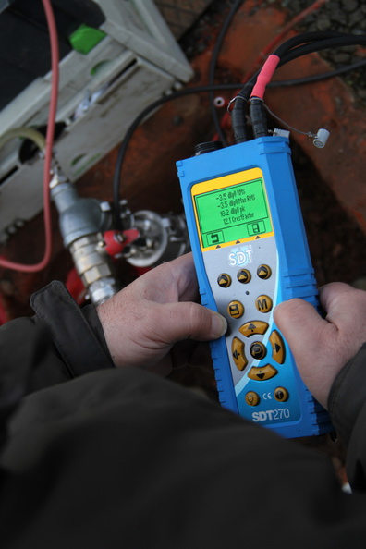
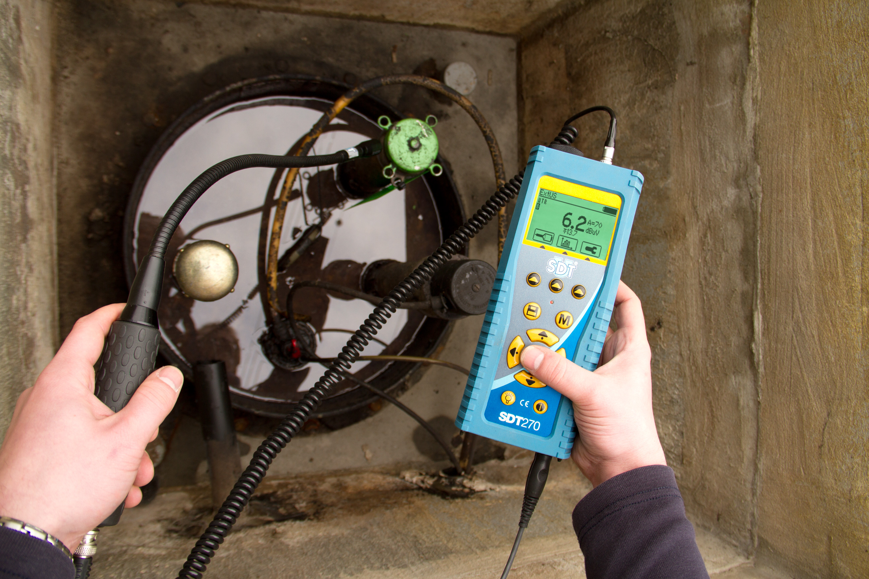
Notes:
Underground Tank testing

Slide 18
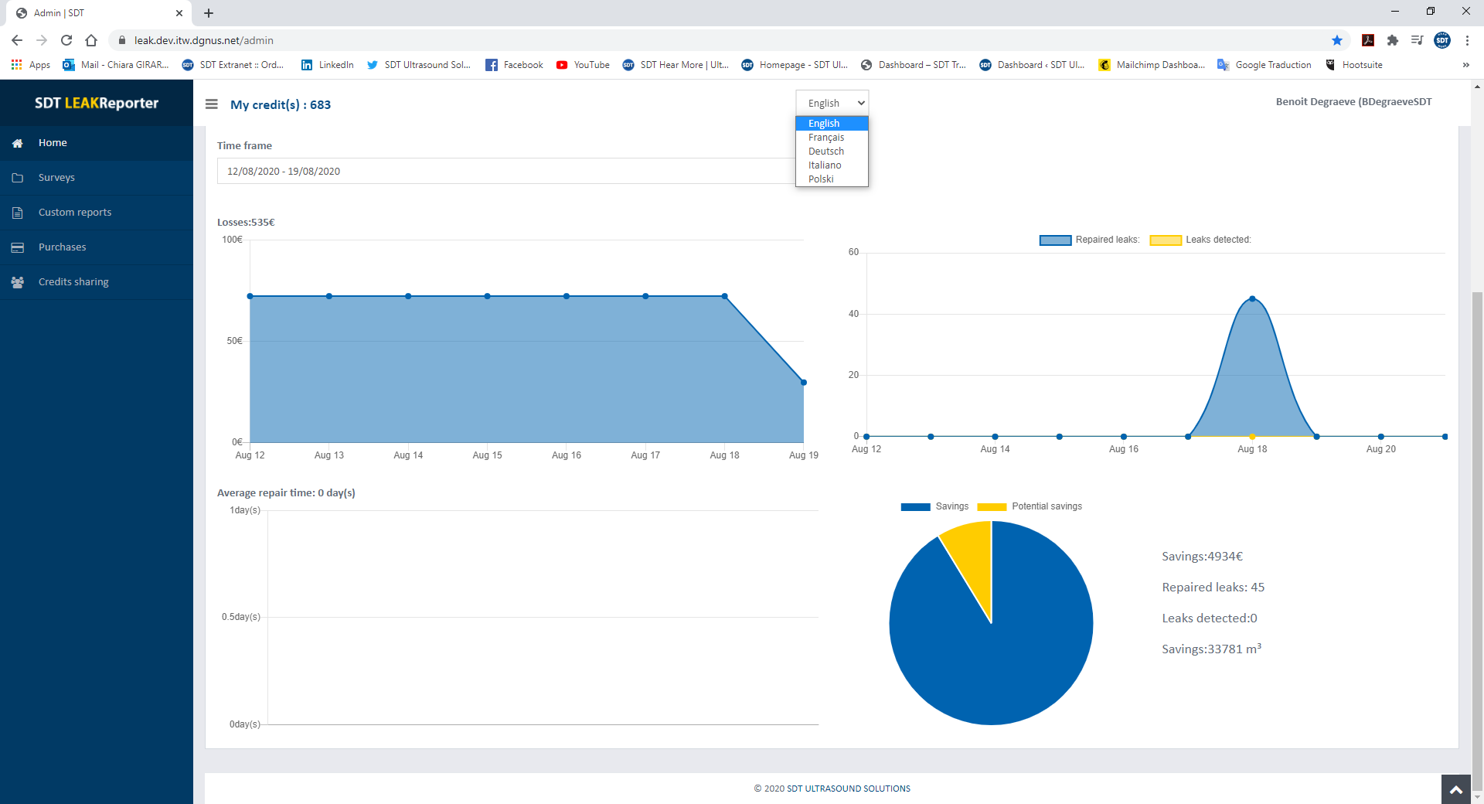
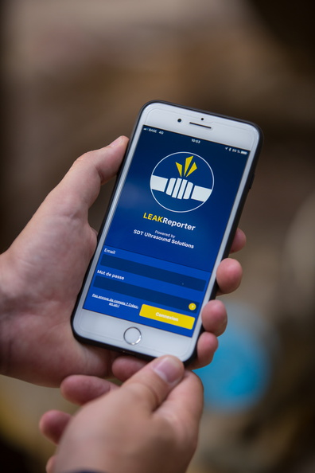
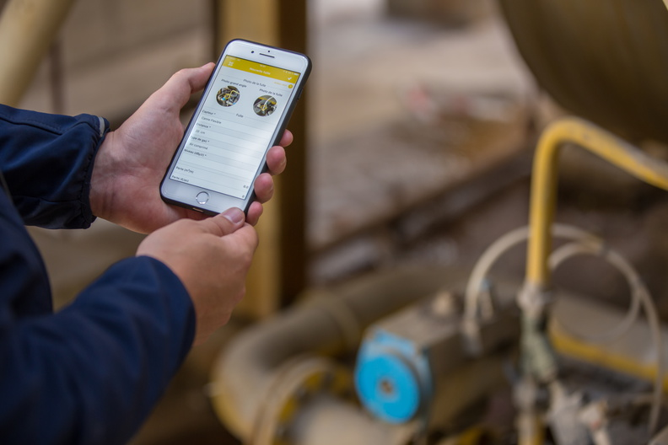
Notes:
Customized apps for various tasks

Slide 19
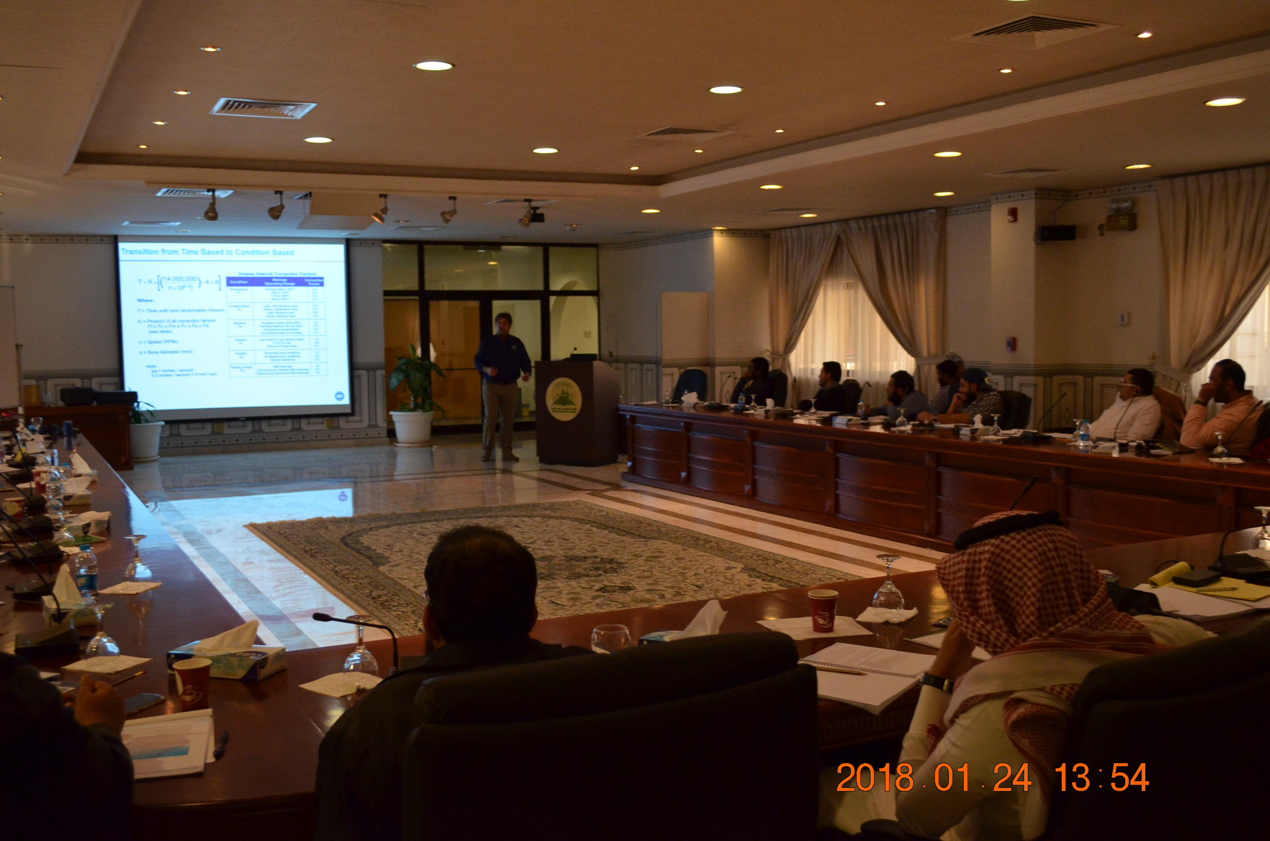
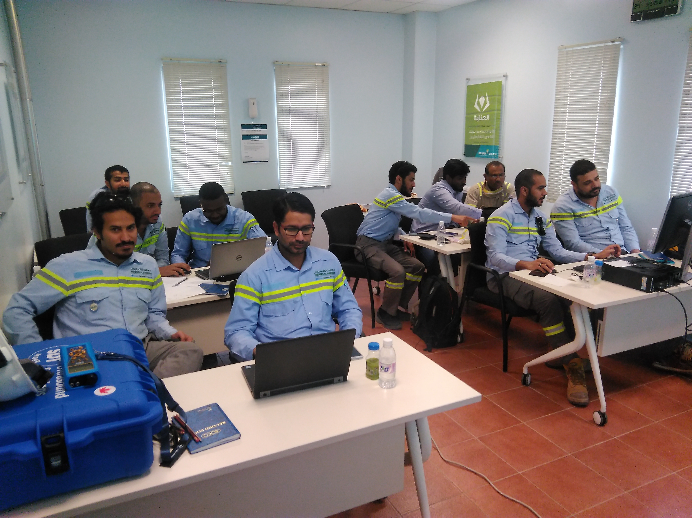
On-site certification trainings & exams

Slide 20
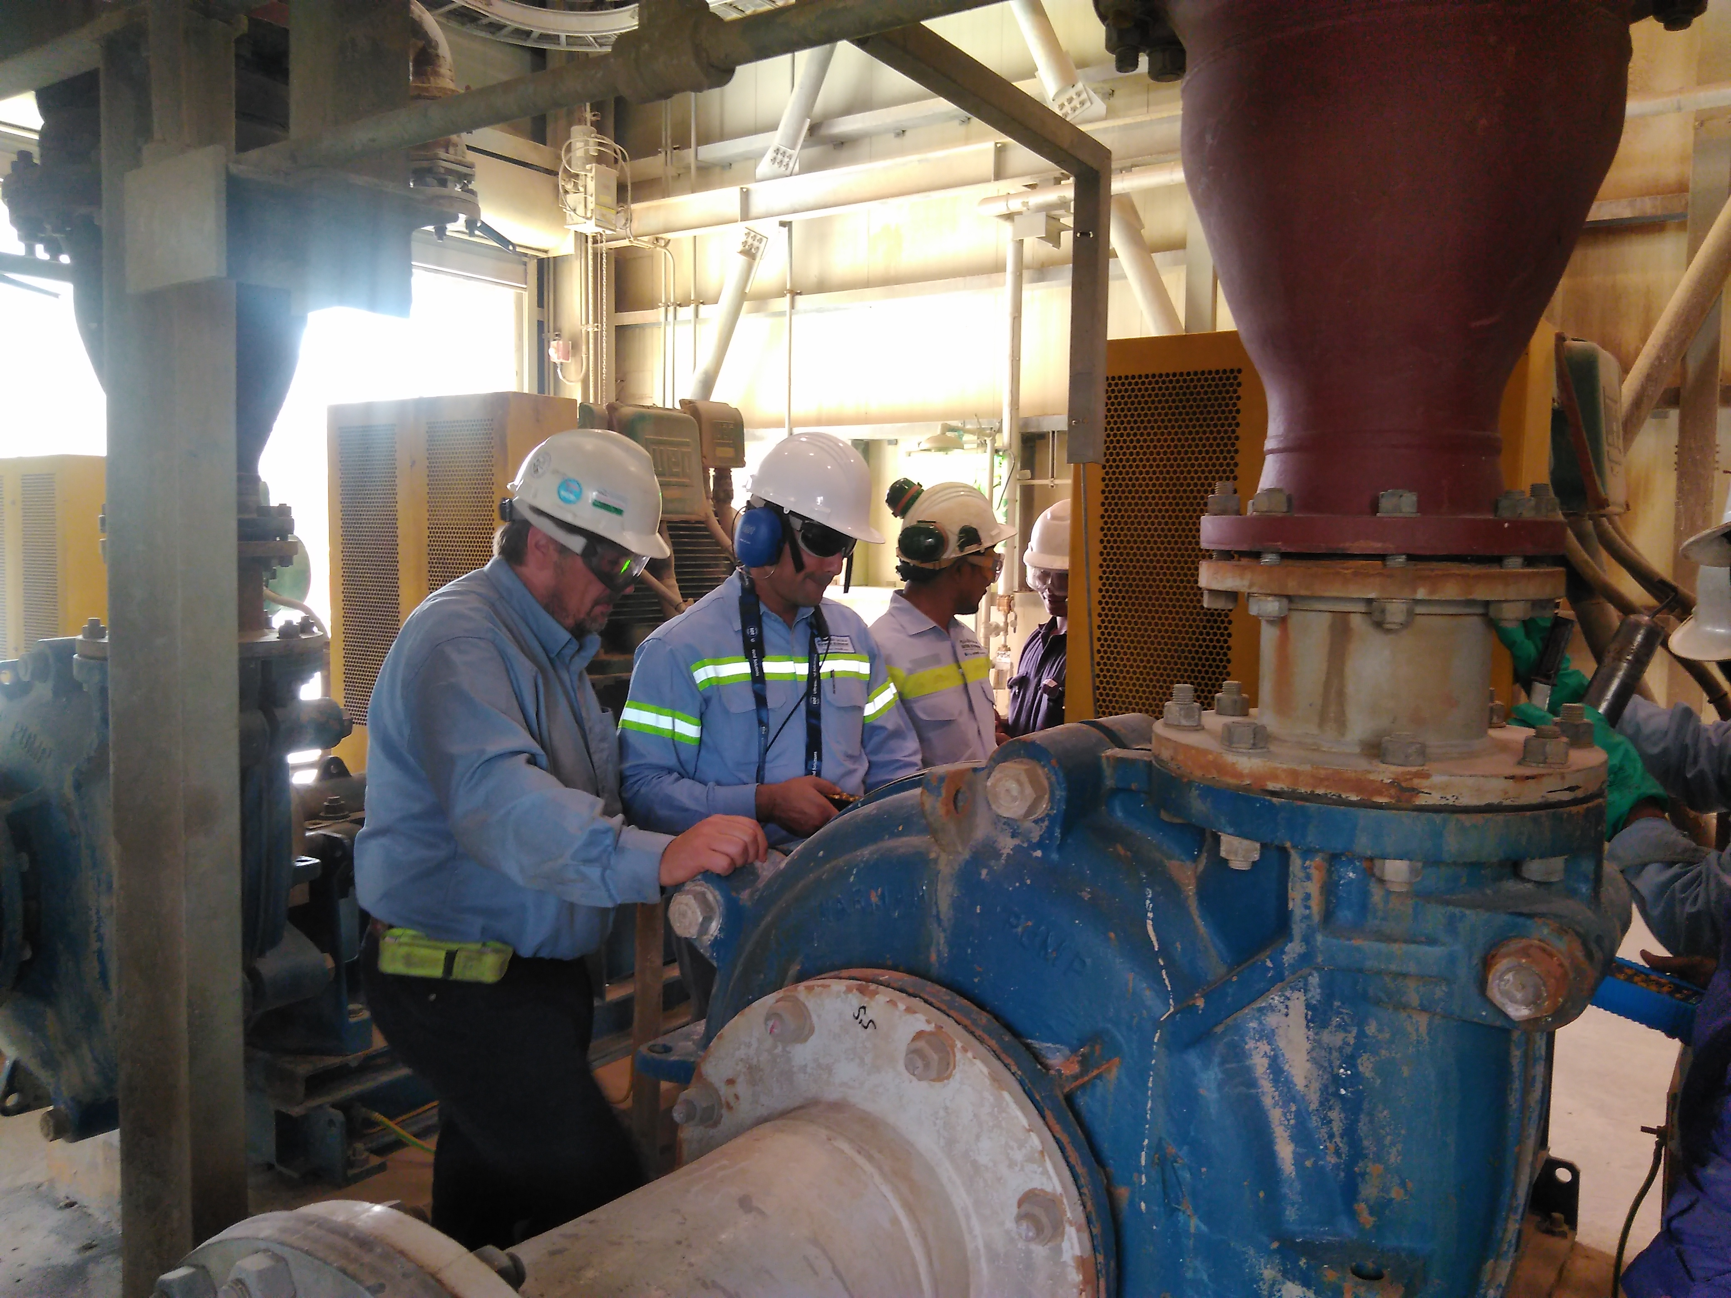
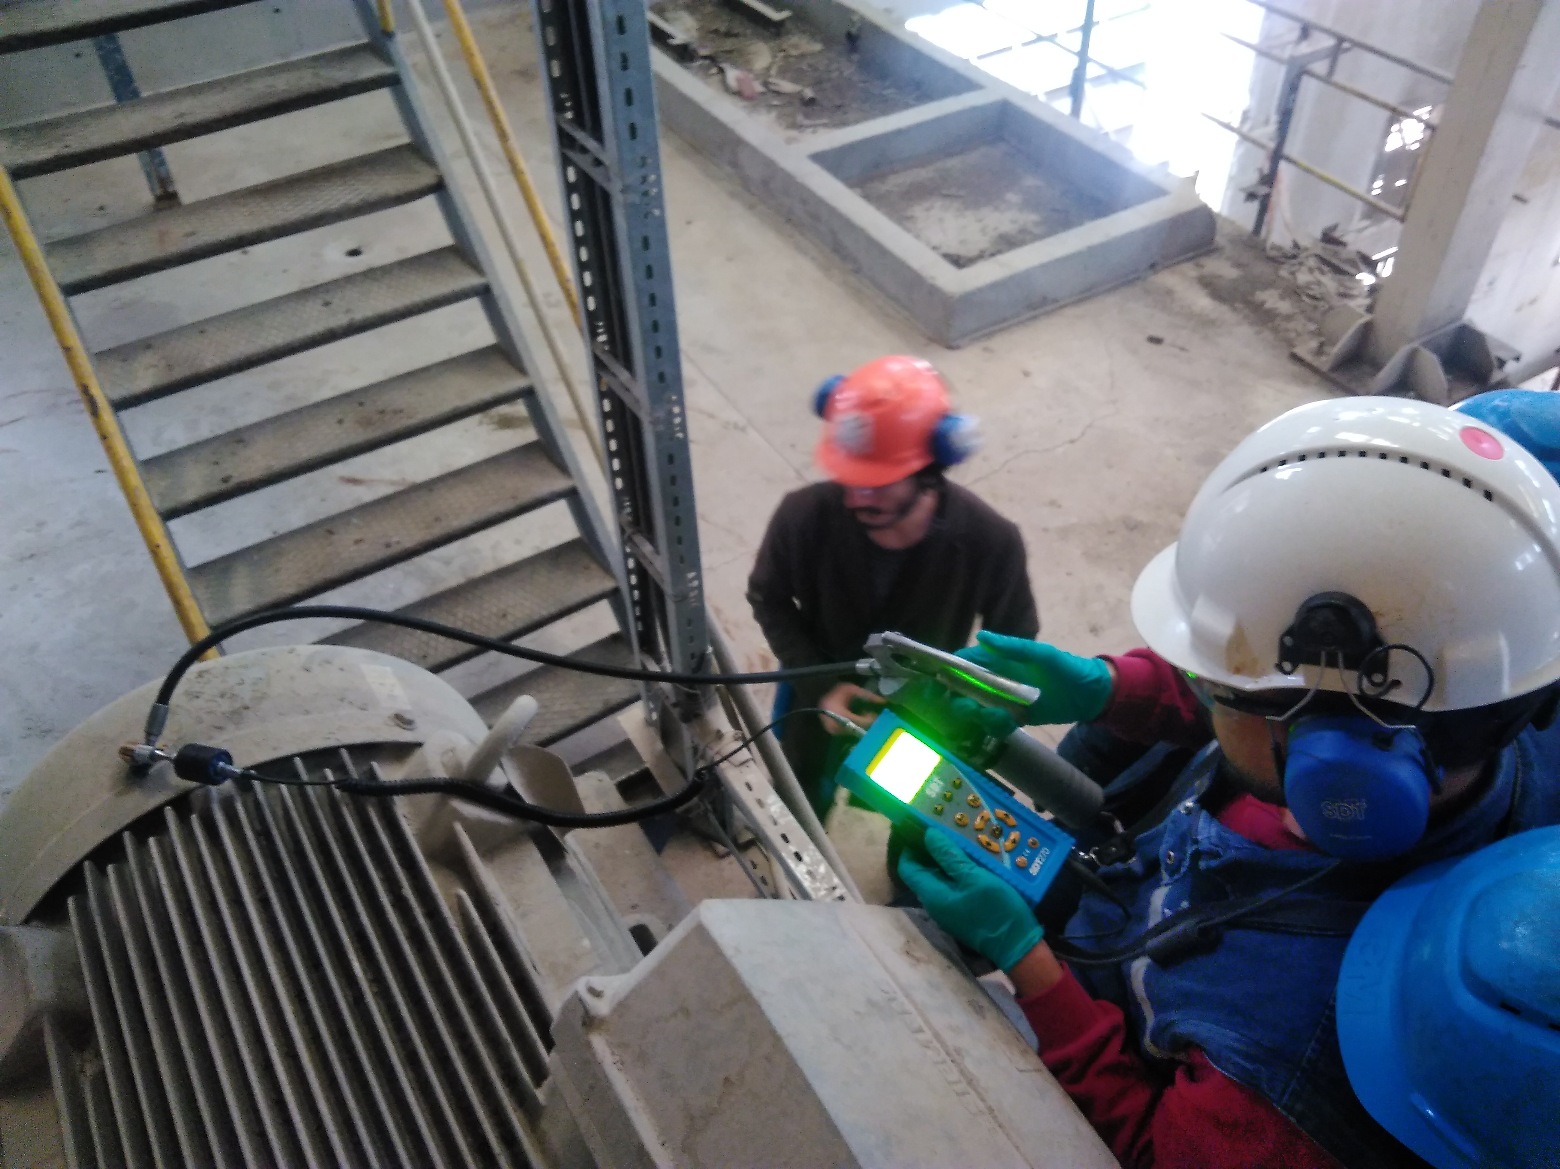
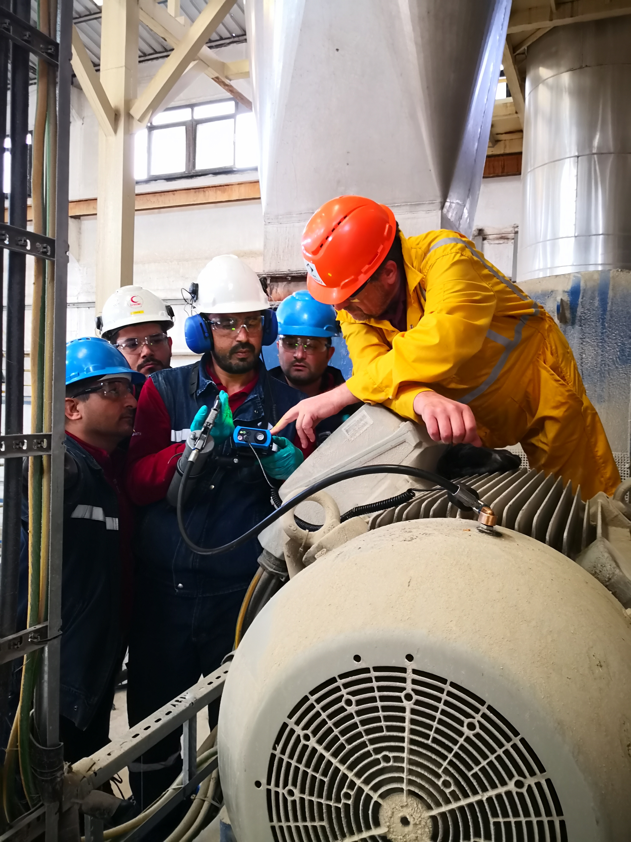
On-site implementation process trainings
Practical operation & strategy trainings
Support & Guidance

Slide 21
https://sdt.training/
World’s leading on-line Ultrasound training program

Slide 22
We make things happen
Notes:
Customized apps for various tasks

