Slide 1
SDT Ultrasound Solutions
Overview

Slide 2
AGENDA
Company
Applications
Solutions

Slide 3
SDT Ultrasound solutions
COMPANY

Slide 4
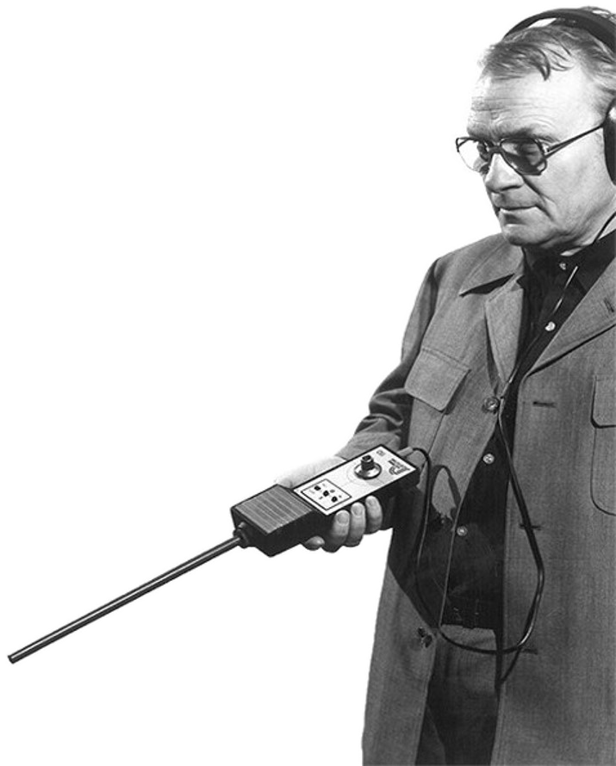
SDT International – Belgian (Brussels) family company created in 1975 by J.H. DEGRAEVE
SDT North America – Ontario Canada
SDT India
SDT Italia Milan

Slide 5
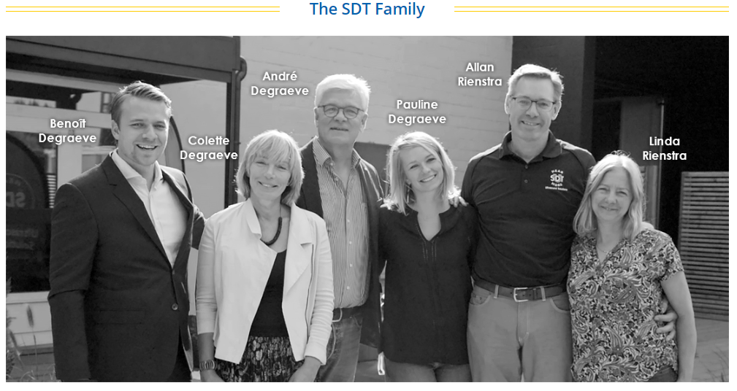
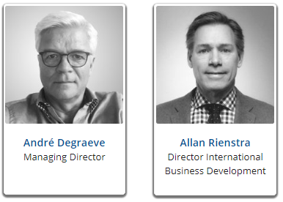

Slide 6
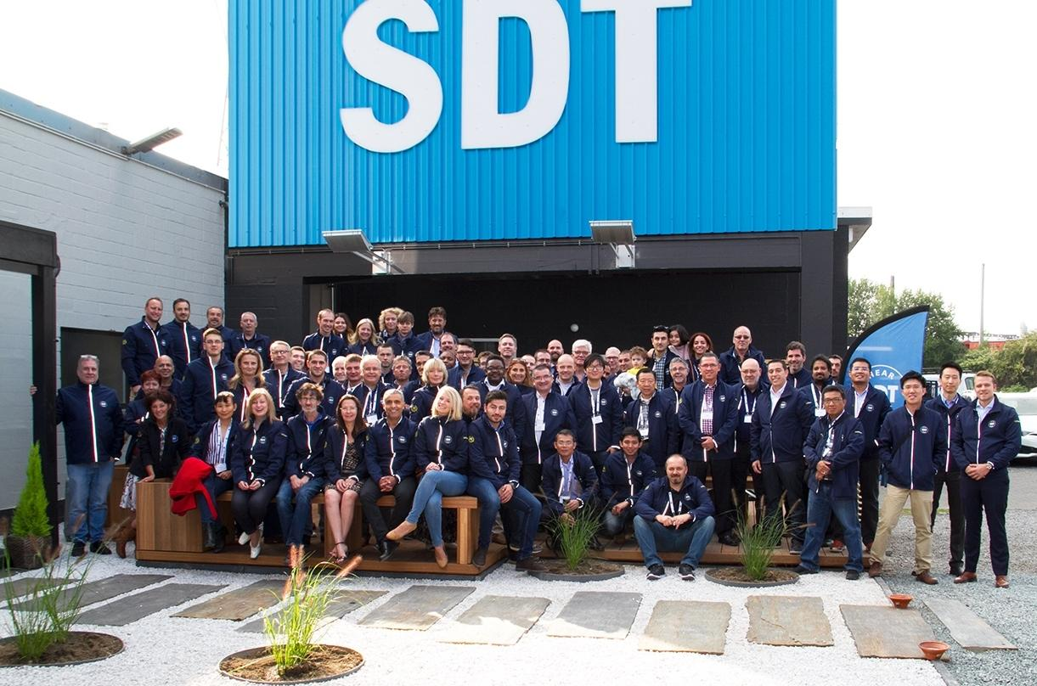
Active in 64 countries with 300 local partners

Slide 7
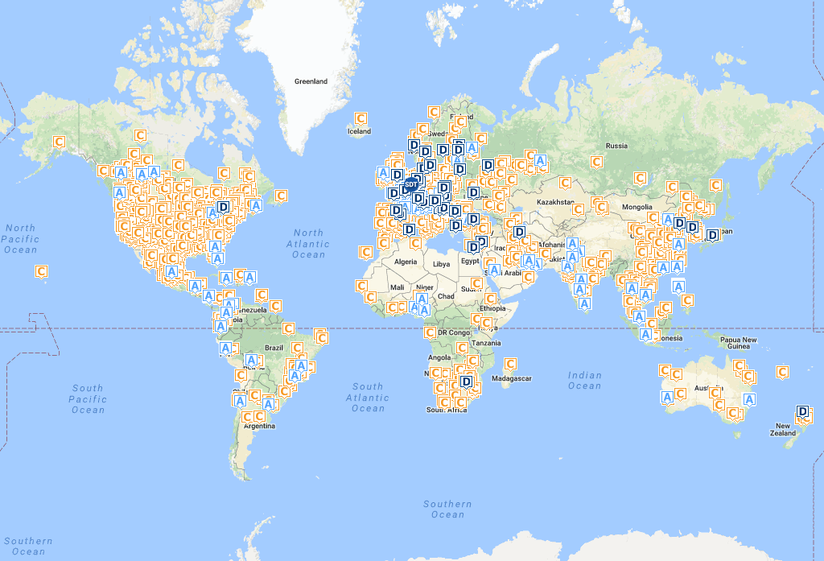
A= agent D=dealer C=client
Notes:
C = client
A = agent
D = dealer
Forte implantation en EU et en Amerique

Slide 8
”
SDT Ultrasound Solutions Mission
SDT provides ultrasound solutions that help our customers gain a better understanding about the health of their factory. We help them predict failures, control energy costs, and improve product quality while contributing to the overall reliability of their assets.
”

Slide 10
Notes:
Nos références sont riches et variées grâce à la polyvalence qu’offre les ultrasons.
Grâce à cette polyvalence, nous pouvons désormais prétendre pouvoir entrer dans n’importe quelle industrie.

Slide 11
SDT Ultrasound solutions
Applications

Slide 14
We detect, measure and analyze ultrasound caused by
Partial discharges

Slide 15
Pillars
Friction
Bearings
Lubrification

Slide 16
Pillars
Impacts
Bearings
Gearings
Pump cavitation

Slide 17
Pillars
Tubulences
Leaks
Stram traps
Valves

Slide 18
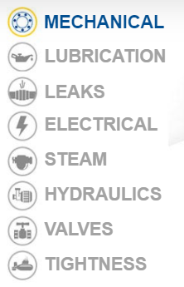
FIT: 8 PILLARS

Slide 19
FIT: 8 PILLARS

Slide 20
SDT Ultrasound solutions
Solutions

Slide 21
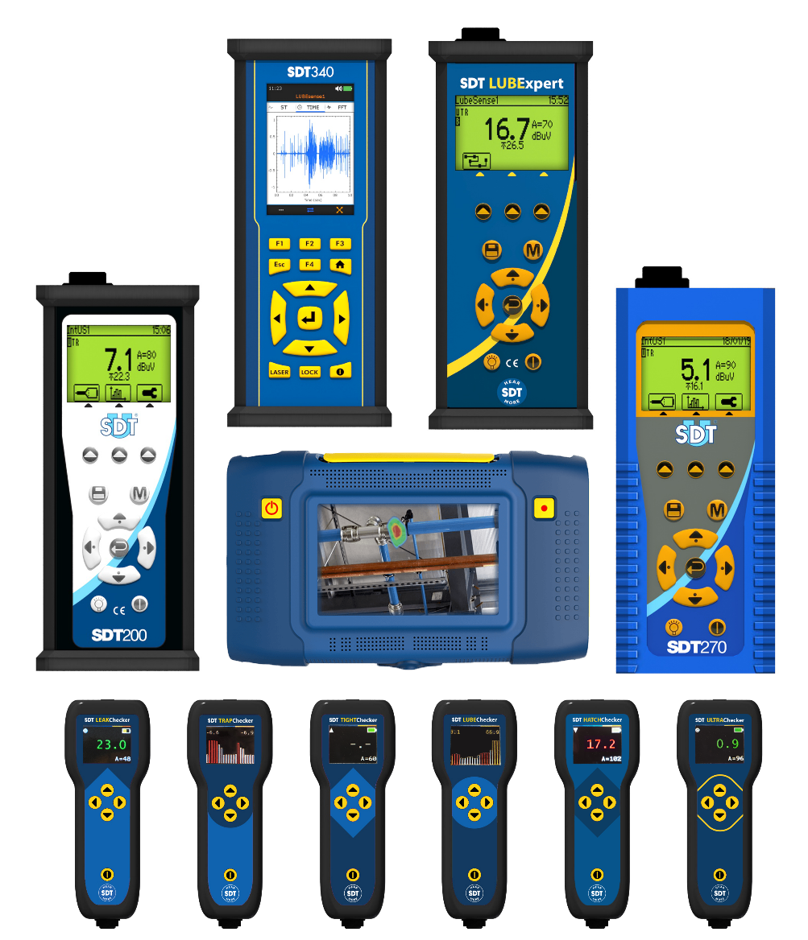
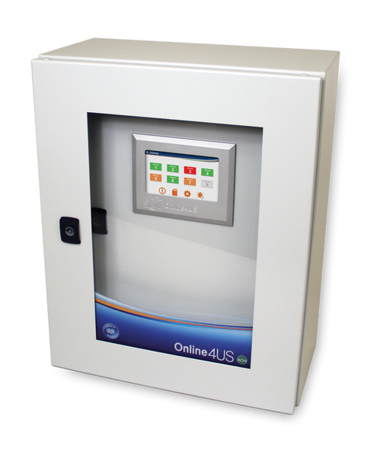
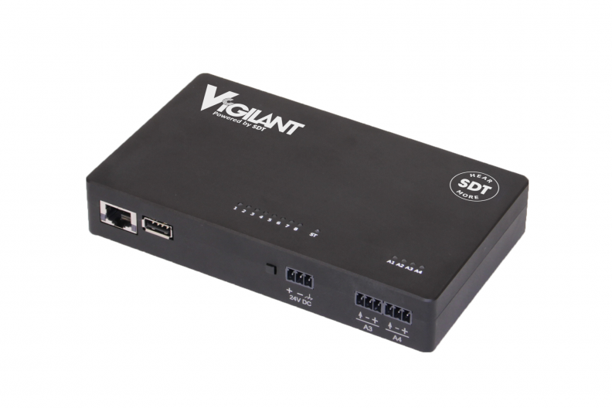
Portable data collectors
Online monitoring

Slide 22
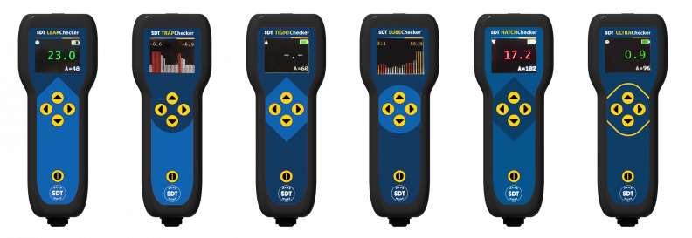

Slide 23
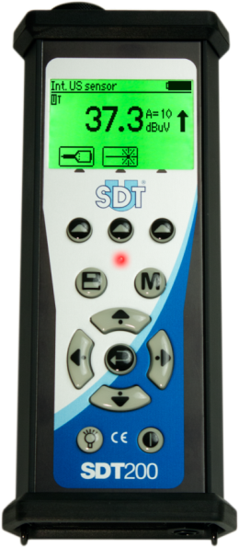
SDT200
AFFORDABLE
RELIABLE
FLEXIBLE
Device developed and designed for energy saving applications (leaks and steam traps) "detect & repair"
II 1 G Ex ia IIC T3/T2 Ga, conform to IEC 60079-0, 60079-11 and 60079-26

Slide 24
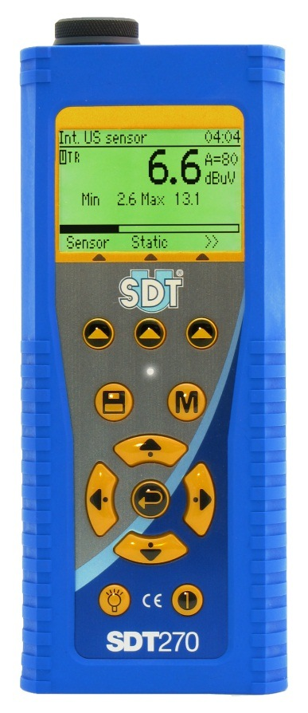
SDT270
AFFORDABLE
RELIABLE
FLEXIBLE
Device developed and designed for predictive maintenance application such as mechanical & electrical inspection

Slide 25
LUBExpert
Grease bearings right
Device developed and designed for proactive and predictive maintenance application : greasing optimisation.

Slide 26
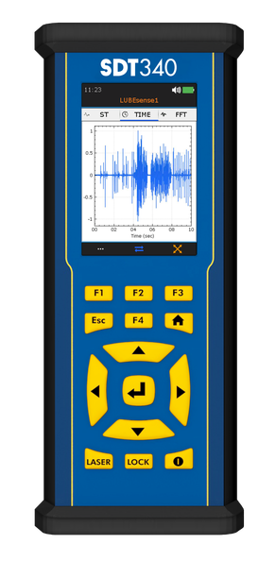
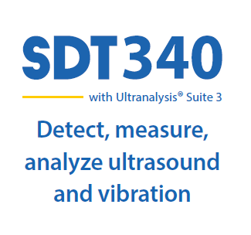
A condition monitoring solution providing the first line of defence for asset reliability

Slide 27
Software
SDT340
LUBExpert
SDT270DUTR

Slide 29
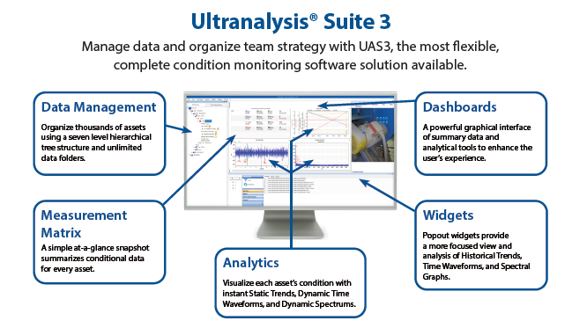

Slide 30
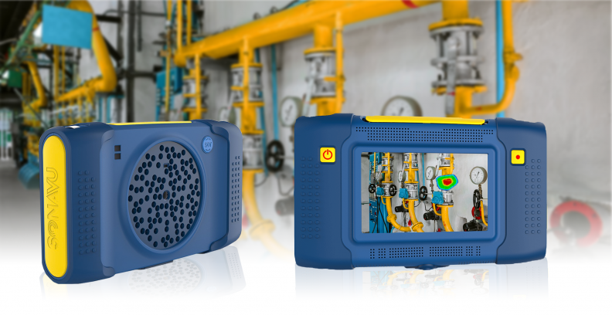
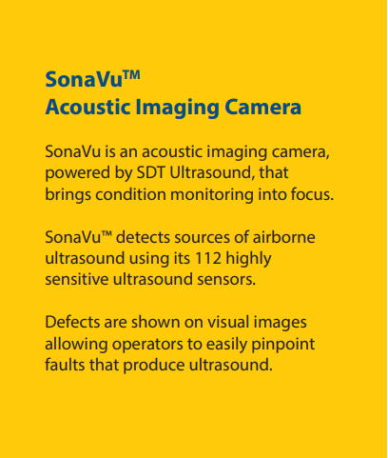

Slide 31
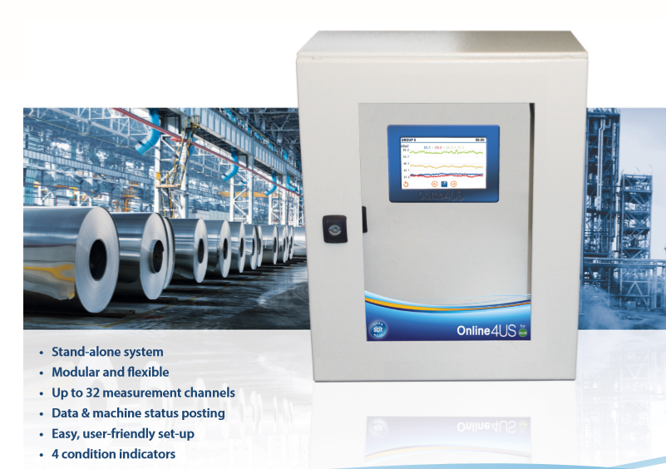

Slide 32
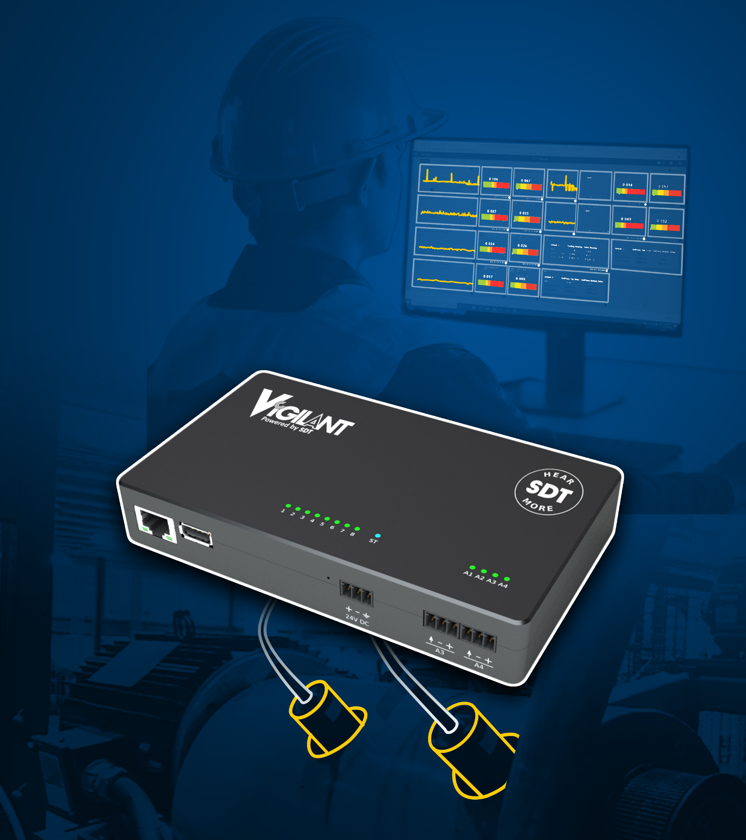
SELF-CONTAINED
CUSTOMIZABLE
AFFORDABLE
Solution that combines the versatility of ultrasound with the analytics of vibration analysis

Slide 33
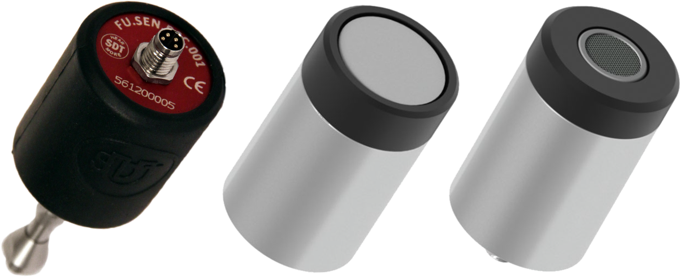
CONMONSense
Specifications

Slide 34
Trainings

