Slide 1
Low speed bearing

Slide 2
Content
Theory of ultrasound
Application of the rotating machines
Case studies dedicated for bearings
Case studies dedicated for gears

Slide 3
Theory of ultrasound

Slide 4
Frequency range of sound
Infrasound < 20 Hz.
Sound : between 20 Hz up to 20 kHz.
Ultrasound = > 20 kHz.
Infrasound
sound
Ultrasound
Sound frequencies
20 Hz
16 KHz/20 KHz

Slide 5
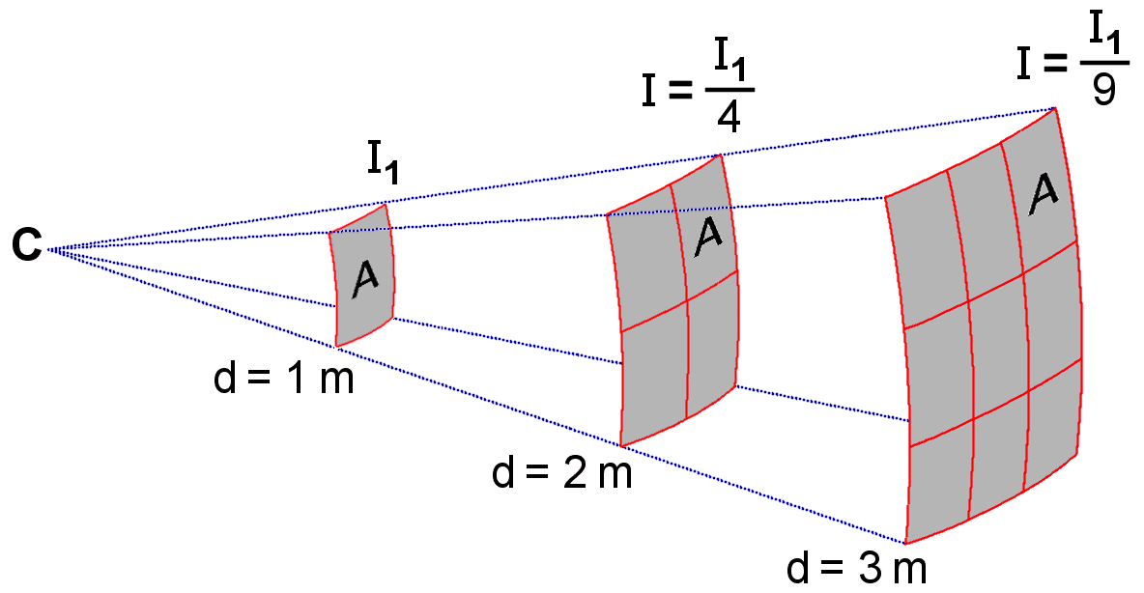
Caracteristic of ultrasound
Ultrasound :
low energy
geometric dispersion
attenuation frequency/distance
Faster absorbed.

Slide 6
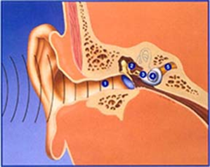
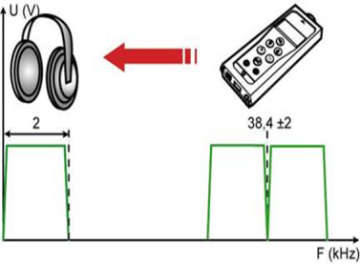
Origins of ultrasound
Sound
Mechanical wave
Propagate through gas, liquids and solids
Fréquency upper at 20 kHz
Zones de compression
Zones de raréfaction

Slide 7
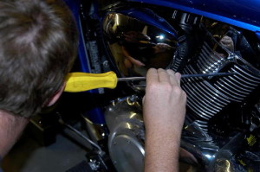
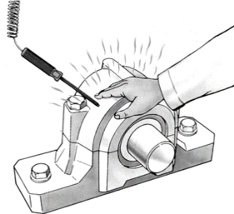
Ultrasound
Oldest method ?
The first line of defense.
Example: An operator will distinguish easily a bearing that is in good condition and the bad one.
Allows to understand the result of the measurement.
Bearing BAD
Bearing OK

Slide 8
Ultrasound

Slide 9
Applications of rotating machines

Slide 10
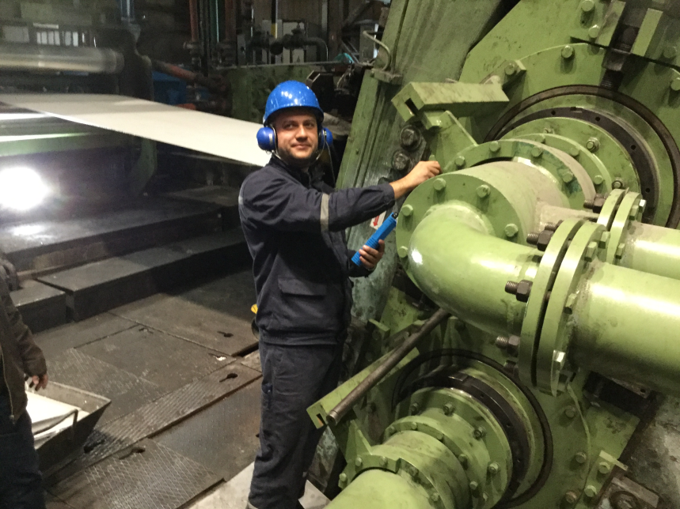
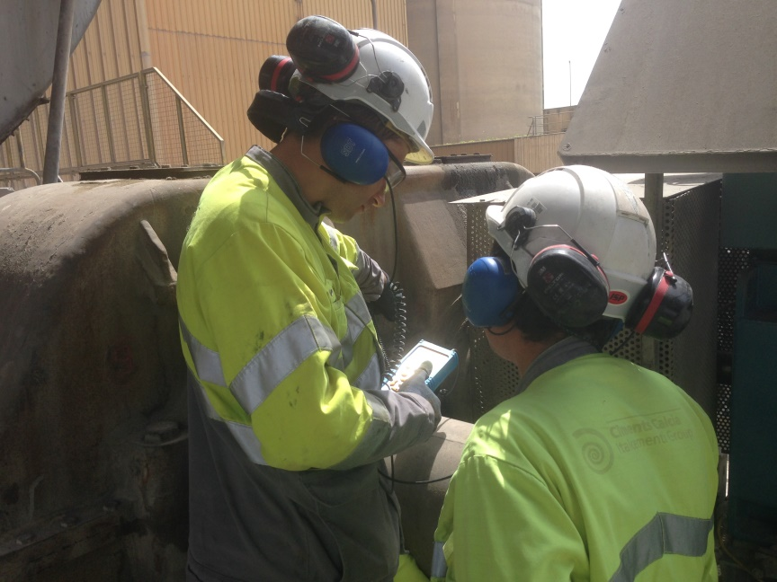
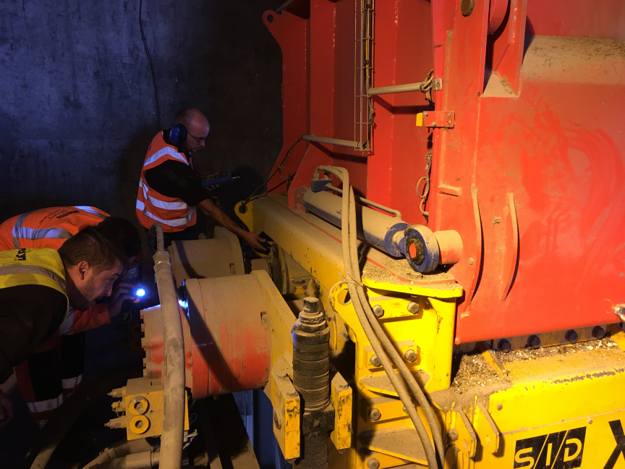
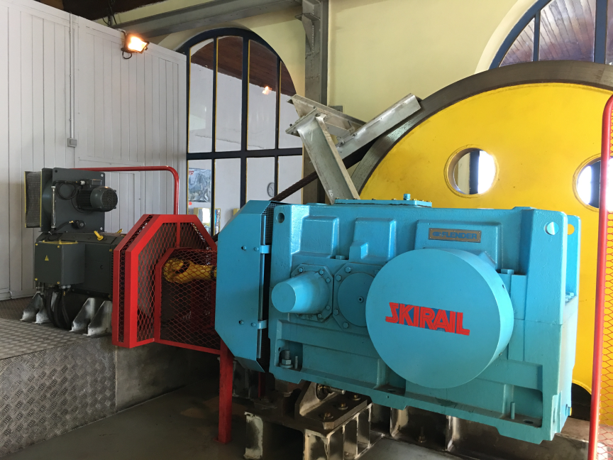
Applications of rotating machines
ALUMINIUM PLANT - COLD MILL – Roller bearing 2 RPM
CEMENT PLANT – GEAR BOXE – Output shaft 10 RPM
INCINERATION PLANT - WASTE CRUSHER – Bearing 13 RPM
FUNICULAR RAILWAY – GEAR BOXE – Output shaft 22 RPM

Slide 11
Case stories

Slide 12
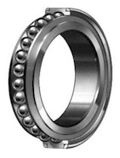
Bearings
1st step:
Listening: simple, intuitive and quick
2nd step:
Recording of the static measurement
→ confirms listening
3rd step:
Recording of the dynamic measurement
→ confirms listening and static measurement

Slide 13
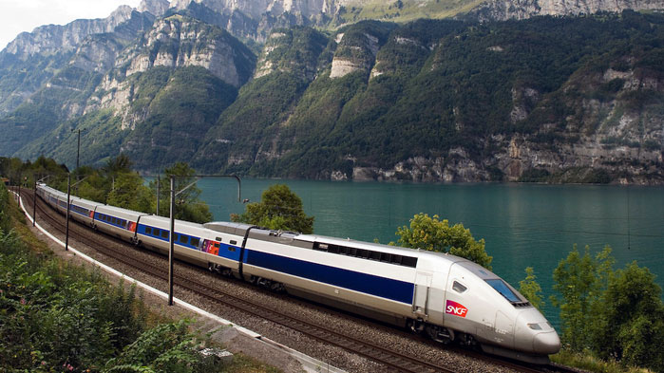
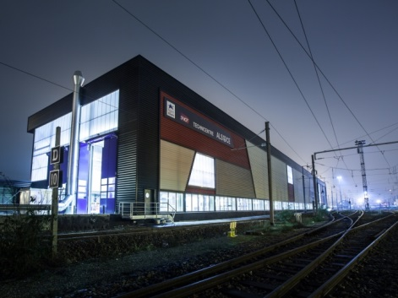
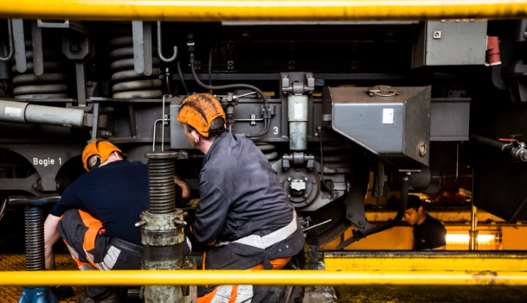
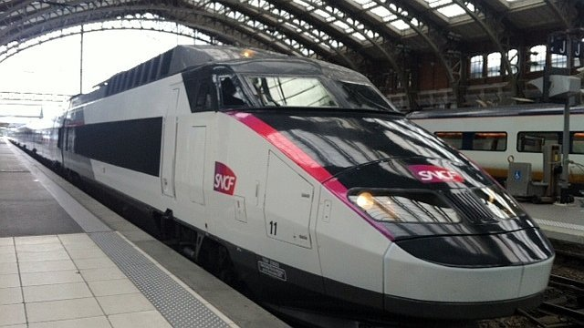
Case story: Train
Object
The tests were performed on an axle test bench. Final customer SNCF
The tests were performed at a rotation speed of the axle 25 - 30 and 60 RPM.
For each speed, the measurements were performed axle loaded and unloaded.
The objective of the tests was to detect the defective bearing among the different hubs of the axle

Slide 14
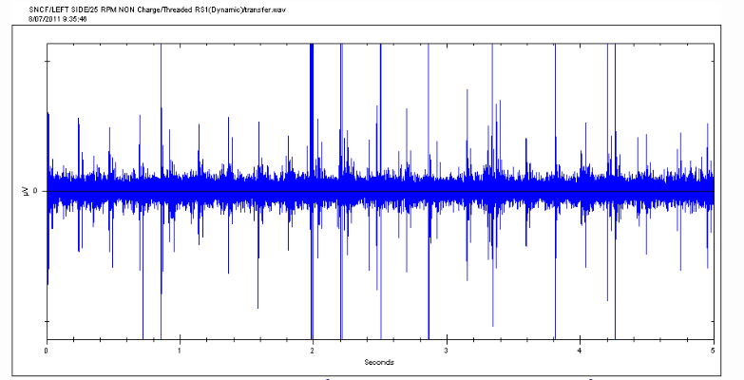
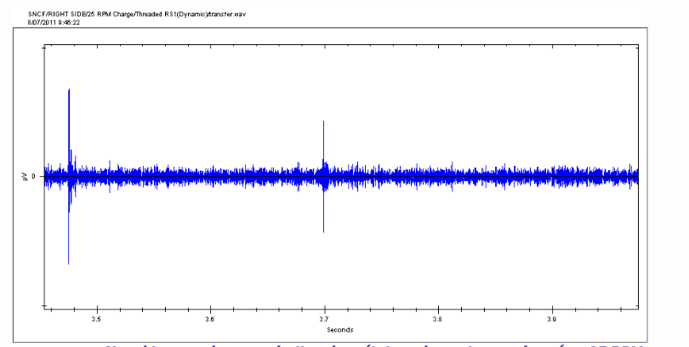
Case story: Train
Ultrasound measurement: static and dynamic
Left defective ball bearing – Periodical shock
ULTRASOUND BEARING CONDITION
dB µV RMS value
6.5
axle supported by its four bearings (X mounting)
ULTRASOUND BEARING CONDITION
dB µV RMS value
-0,6
Right ball bearing – Good condition

Slide 15
Case story: Train
Conclusion
The signal acquisition and fast analysis confirmed that the defect between the two hubs corresponded to the expected spalling default .
In common use, the overall measurement is a sufficient parameter to detect a possible failure of one or more bearings.
The result is immediate. Its implementation is simple (an overall measurements of the bearings, without prior programming of the device).
The operator may also confirmed his judgment by listening to the audio signal

Slide 16
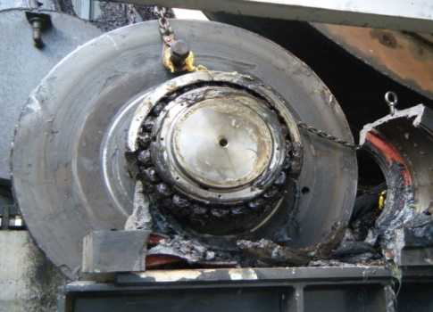
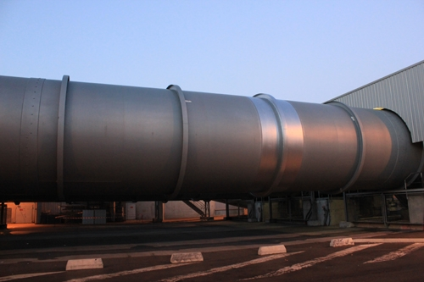
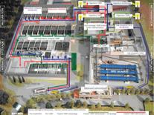
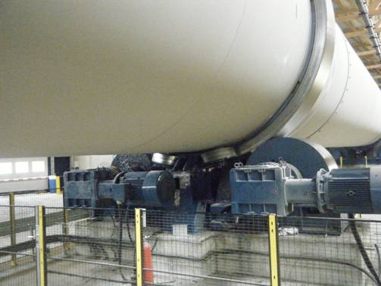
Case story: Methanation oven
Object
The measurements were performed on the methanation ovens. THYSSENKRUPP has in charge the maintenance of those ovens (Montpellier).
The tests were carried out on the spherical roller bearings on the oven 1 and the oven 3 and to know the status of each spherical roller bearing due to damage occurred on the spherical roller bearing of the oven 2.
Rotation speed of the oven around 1 RPM.

Slide 17
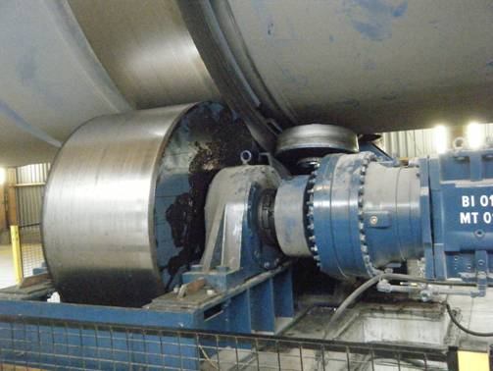
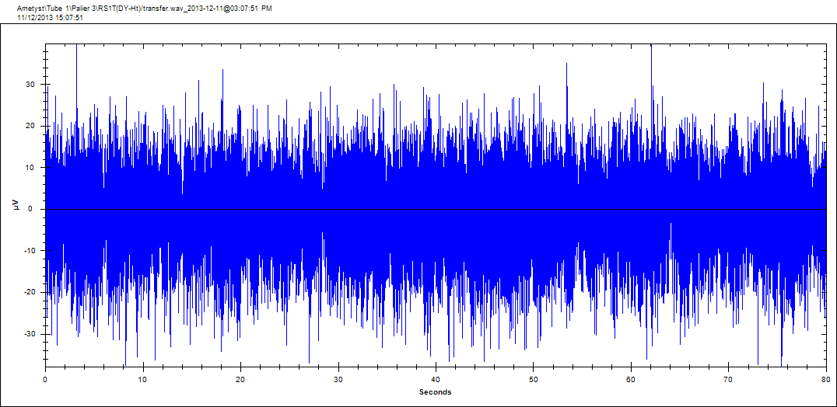
Case story: Methanation oven
Example: oven bearing 4 RPM
 | dB µV (RMS) | dB µV (Peak)
Bearing 1 | - 9,6 | 11,2
Bearing 2 | -9,7 | 15,8
Bearing 3 | 12,8 | 32,1
Bearing 4 | 14,2 | 32
Bearing 5 | -9,9 | 21,7
Bearing 6 | -10 | 7,5
Bearing 7 | -10,3 | 13
Bearing 8 | -6,8 | 30,5

Slide 18
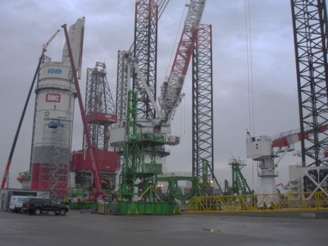
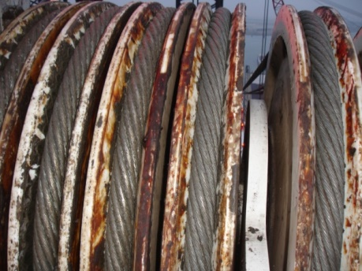
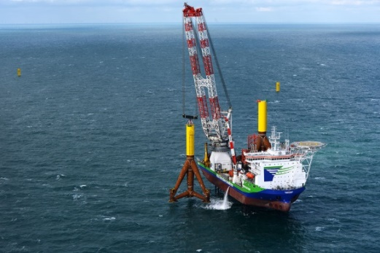
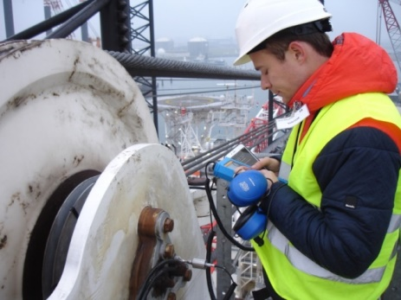
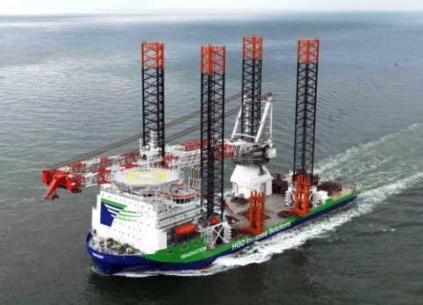
Case story: Crane
Object
The measurements were performed on the crane. Final customer GEOSEA.
Luffing wire sheave banks PS & SB (inner and outer sheave bank – 4 sets in total): bearings producing abnormal audible sound.
SB inner sheave bank suspected of being damaged

Slide 19
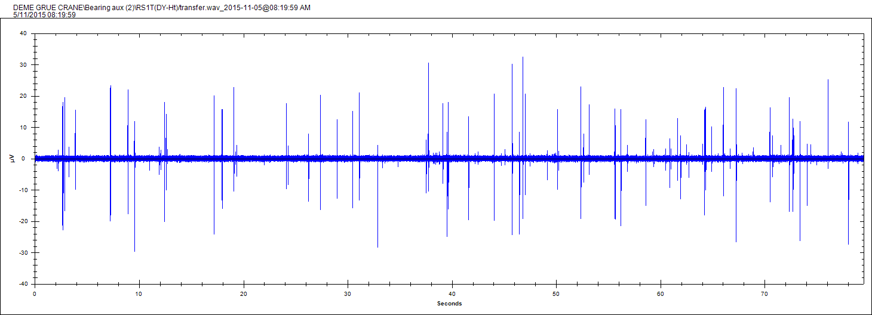
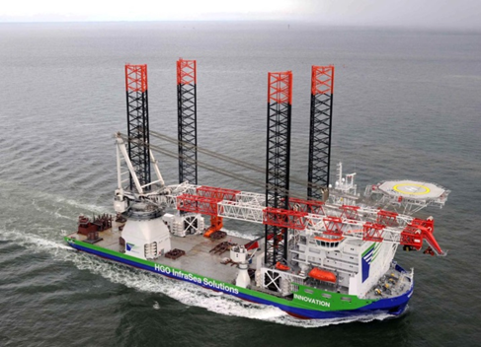
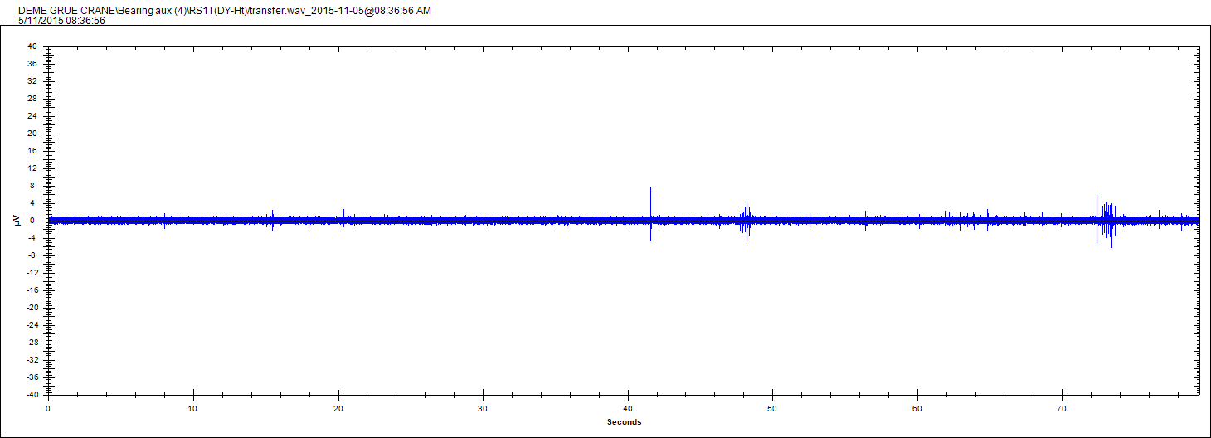
Case story: Crane
Example: bearing 1 to 6 RPM

Slide 20
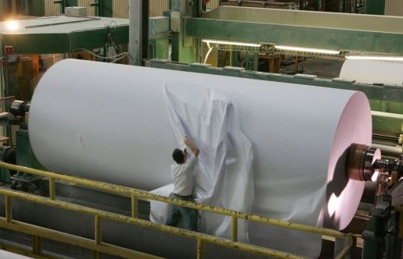
Case story: Paper mill
Object
The measurements were performed on the washing machine. Final customer INTERNATIONAL PAPER (Saillat).
The tests were carried out on the Washing machine (6 RPM).
Effectiveness of ultrasonic measurement at slow speeds with a hydraulic motor drive.

Slide 21
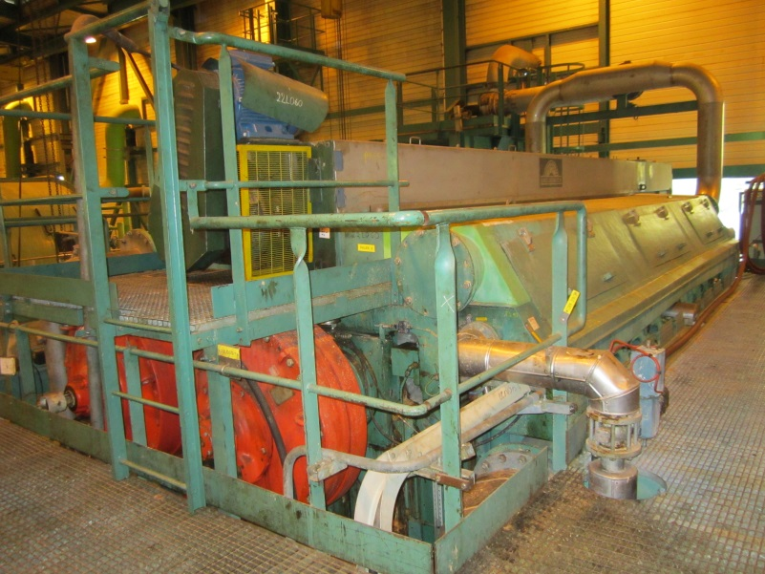
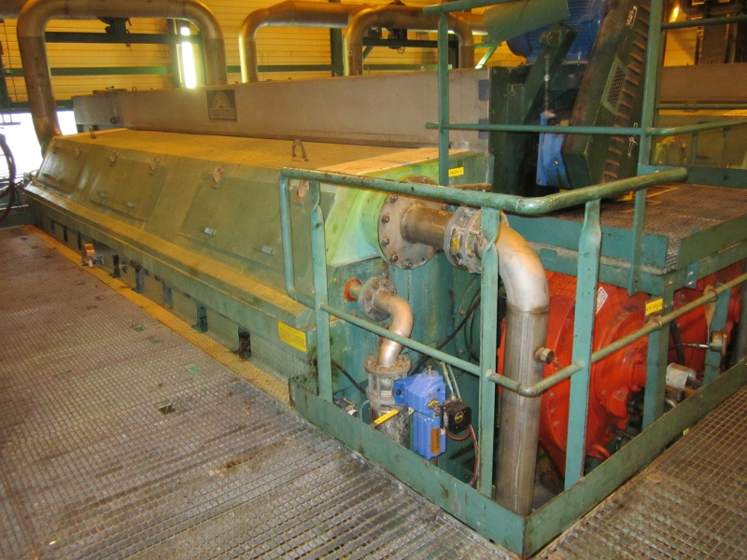
Case story: Paper mill
L22-050 | dB µV (RMS) | dB µV (Peak)
Bearing 1 | -2,4 | 23
Bearing 2 | 4 | 31,3
Bearing 3 | 18,1 | 42,6
Bearing 4 | 18,9 | 42,6
L22-060 | dB µV (RMS) | dB µV (Peak)
Bearing 1 | -7 | 16,8
Bearing 2 | -6,8 | 18,5
Bearing 3 | 17,7 | 43,1
Bearing 4 | 3,6 | 31,2
NDE
Hydraulic Motor
DE
Hydraulic Motor

Slide 22
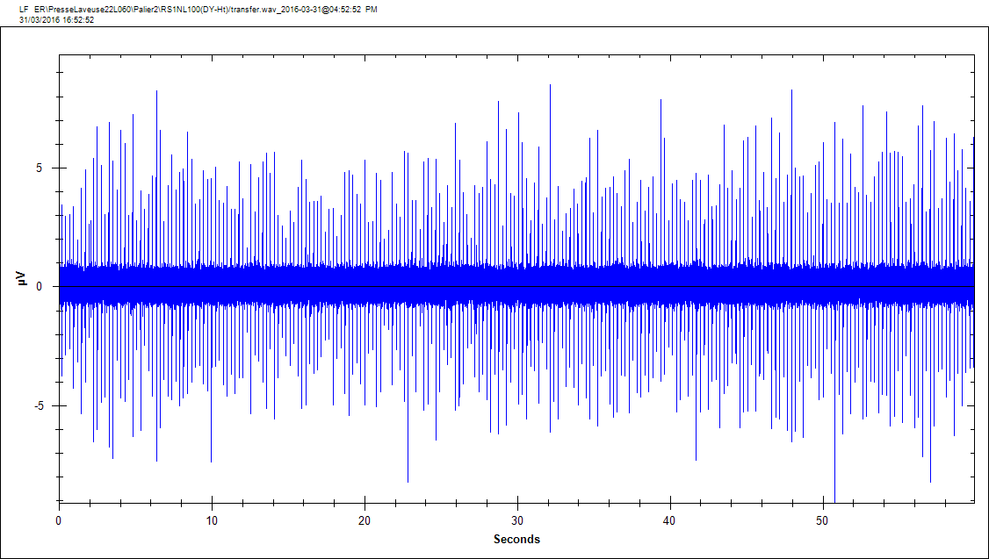
Case story: Paper mill
Bearing 2 - NDE Hydraulic motor – Washing machine 1
Ultrasound dynamic signal of hydraulic motor
Ultrasound dynamic signal of hydraulic motor
Bearing 2 - NDE Hydraulic motor – Washing machine 2

Slide 23
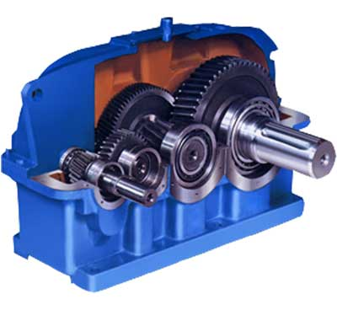
Gears
If ultrasound methodology let the control of the bearing, you can do also the gear control (gear boxes, multiplicator, …)
The dynamic measurements is recommanded on this case to identify the gear problem or bearing failure.

Slide 24
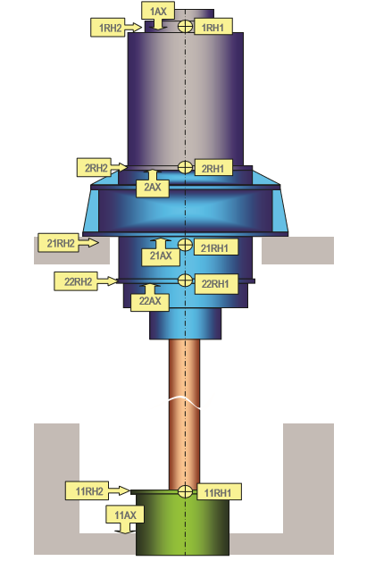
Case story: Nuclear plant
KINEMATICS OF THE PUMP
PLANETARY GEAR BOXE | FREQUENCiES
Axial gear 21 teeth | 68,09 Hz
Solar gear 98 teeth | 4,86 Hz
Outer ring of gear 223 teeth | 6,41 Hz
Output speed 128,4 RPM | 2,14 Hz
Gearmesh frequency | 476,62 Hz
KINEMATICS OF THE PUMP
PUMP | FREQUENCiES
 | 1,03 Hz
Wheel 6 blades | 12,82 Hz

Slide 25
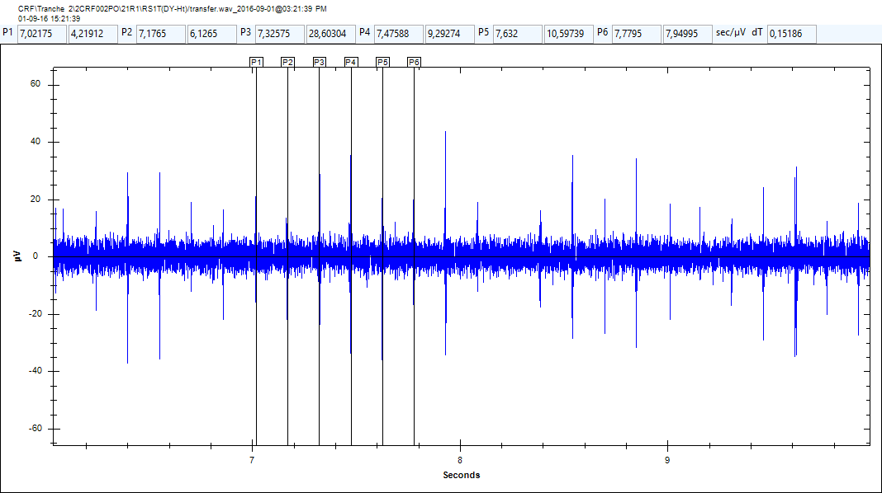
Case story: Nuclear plant
On the housing bearing 21R1 of the reducer, there is a regular shock with an interval of 0.1518 s, ie 6.58 Hz, which corresponds to the frequency of the outer ring of the gear.
This phenomenon could be related to a broken tooth of the outer gear.
It would be recommended to do a video endoscopy of the reducer.
Location 22R1 – Outer ring of the gear frequency

Slide 26
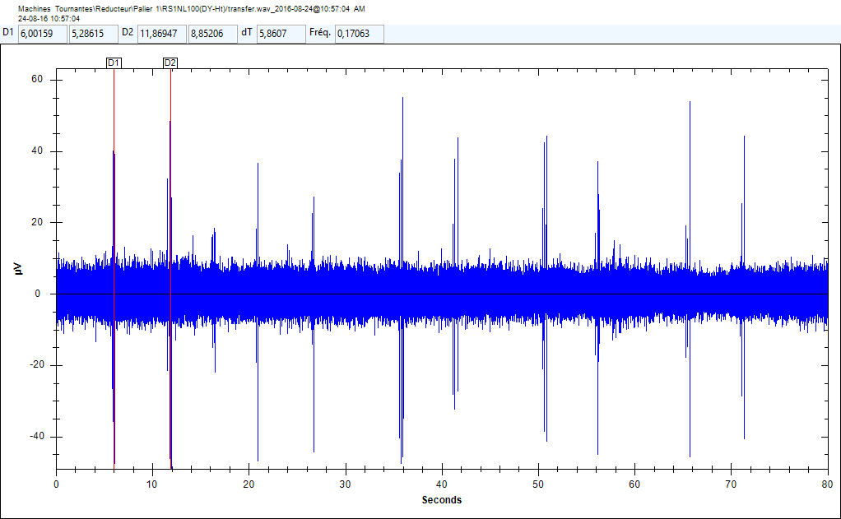
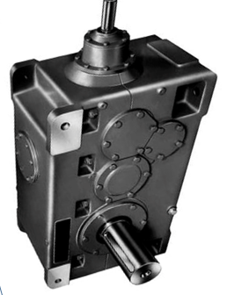
Case story: Chemical plant
ULTRASOUND MEASUREMENTS OUTPUT SHAFT- 4 RPM
dB µV RMS | dB µV Peak Value | GEAR BOXE
7,4 | 34,7 | Right Mixer
1
2
3
4
5
On the output shaft of the reducer there are two shocks at each rotation. Not having the exact frequencies of the kinematics of the reducer it is difficult to make an accurate diagnosis. It would seem that it would be a problem of teeth clearance (excessive or tight). To monitor
An inspection with an endoscope would be recommended.
1
1 revolution of the output shaft of the gear boxe

Slide 27
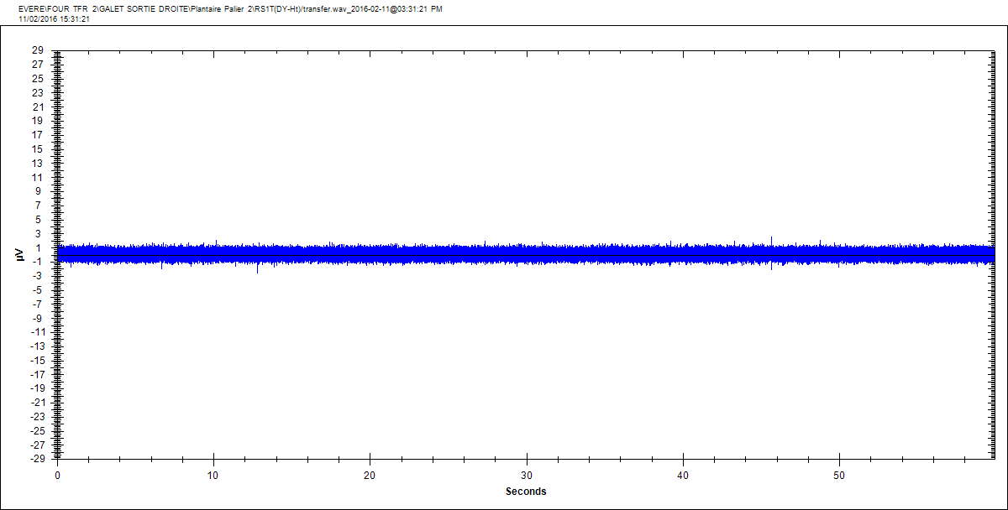
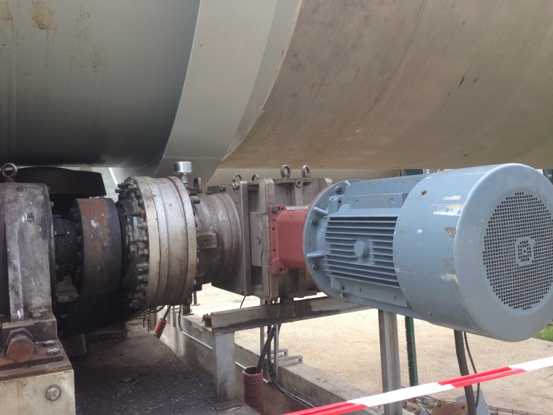
Case story: Incineration plant
Example: planetary gear
BEARING 2 PLANETARY GEAR – INPUT LEFT
Input speed: 11 RPM
Output speed: 2 RPM
BEARING 2 PLANETARY GEAR – OUTPUT RIGHT

