Slide 1

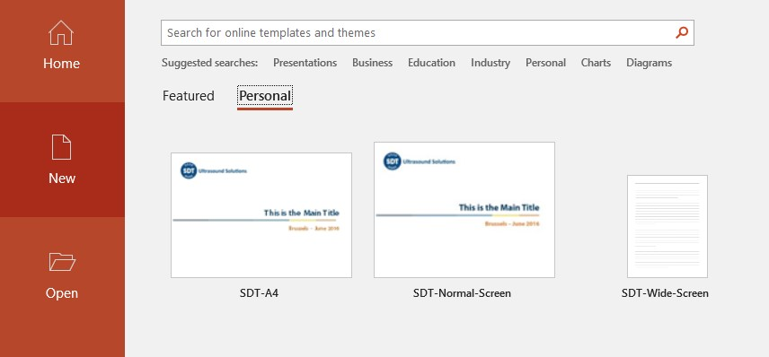
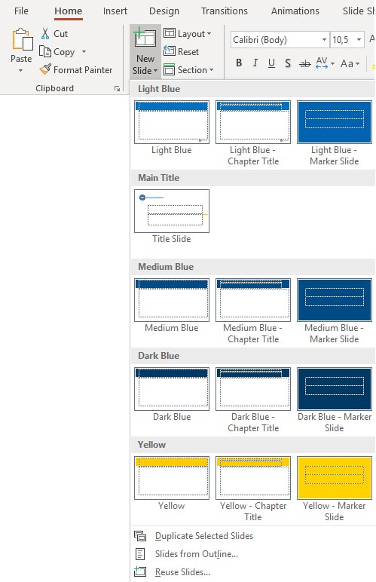






How to…
SDT POWERPOINT TEMPLATE
Create a new SDT presentation
Create a new Slide
Organise your slides
File/New/Personal/SDT-Wide-Screen
Home/New Slide (down arrow)
Choose layout and color :
Main Title Slide
First Chapter Marker Slide
Choose between two headers :
Slides with optional chapter title
If you are outside of SDT network, please save the SDT-Wide-Screen.potx file in this folder :
C:\Users\<Username>\AppData\Roaming\Microsoft\Templates
Introduce a new chapter with a Marker Slide
Use a different
color per chapter
New chapter / New Color
Slides without chapter title

Slide 4
EDIT TITLE
EDIT OPTIONAL CHAPTER TITLE

Slide 5
EDIT TITLE

